Slide 1
Westward Expansion
4-5.3: Explain the purpose, location, and impact of key United States acquisitions in the first half of the nineteenth century, including the Louisiana Purchase, the Florida Purchase, the Oregon Treaty, the annexation of Texas, and the Mexican Cession.
Indicator 4-5.4: Summarize how territorial expansion, related land policies, and specific legislation that affected Native Americans, including the Northwest Ordinance of 1787 and the Indian Removal Act.

Slide 2
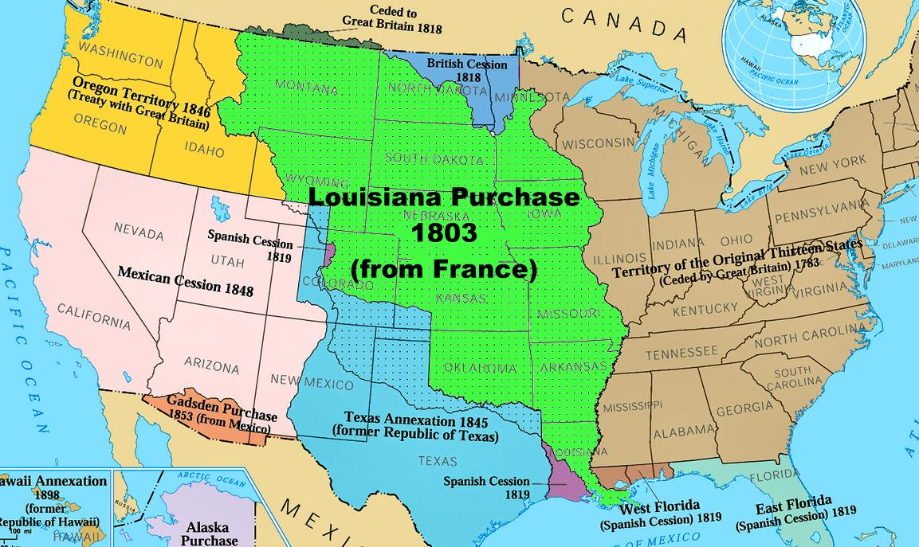
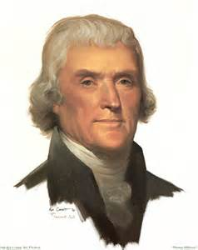
Thomas Jefferson made inquiries about buying land around New Orleans to assist farmers along the Mississippi River who needed to transport their products downriver to the French port of New Orleans and store them before export [called right of deposit].

Slide 3
It was too costly to transport the goods across the Appalachian Mountains so Jefferson’s foreign ministers were authorized to offer France $10 million dollars for the port city that controlled the Mississippi.

Slide 4
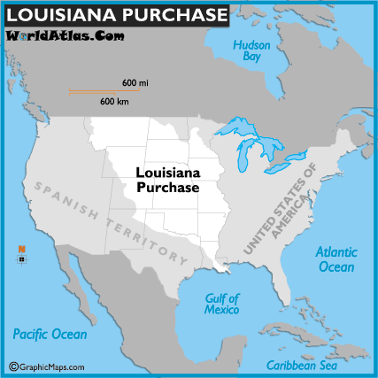
However, before they could make the offer, France surprised Jefferson’s foreign ministers by offering to sell the entire area of Louisiana [Louisiana Purchase-1803] which encompassed the territory west of the Mississippi River to present-day Idaho and north to Canada for $15 million dollars (less than 3 cents per acre!) nearly doubling the size of the US at the time.

Slide 5
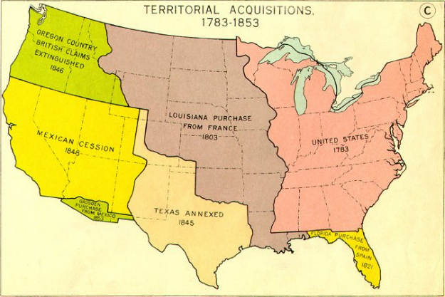

Slide 6
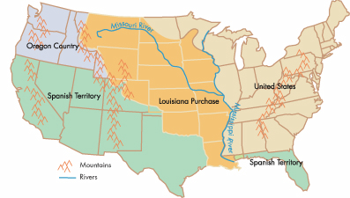

Slide 7
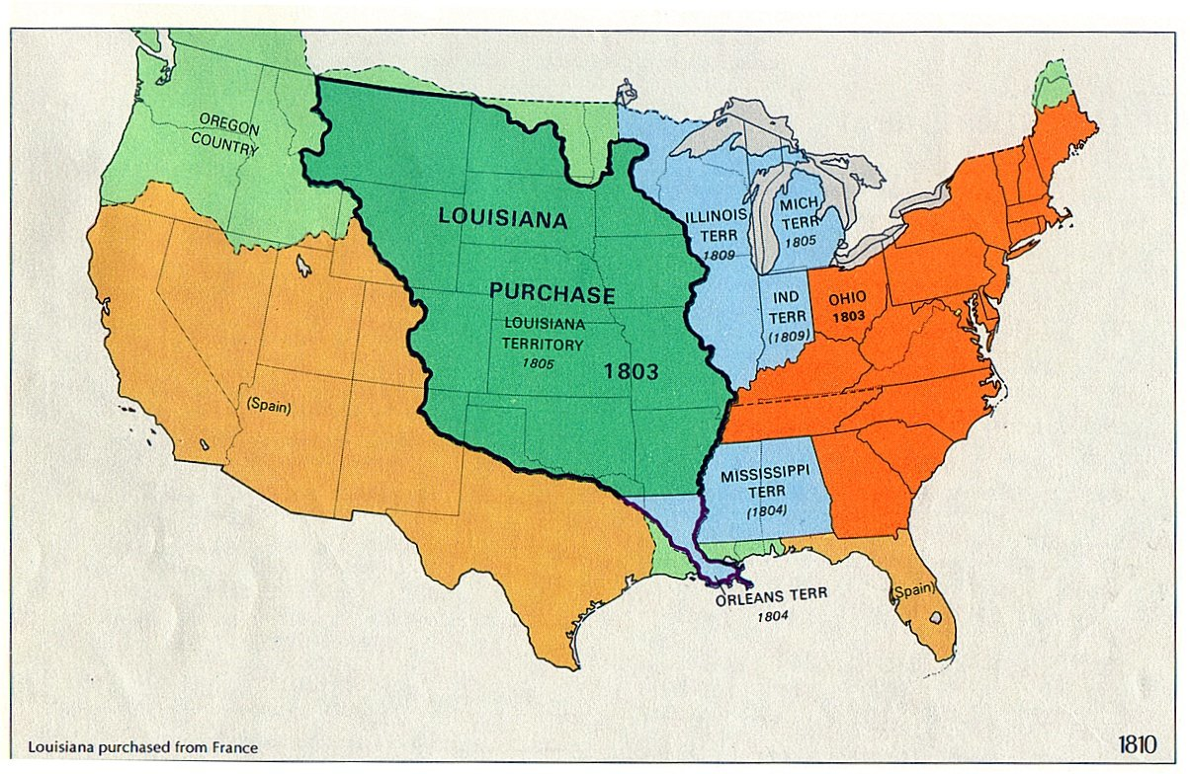
The Florida Purchase [Adams-Onis Treaty] was the result of friction between Spain and the United States over boundary lines of the Louisiana Territory.

Slide 8
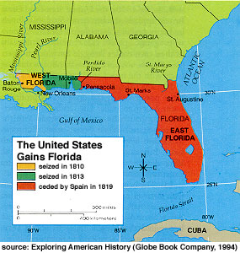
Relations with Native Americans also impacted the United States’ desire for this land.

Slide 9
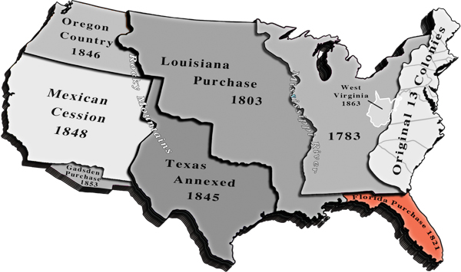
Spain sold Florida to the United States (1819) in exchange for $5 million dollars and a clear southern boundary between the Louisiana Territory and New Spain.

Slide 10
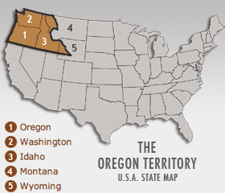
The United States claimed the Oregon Territory based on the explorations of Lewis and Clark (4- 5.1).

Slide 11
Britain also claimed the area, while Spain and Russia had already relinquished their earlier claims.

Slide 12
Initially, Americans in search of economic opportunity in the fur trade moved into the area.

Slide 13
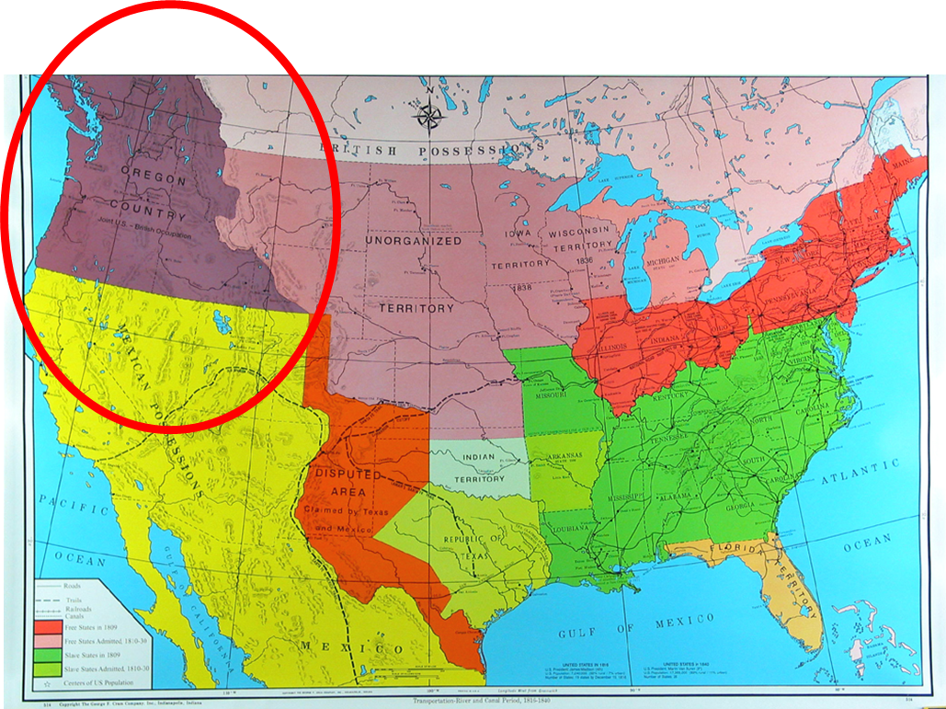
The farmers that followed the fur traders wanted to be part of the United States.

Slide 14
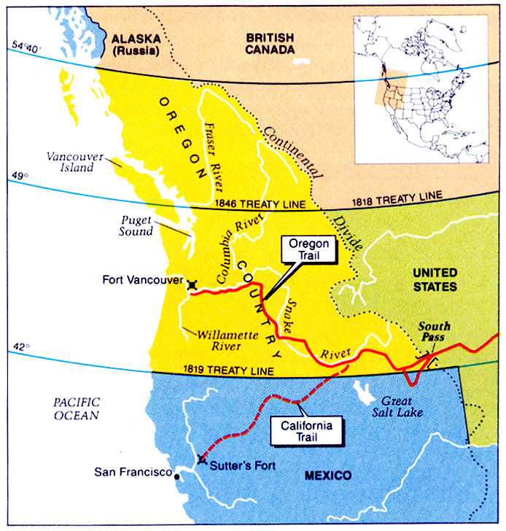
After much negotiation, the Oregon Treaty was a compromise with Great Britain so as not to go to war with two different countries simultaneously (“annexation of Texas” which led to the Mexican War).

Slide 15
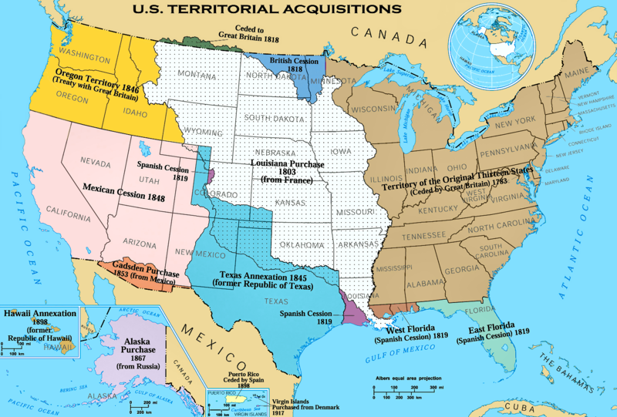
The annexation of Texas came nine years after the Texan War for Independence from Mexico.

Slide 16
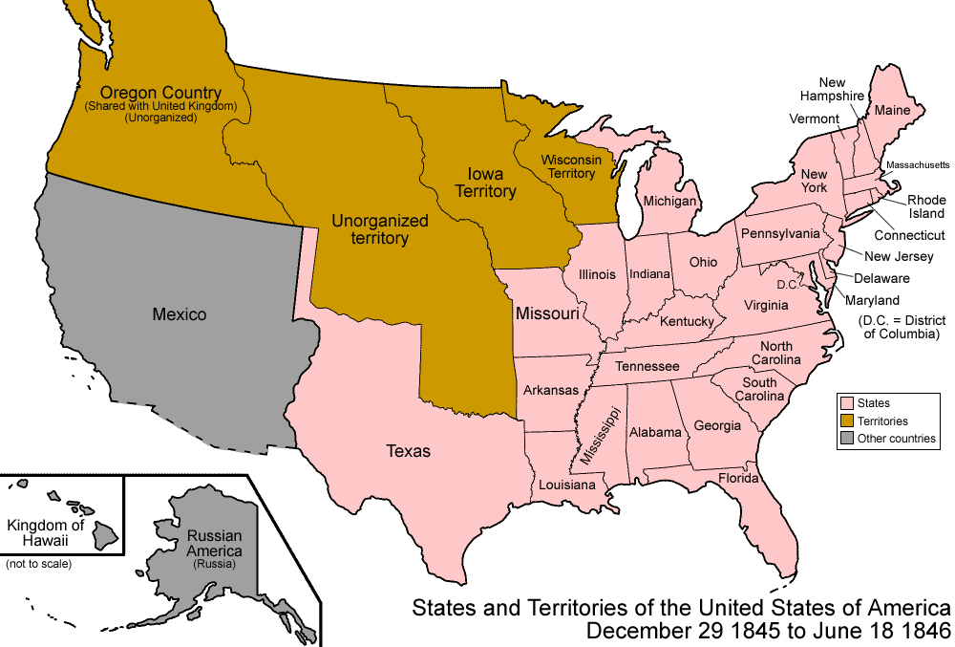
Prior to Texan independence, American southerners had accepted Mexico’s invitations to move into the Texas territory.

Slide 17
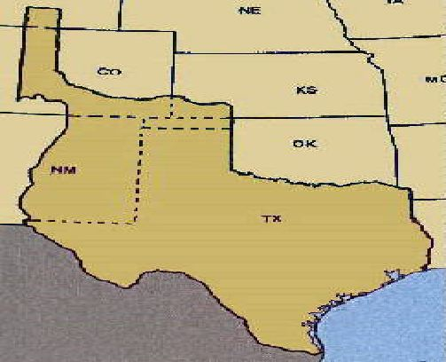
These cotton planters agreed to become Mexican citizens, convert to Catholicism, and to follow Mexican law (with an exemption to allow slavery) in order to have access to more fertile land for cotton.

Slide 18
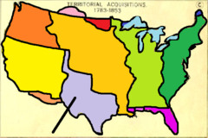
When a new dictatorial Mexican government came into power in Mexico and enforced its control over Texas, including re-outlawing slavery, Texans rebelled and fought a war to win their independence.

Slide 19
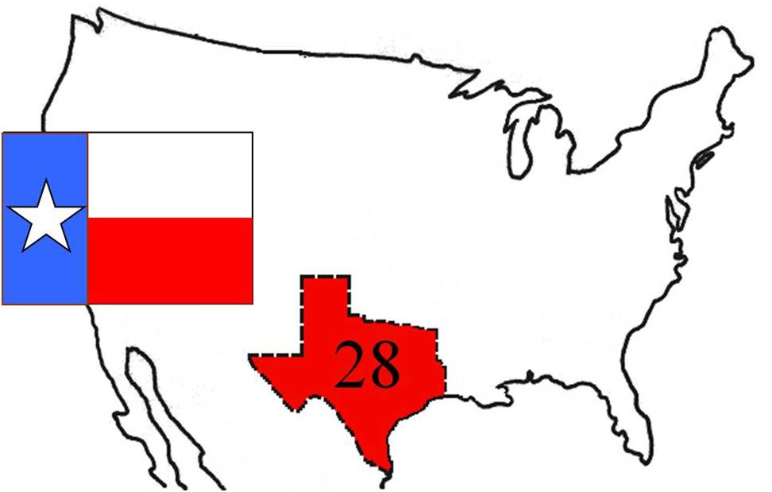
Texans then wanted to become part of the United States.

Slide 20
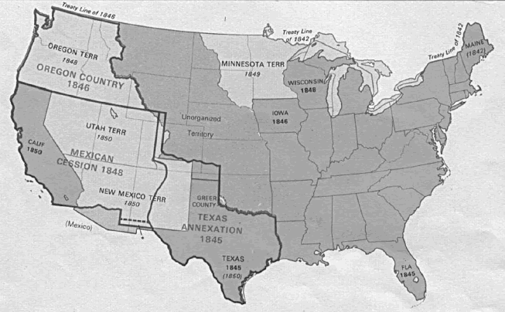
At first, the United States Congress would not annex Texas because it would upset the balance of slave and free states.

Slide 21
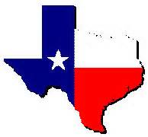
As a result, Texas was an independent country for nine years.

Slide 22
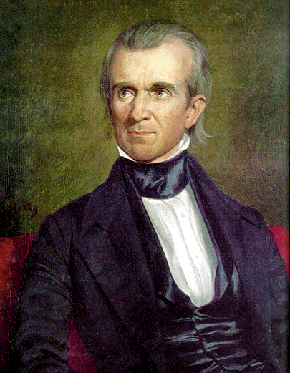
When James K. Polk won the presidency in 1844, running on the platform of Manifest Destiny in both Texas and Oregon, the United States Congress finally annexed Texas.

Slide 23
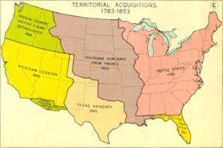
The Mexican Cession was the territory that the United States acquired as a result of winning the Mexican War.

Slide 24
The Mexican War was the result of Manifest Destiny, the desire for Pacific ports, and the annexation of Texas.

Slide 25
The United States wanted a port on the Pacific coast in the Mexican territory of California.

Slide 26
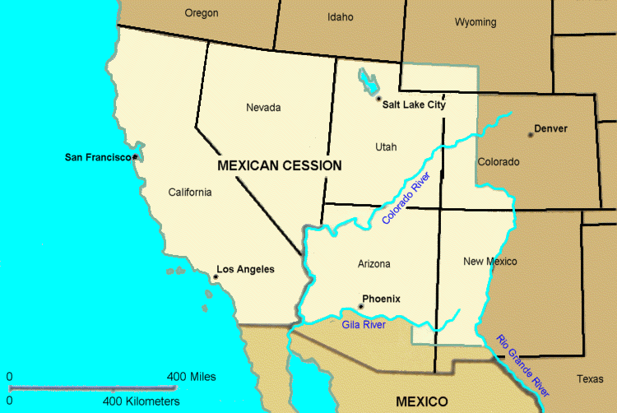
President Polk tried to buy this land, but the Mexicans would not sell.

Slide 27
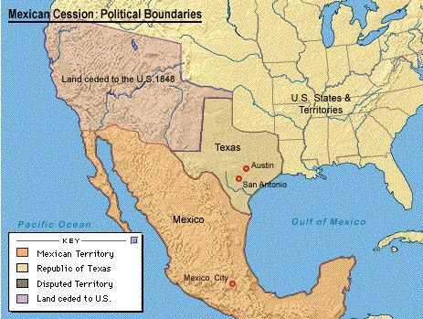
After Texas was annexed, the United States sent American troops into an area on the border of Texas that the Mexican government also claimed as their own.

Slide 28
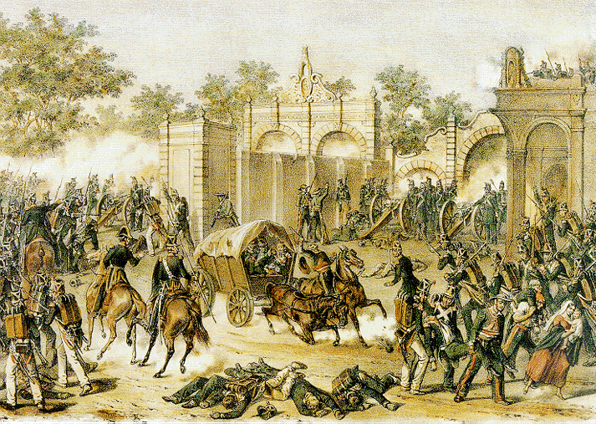
Shots were fired and the Mexican War began (1846-8).

Slide 29
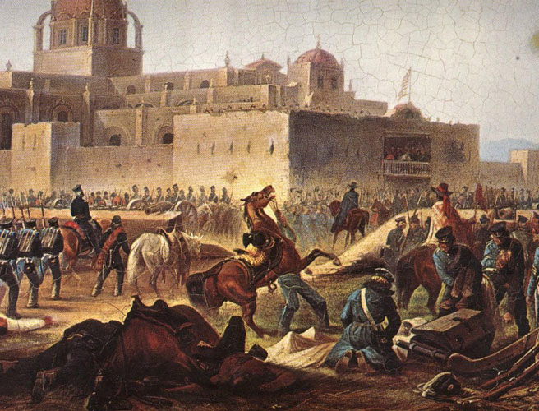
The United States invaded Mexico and defeated the Mexican army at the disputed border, and won the war by taking the capital city.

Slide 30
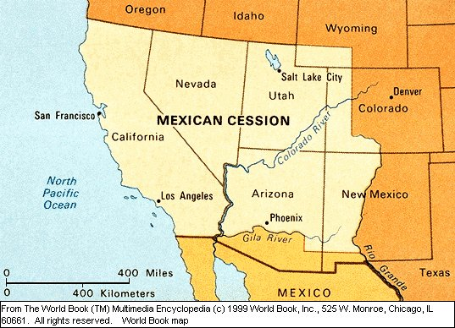
Americans also “assisted” the Mexican citizens in California in declaring their independence from Mexico, as well.

Slide 31
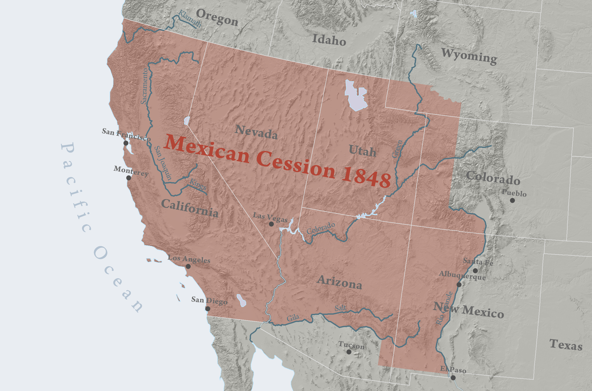
The treaty that ended the Mexican War ceded Mexican territory in what is now New Mexico, Arizona, California, Utah, and Nevada to the United States in return for $15 million dollars

Slide 32
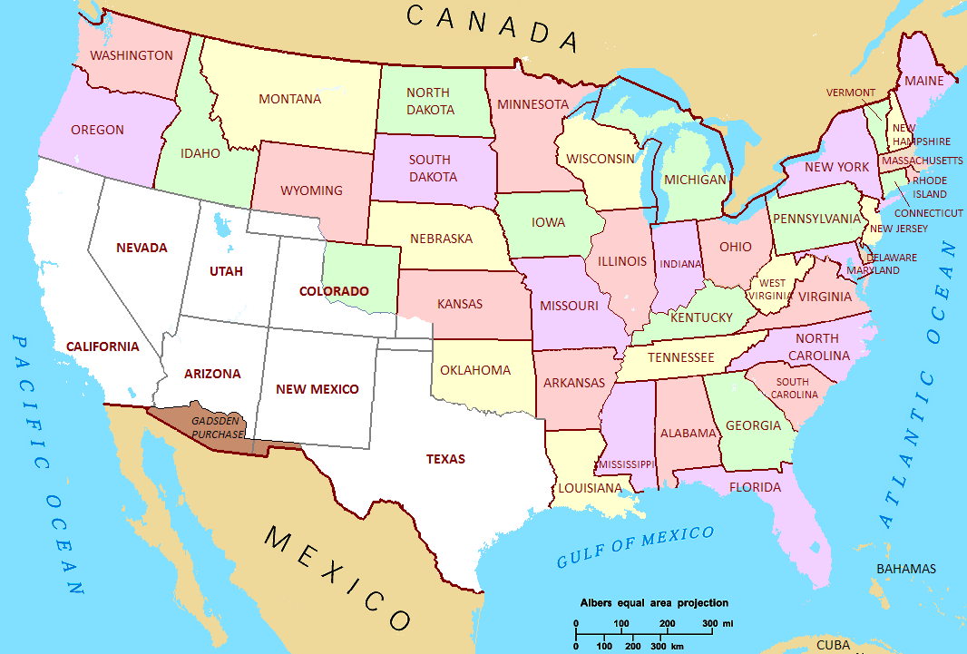
The Mexican Cession (1848) gave the United States access to Pacific ports and the soon-to-be-discovered gold fields of California.

Slide 33
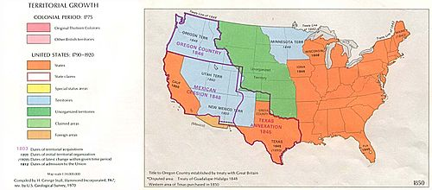
Territorial expansion and related land policies had a very negative impact on Native Americans.

Slide 34
As more settlers moved farther west, they took more Native American land and created conflict with the Native American tribes.

Slide 35
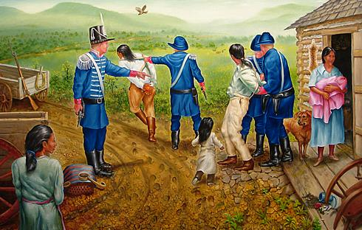
The United States government exercised its power to make treaties and thus to force tribes to move from their ancestral lands.

Slide 36
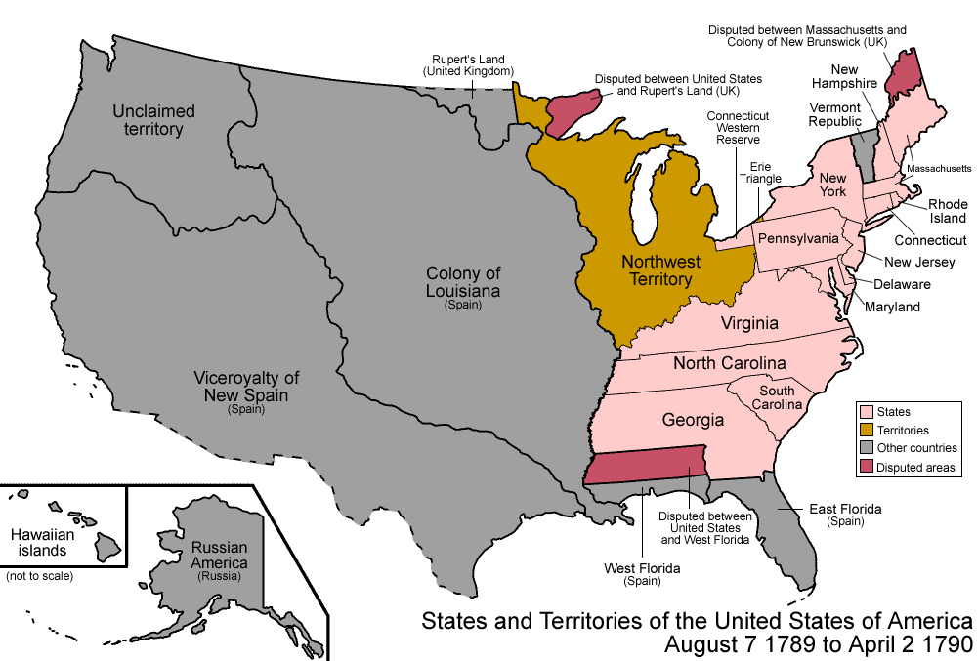
The Northwest Ordinance of 1787 allowed new lands to organize as territories and later as states when their population of white settlers reached a certain number.

Slide 37
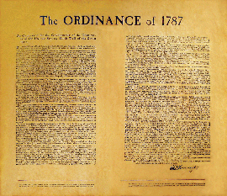
The ordinance also provided for public schools and outlawed slavery in the region.

Slide 38
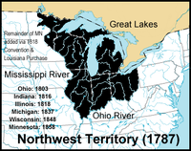
This region later became the states of Ohio, Indiana, Illinois, Michigan and Wisconsin and could not allow slavery.

Slide 39
This was the first time the national government had taken a stand against the spread of slavery that was motivated by the ideas of the Declaration of Independence that “all men are created equal.”

Slide 40
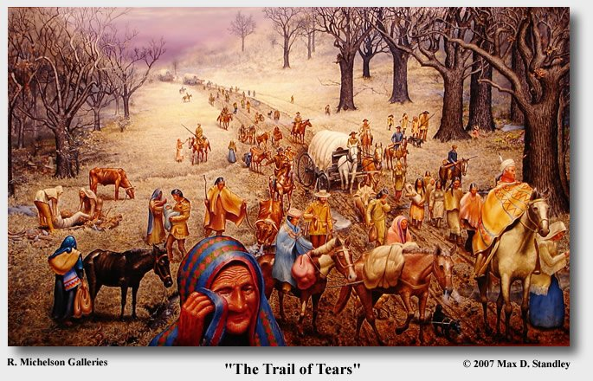
Although the Northwest Ordinance promised that the “utmost good faith shall always be observed towards the Indians, their lands and property shall never be taken from them without their consent,” because the Land Ordinance and the Northwest Ordinance encouraged westward expansion, Native Americans were forced to give up their lands and move farther west.

Slide 41
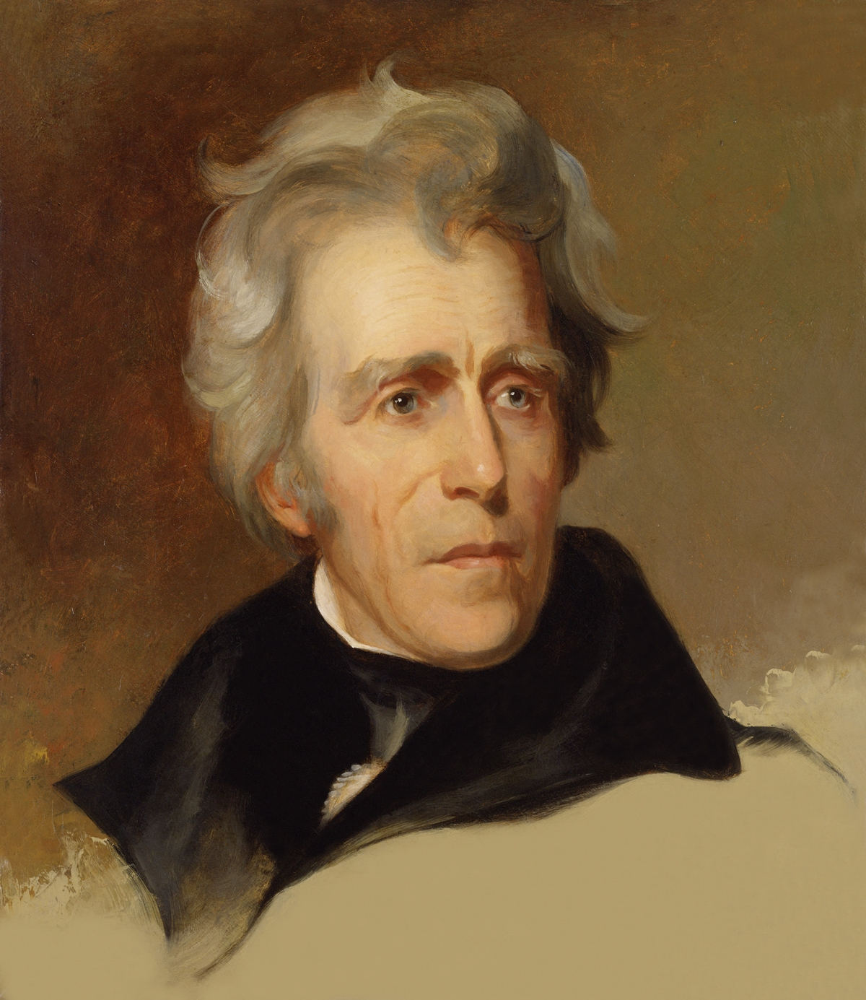
The Indian Removal Act of 1830 was a law passed by the United States Congress and signed by President Andrew Jackson.

Slide 42
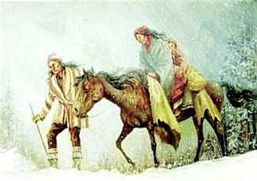
It provided land and money the president could use to enter treaties with the Native American nations in which the tribes agreed to leave their lands east of the Mississippi and move west.

Slide 43
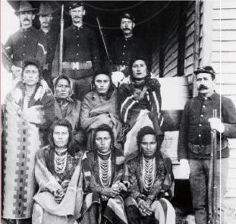
Tribal resistance to American encroachment was answered with military-forced takeover.

Slide 44
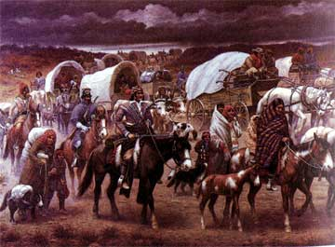
Having no choice, some Native American tribes moved farther west voluntarily.

Slide 45
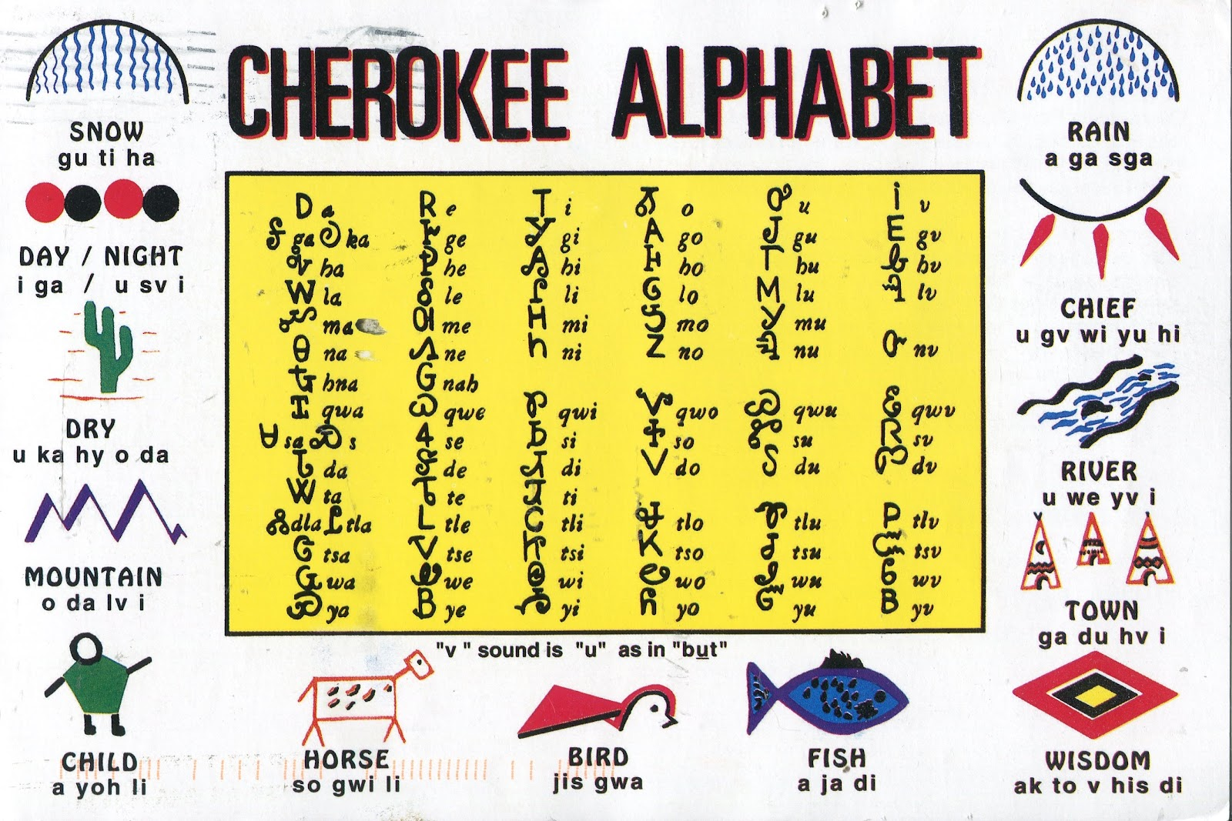
Other tribes, such as the Cherokee nation, attempted to live in harmony with the American settlers by adopting many American customs, including a written language and governmental system and even the plantation system with slavery.

Slide 46
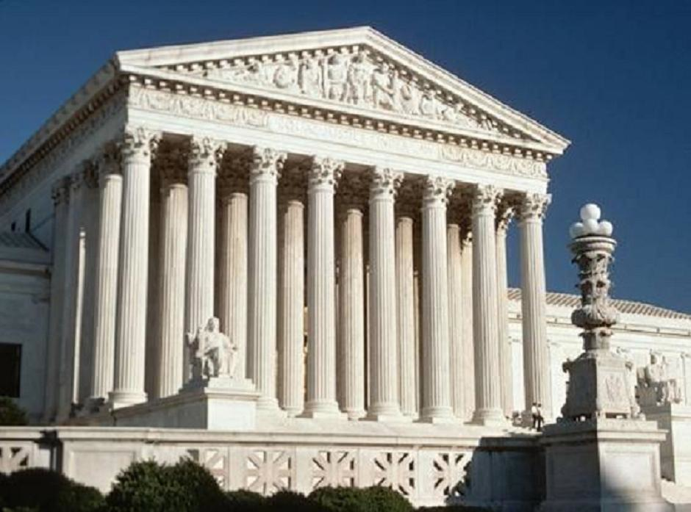
The Cherokee tried to resist removal by taking their case to the Supreme Court.

Slide 47
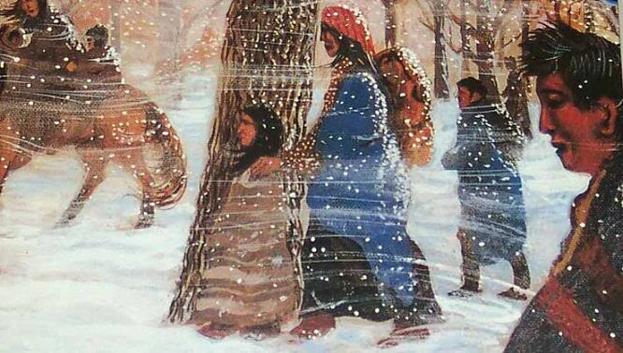
Even though the Supreme Court ruled that the Cherokee had the right to keep their land, President Andrew Jackson ignored the court’s ruling and used the army to force the Cherokee to move from their homes in the Appalachian Mountains across the Mississippi River to present-day Oklahoma, then designated Indian Territory, on what is called “The Trail of Tears.”

Slide 48
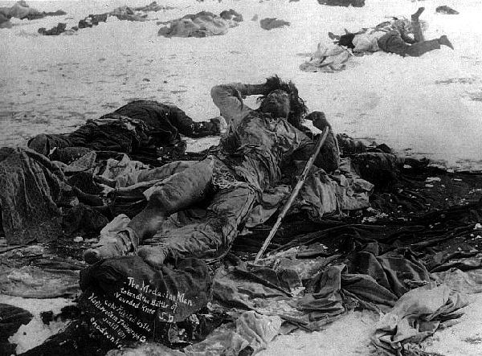
The use of contract labor to insure the move was accomplished earned the moniker as roughly one fourth of the population died on what evolved into a forced (foot) march during the winter.

Slide 49
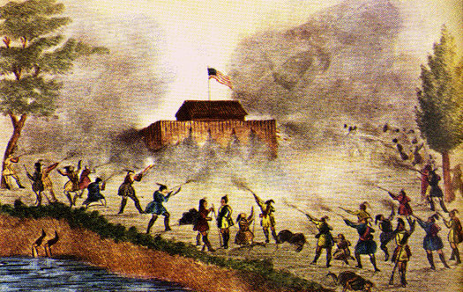
The Seminole tribe tried a different approach, going to war in Florida over their refusal to evacuate and transfer themselves to reservations in designated areas.

Slide 50
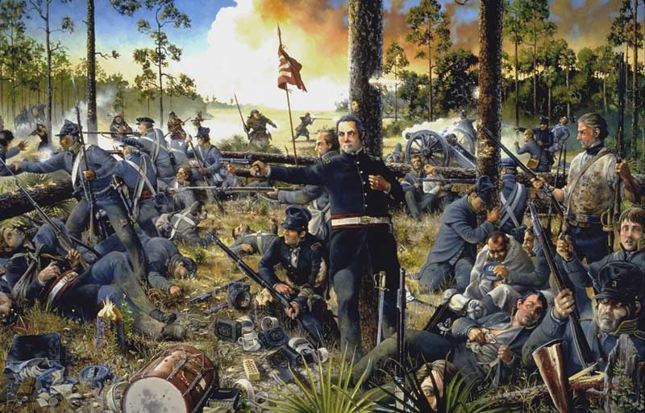
Because the Seminoles lost, many were captured and forced to move to Indian Territory.

Slide 51
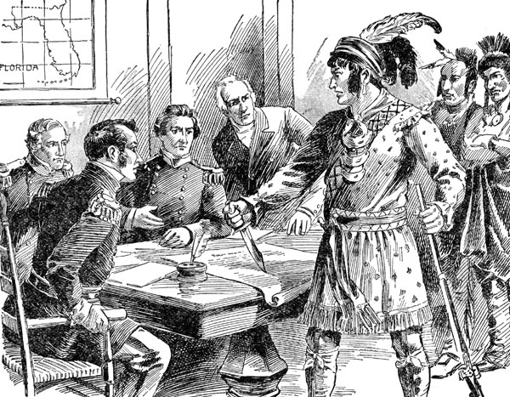
Even though the Native Americans were promised reservations in the west, settlers and military often broke treaties.

Slide 52
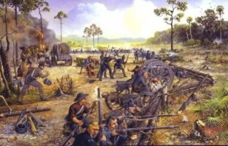
White settlers wanted Native American lands because of the gold, silver, or rich grazing land found there and this process was continually repeated as land was settled

Slide 53
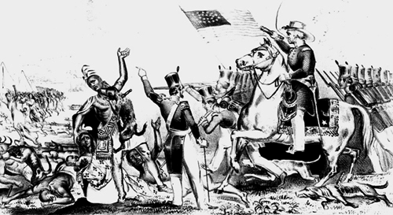
This caused conflicts between settlers and Native Americans that later led to a series of Indian wars.

Slide 54
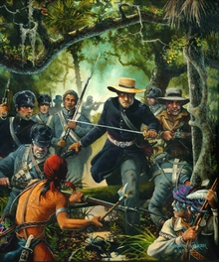
These conflicts were sometimes used as an excuse by soldiers and settlers to massacre Native Americans.

Slide 55
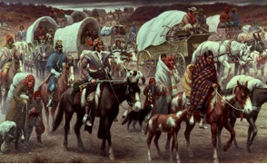
Native Americans resisted until they defeated and forced onto reservations in the period after the Civil War.

