Slide 1
The Impact of the Civil War on America
4-6.4

Slide 2
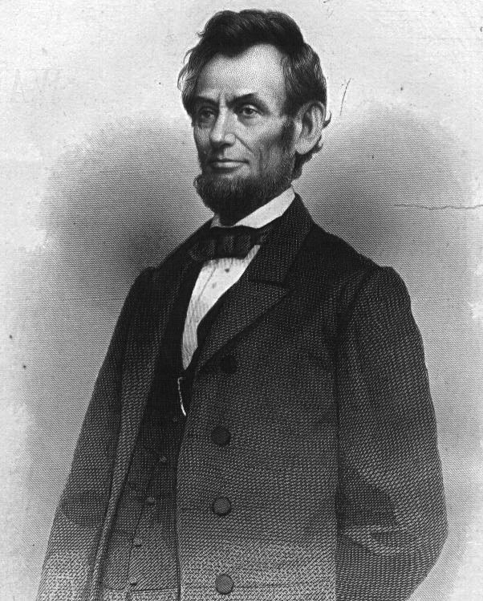
Lincoln made two promises to the South, neither of which were heeded, causing a civil war to begin.

Slide 3
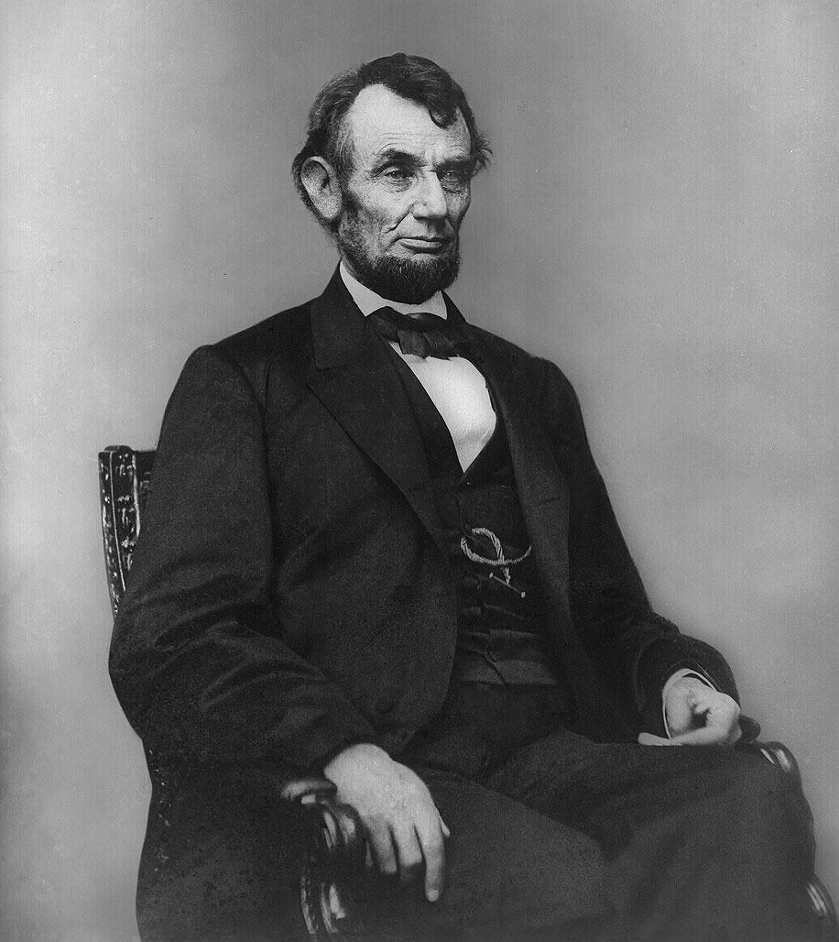
First, he did not desire to fight a war but was constitutionally bound to protect federal property despite the efforts of the South to take over federal property prior to his inauguration.

Slide 4
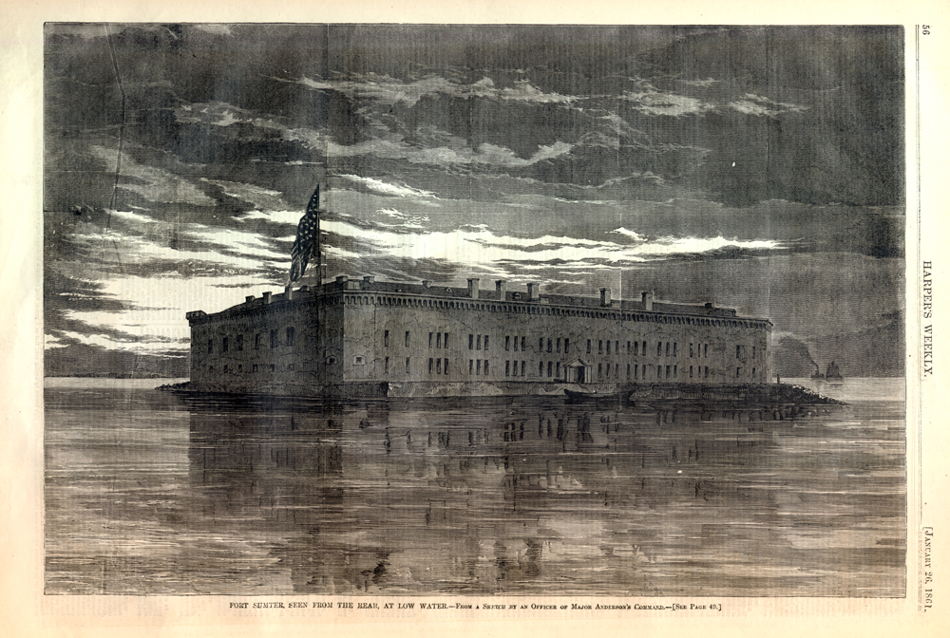
By the time he was sworn into office only two federal properties in the South remained under Union control- those in Charleston, SC and Pensacola, FL.

Slide 5
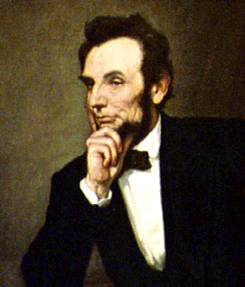
Second, Lincoln’s stated position was that he did not want slavery to spread into the territories but would not interfere with it where it was already established.

Slide 6
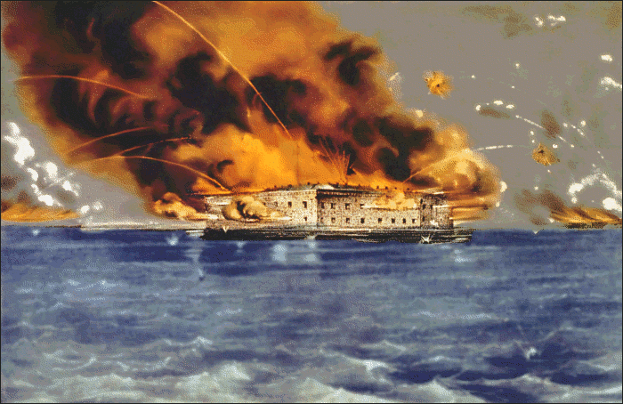
The war began with the Battle of Fort Sumter, in Charleston harbor, South Carolina.

Slide 7
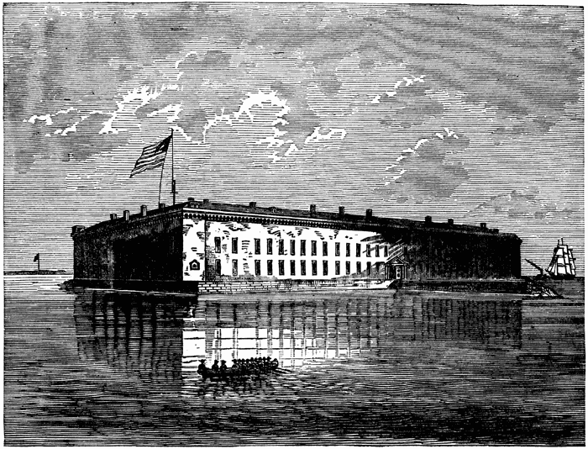
Union President Lincoln informed Confederate President Davis he would be sending supplies to federal troops stationed in the middle of Charleston Harbor at Fort Sumter.

Slide 8
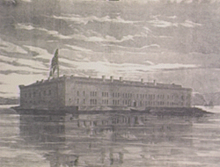
BADLY outnumbered Union troops were ordered to surrender by the Confederate armed forces but they refused.

Slide 9
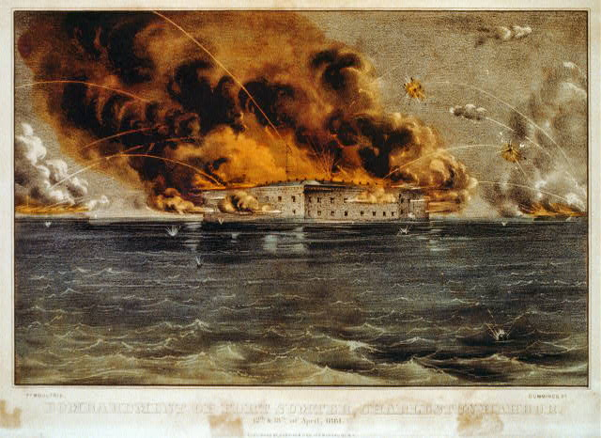
Jefferson Davis sent orders for the Confederate troops to fire on Fort Sumter.

Slide 10
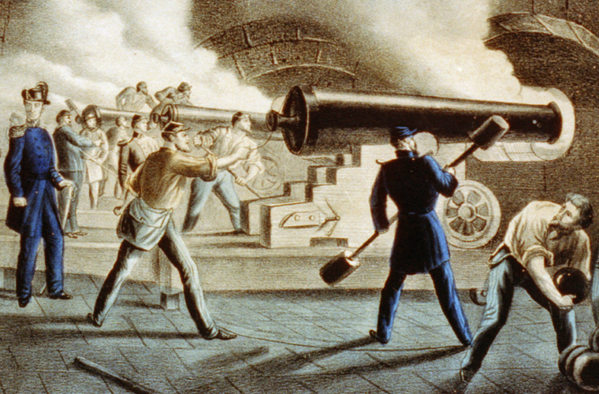
This 34 hour bombardment on union troops stationed at Fort Sumter started the Civil War.

Slide 11
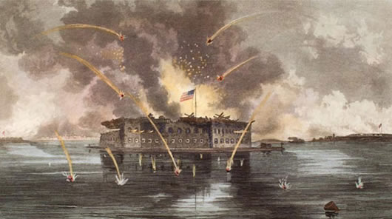
Buildings at the fort were burned, but there were no casualties during the battle.

Slide 12
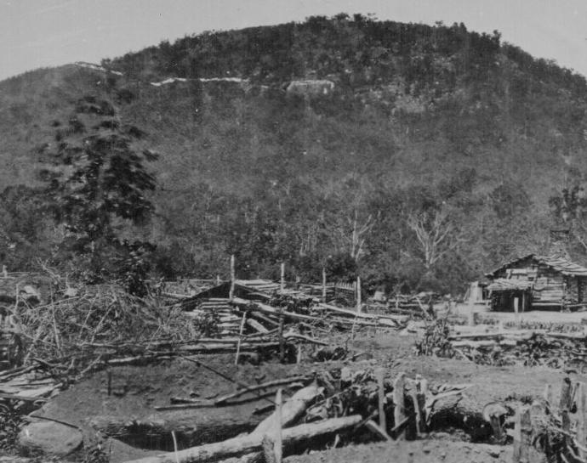
The Union and Confederacy had different strategies to try to win the war based:
geography

Slide 13
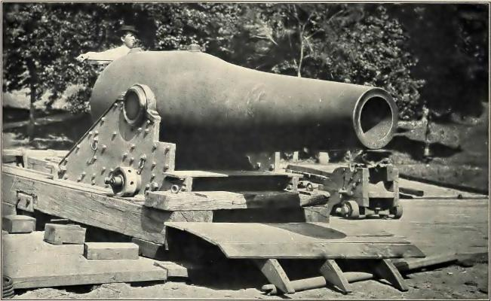
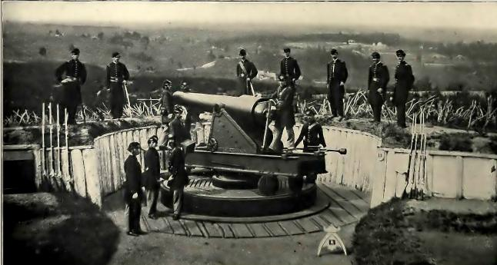
Resources:

Slide 14
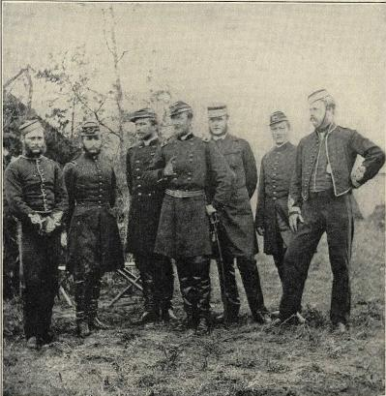
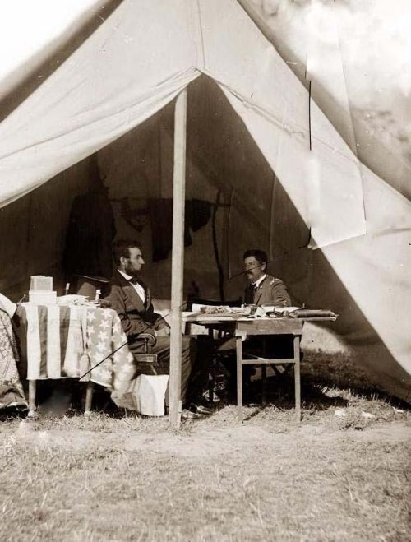
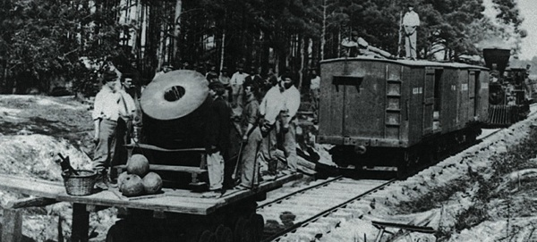
Or their economy:

Slide 15
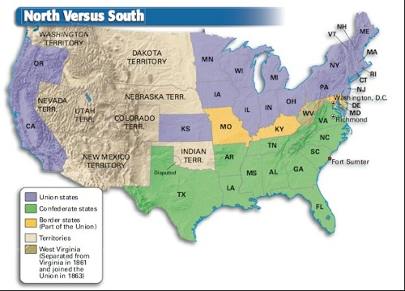
There were four portions to the North’s strategies:

Slide 16
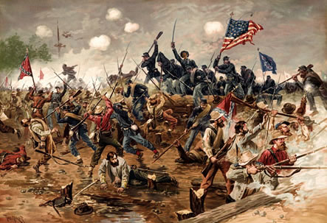
The North initially fought to preserve the Union and victory would only come with southern surrender (a war on the offensive).

Slide 17
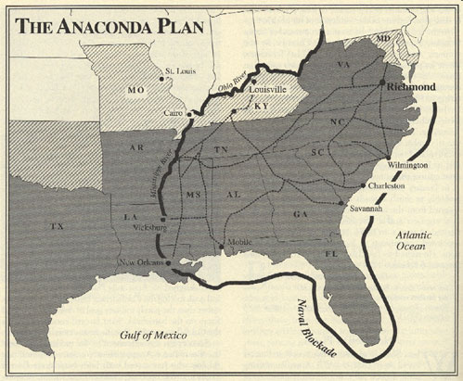
The strategy of the North was called the Anaconda Plan.

Slide 18
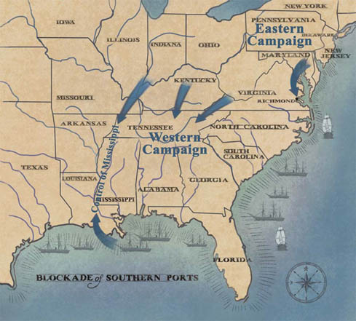
1. Blockading the southern ports using the navy

Slide 19
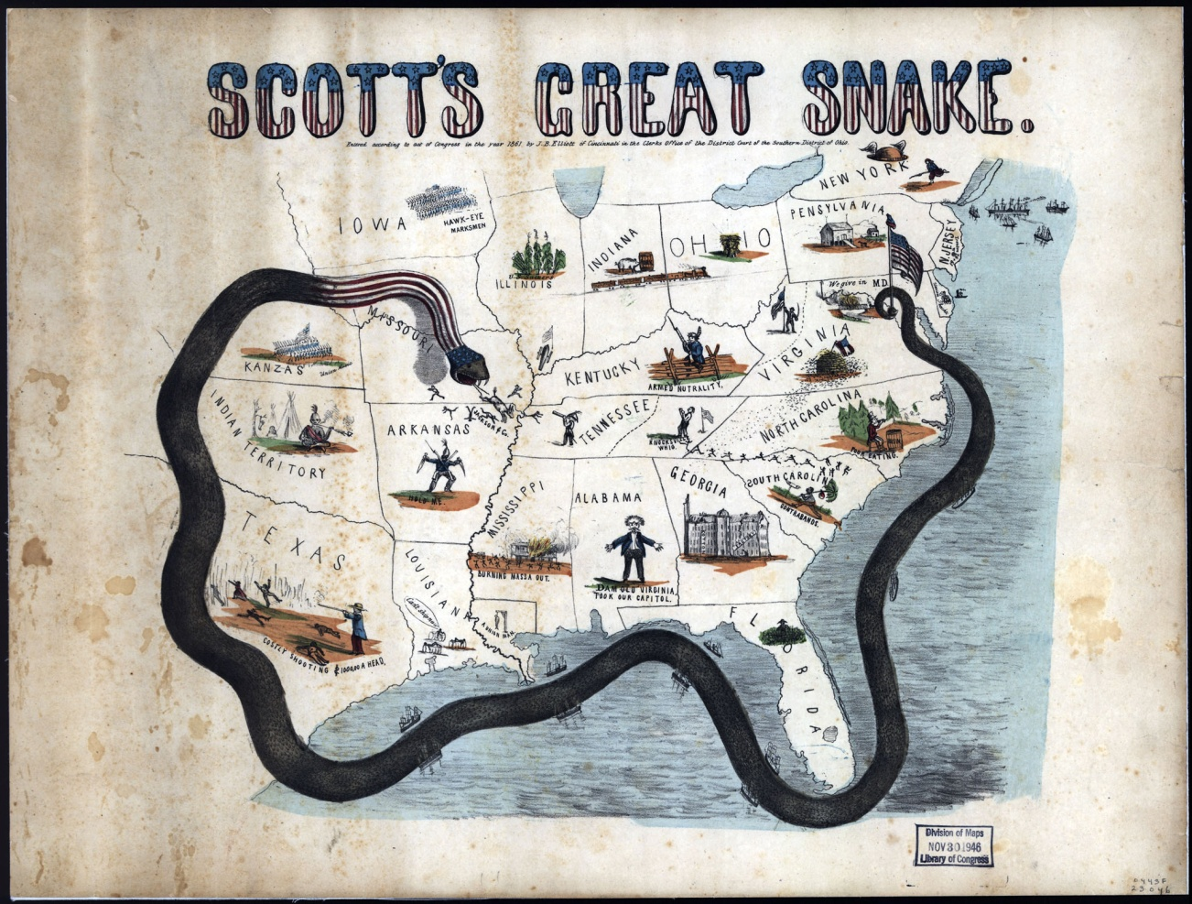
This way the south couldn’t get supplies from their supporters in Europe

Slide 20
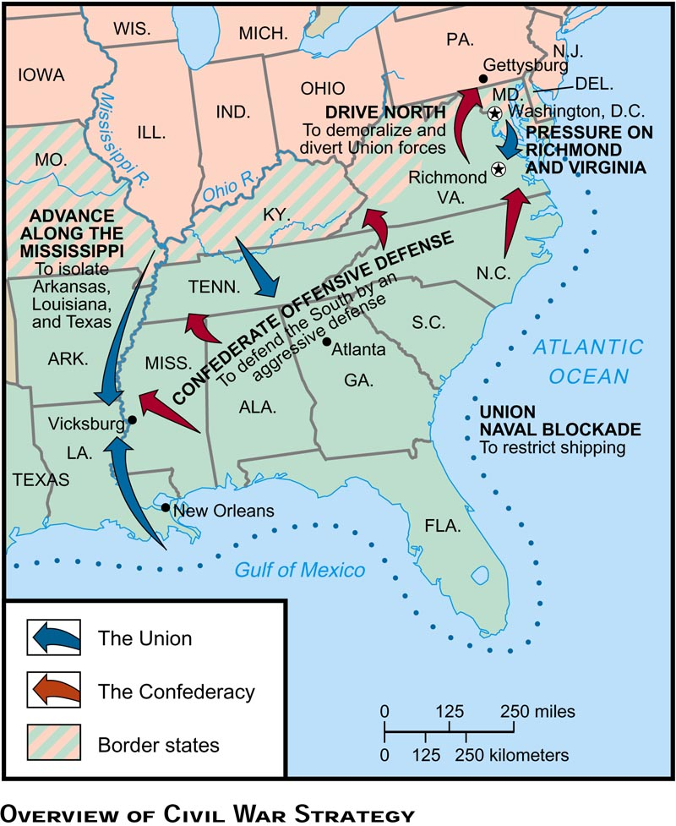
2. Spilt the Confederacy in two at the Mississippi River costing the south its unity.

Slide 21
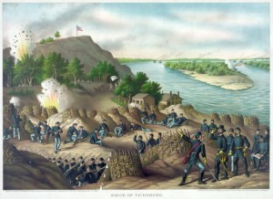
They were finally successful with this phase of the plan as a result of the fall of Vicksburg, another turning point that occurred simultaneously with the battle of Gettysburg.

Slide 22
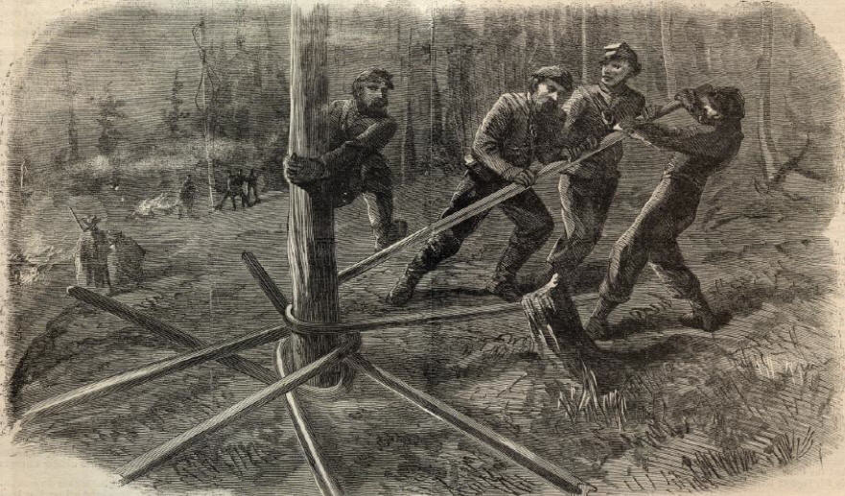
Third, they would increase doubt and confusion by destroying the South from within by attacking its transportation (railroad) and communication (telegraph) systems and thus its morale.

Slide 23
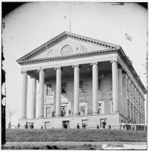
4. Attack the Confederate Capitol city of Richmond Virginia

Slide 24
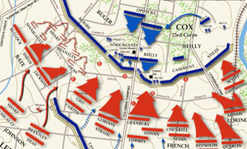
The southern strategy was to: 1. fight a defensive war

Slide 25
2. Depend on their trade relationship with England (based on cotton production) to lend them the supplies they needed

Slide 26
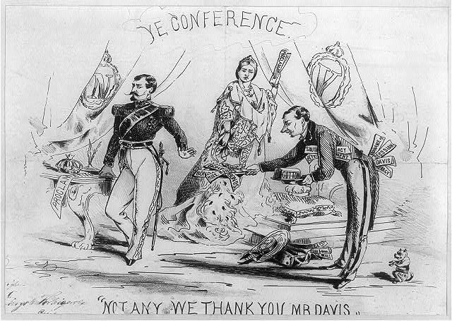
They hoped England would lend the monetary resources for the materiel as needed in order to have a monopoly on being the sole buyer of the southern cotton.

Slide 27
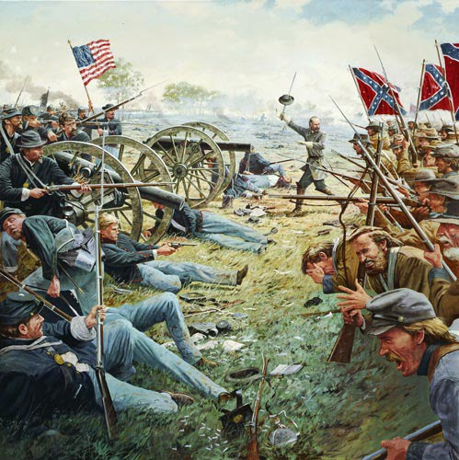
Southern armies defended Richmond and threatened the Union capital in Washington but only attacked Northern soil twice at Antietam and Gettysburg.

Slide 28
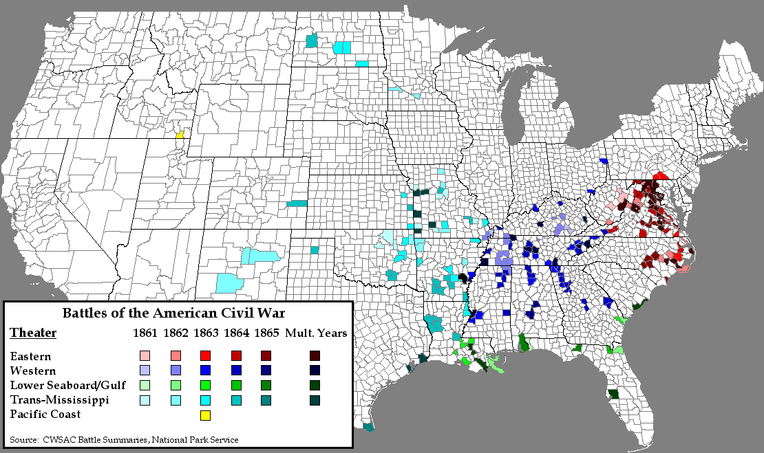
The Confederate army fought most of the battles in their own section of the country

Slide 29
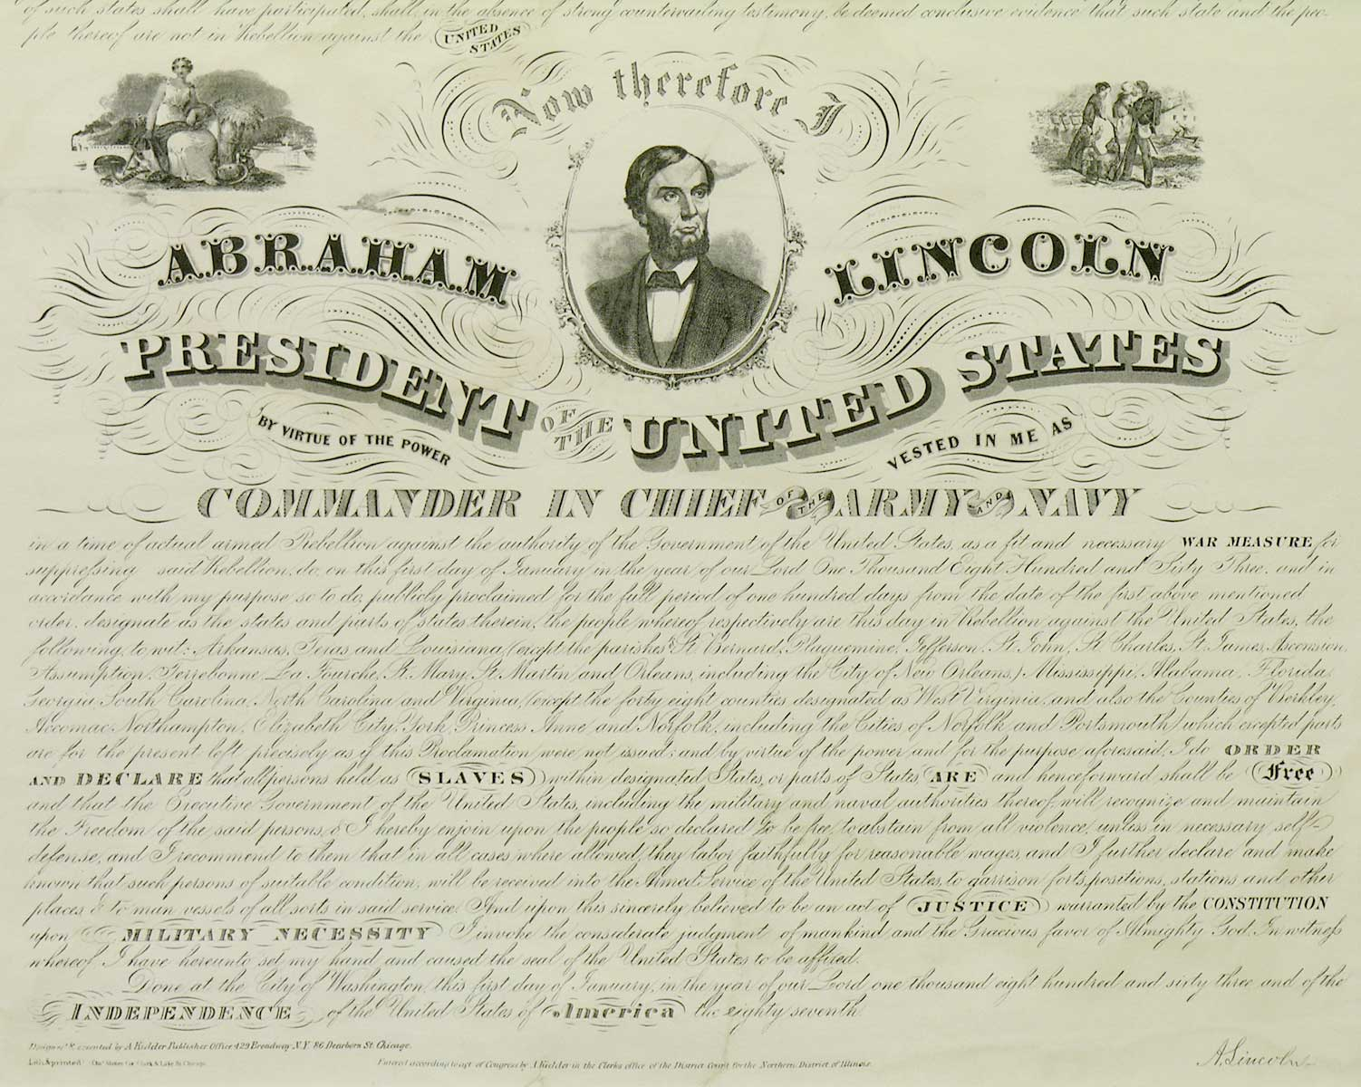
The Emancipation Proclamation was an order issued after the Union victory at Antietam by President Lincoln as Commander in Chief of the United States Armed Forces that freed the slaves in all the states still fighting against the Union (10 states), effective January 1, 1863.

Slide 30
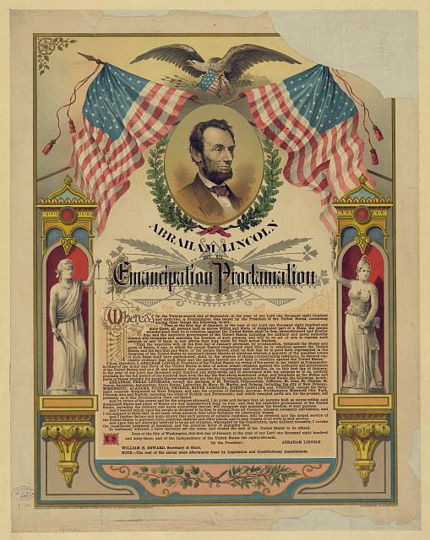
It did not free the slaves that were living in the states that remained loyal to the United States (the border states) or those already defeated (like Tennessee), and was thus done for political reasons at home and abroad on both sides of the war.

Slide 31
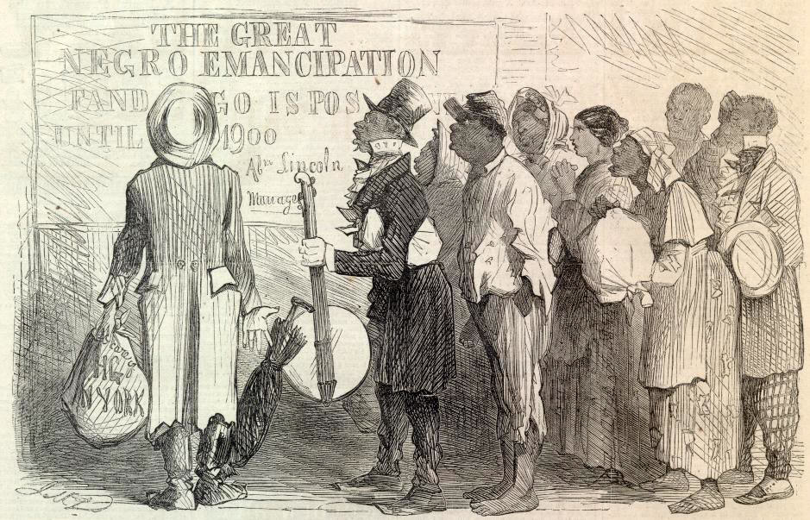
Since the Confederate states did not recognize the authority of the President of the United States, they did not obey his order.

Slide 32
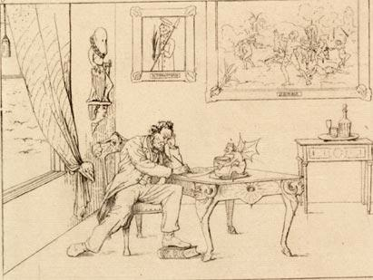
Although the proclamation achieved its purpose in changing the tone of the war by adding another cause for which to fight, creating problems of slave control in the South and enabling African Americans to legally serve their country, it did not actually outlaw slavery.

Slide 33
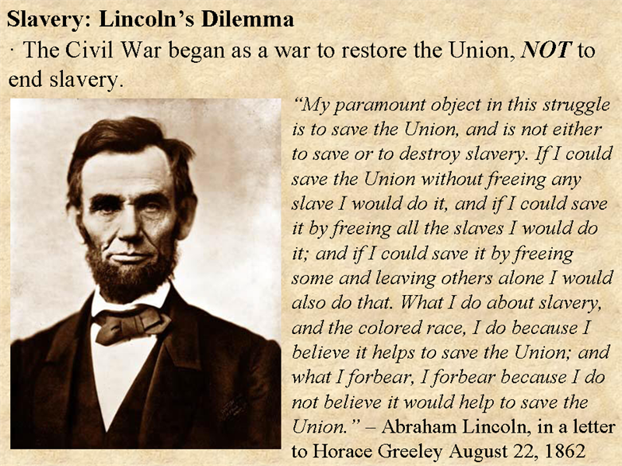
Slaves were freed only as the Union army liberated them after victories in Southern towns and cities

Slide 34
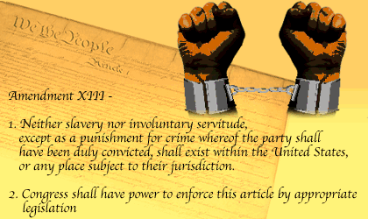
Slavery’s end needed to be accomplished legally through an amendment to the Constitution and was thus accomplished through the 13th amendment in 1865.

Slide 35
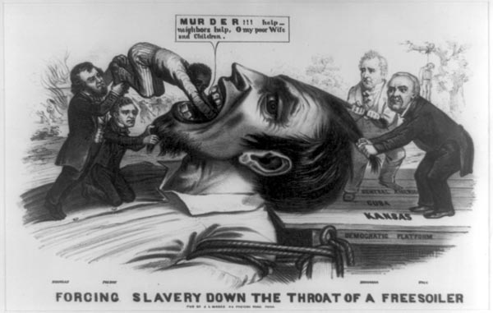
However, the proclamation transformed the war into a war to liberate slaves, giving it an additional cause.

Slide 36
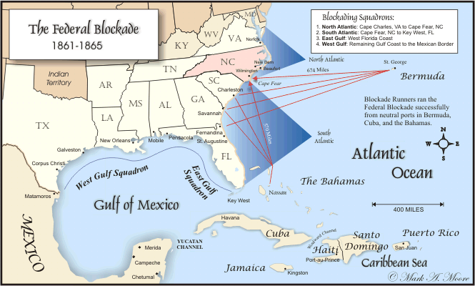
Consequently, it made it harder for the British government to continue to support the South and therefore slavery.

Slide 37
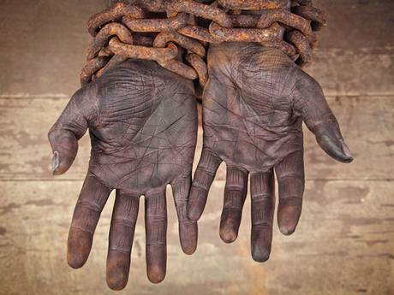
Great Britain had already abolished slavery and many British citizens opposed slavery and their government’s continued assistance in its continuance.

Slide 38
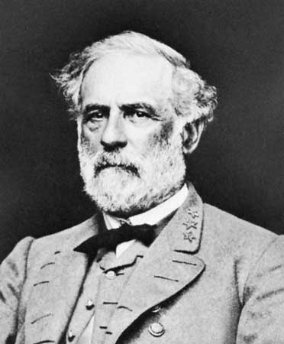
The Confederate Army was led in large part by Robert E. Lee.

Slide 39
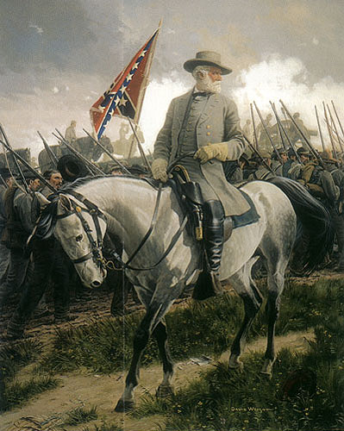
The second time Lee invaded the north he and the Confederate army were turned back at the Battle of Gettysburg in Pennsylvania

Slide 40
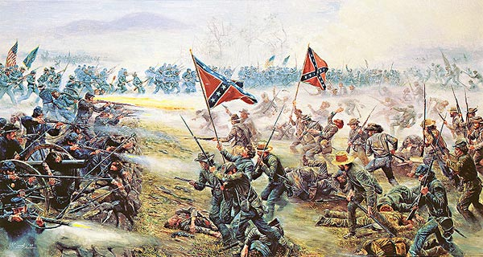
Gettysburg became the turning point of the Civil War

Slide 41
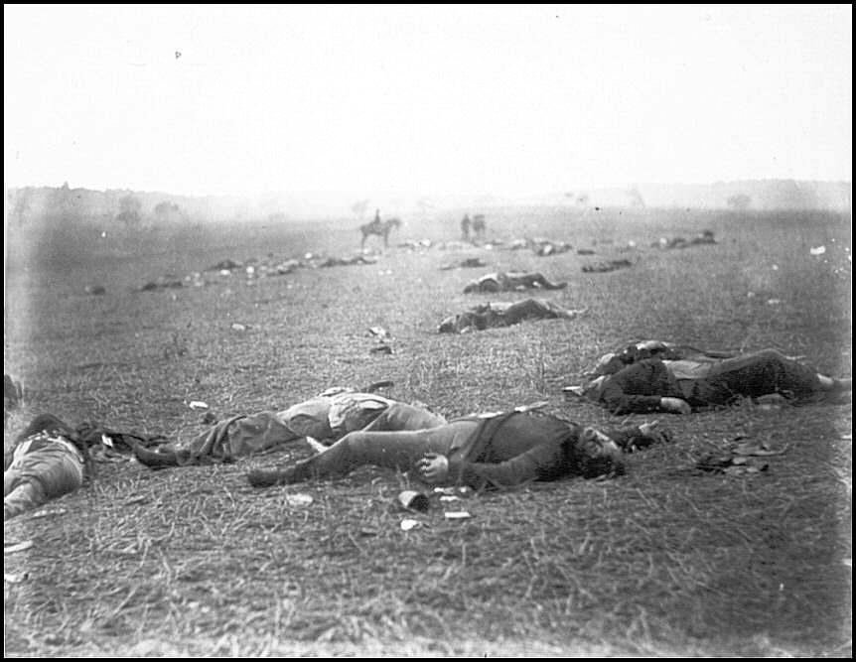
The Confederate Army was so severely wounded at Gettysburg they never had the military strength to attempt another northern invasion.

Slide 42
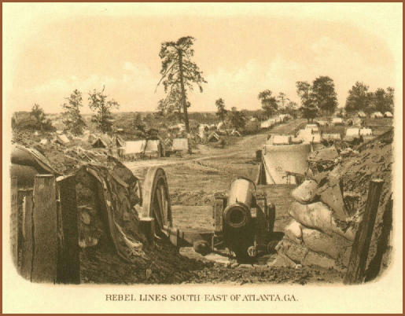
After Gettysburg the South could only defend itself from Northern attacks

Slide 43
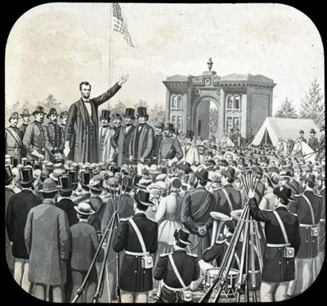
Four months after the Battle of Gettysburg, President Lincoln gave the Gettysburg Address to dedicate part of the Battlefield as a National Cemetery honoring those who died in battle

Slide 44
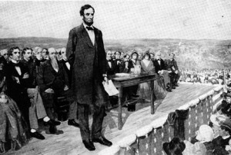
It became one of his most famous speeches and only lasted 2 minutes

Slide 45
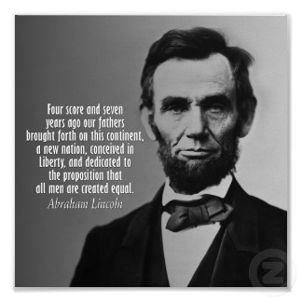
Lincoln reminded Americans his only intention as President was to preserve the Union and democracy

Slide 46
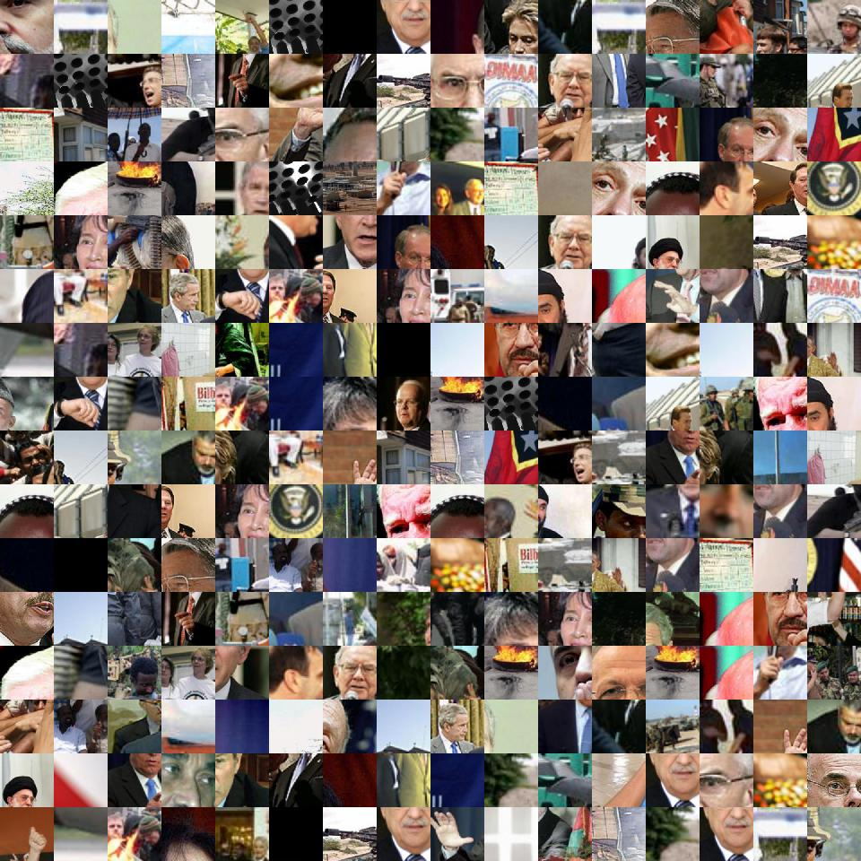
His speech included this famous statement: “government of the people, by the people, for the people, shall not perish from the earth.”

Slide 47
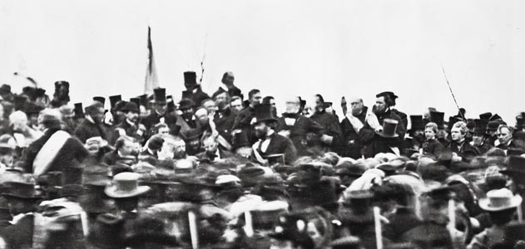
It is one of the most famous speeches in our history because it so succinctly articulated reasons for which the US government exists and why the war was being waged, rededicating the Union to its cause.

Slide 48
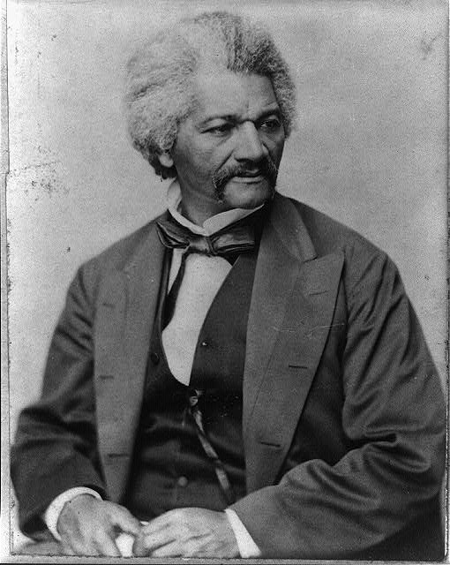
Many Northern African Americans, like Frederick Douglas, realized LONG before white Northern realized that for slavery to end the Union HAD to WIN the Civil War

Slide 49
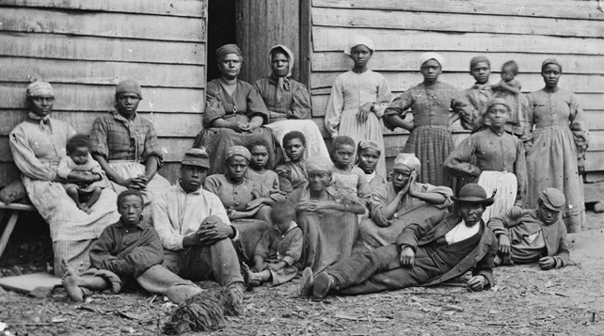
Any possibility of eliminating slavery was tied to the outcome of the conflict.

Slide 50
When the Civil War began many African Americans in the North began to form AND FINANACE their own military companies to practice drills

Slide 51
Although they requested to fight against the confederacy the Secretary of War would not let them

Slide 52
Some southerners would re-enslave or even execute captured slaves who ran away to try to fight for the Union

Slide 53
This didn’t stop thousands of slaves from fleeing North to military sites

Slide 54
Slaves who fled to Union military camps to try to join were turned away though because, the war was being fought to preserve the Union, not to free the slaves.

Slide 55
By 1862 arguments by abolitionists and the growing number of refugee slaves had increased to convince President Lincoln that a Union victory was important to freedom for slaves

Slide 56
In the Emancipation Proclamation President Lincoln asked freed slaves to join the Union Army

Slide 57
In 1861 the Union army took control of South Carolina’s low country AND the first African-American troop of soldiers was part of the Union army

Slide 58
Many African-Americans joined segregated units led by white officers

Slide 59
The most famous was the 54th Massachusetts that led an attack on Fort Wagner outside of Charleston.

Slide 60
During the Civil War African-Americans, like Harriet Tubman, worked as spies, guides and messengers

Slide 61
In the South, some slave owners required their slaves to accompany them on the Confederate battlefield.

Slide 62
Both slaves and free African Americans were forced into service throughout the South.

Slide 63
The Confederacy would not give slaves weapons but some troops made slaves work in factories, dig trenches, perform hard labor or build bridges all while fighting was occurring

Slide 65
After 4 years of fighting Confederate General Robert E. Lee surrendered to Union General Ulysses S. Grant at Appomattox Courthouse in Virginia

Slide 66
Once Lee’s troops surrendered other southern armies surrendered over the next few months too

Slide 67
Lee’s troops were exhausted, without food and supplies and their ranks had been decimated by a 4 year war

Slide 68
The Confederate economy had also been decimated by four years of war against a larger, stronger, wealthier federal system.

Slide 69
Four days after the Confederacy’s surrender at Appomattox Courthouse, Lincoln was assassinated by John Wilkes Booth at Ford’s Theater in Washington, D.C.

Slide 70
Booth was unhappy with the outcome of the war. He was a Confederate sympathizer and had initially devised a plan to kidnap the president and other cabinet members.

Slide 71
When the plan was foiled in several instances by regular circumstances and then the war ended without its occurrence, Booth determined to instead take the life of the Lincoln.

Slide 72
He hoped the assassination would cause great disarray for the United States. Lincoln’s assassination did in fact leave the nation in shock and disbelief. The difficult task of rebuilding a divided nation proved to be far more difficult without the capable guidance of the man who labored long and hard to preserve it.

