Slide 1
Severe Weather and Tools
4-4.4 Summarize the conditions and effects of severe weather phenomena (including thunderstorms, hurricanes, and tornadoes) and related safety concerns.
4-4.5 Carry out procedures for data collecting and measuring weather conditions (including wind speed and direction, precipitation, and temperature) by using appropriate tools and instruments.
4-4.6 Predict weather from data collected through observation and measurements.

Slide 2
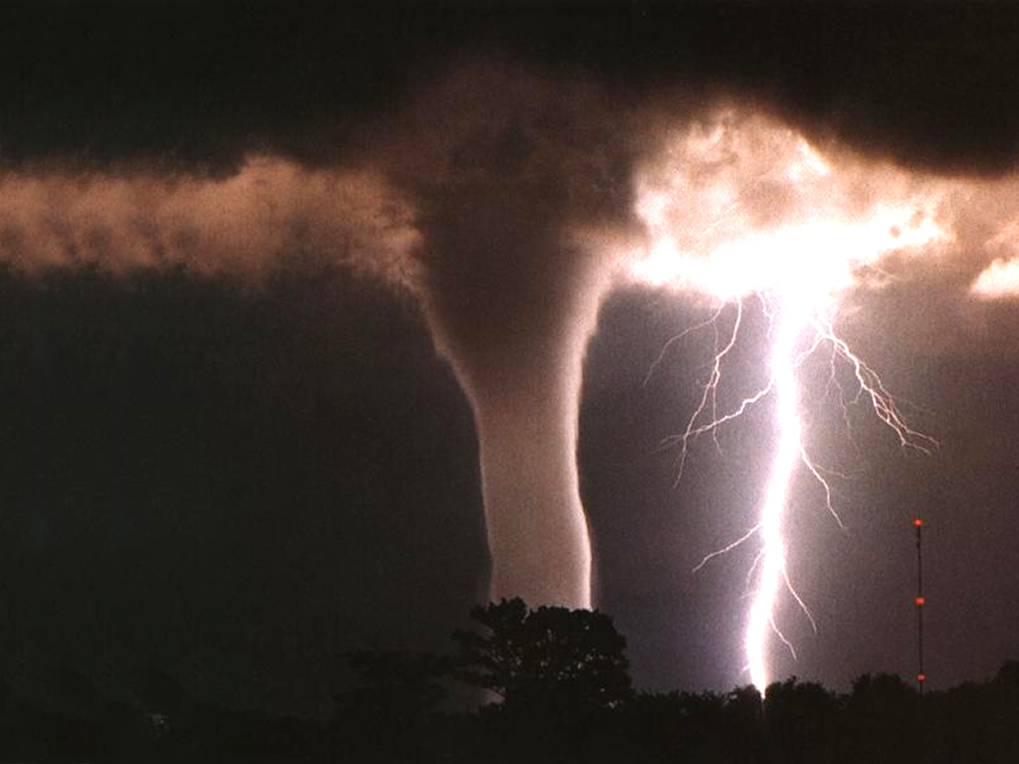
Weather conditions associated with severe weather are different for each type of storm

Slide 3
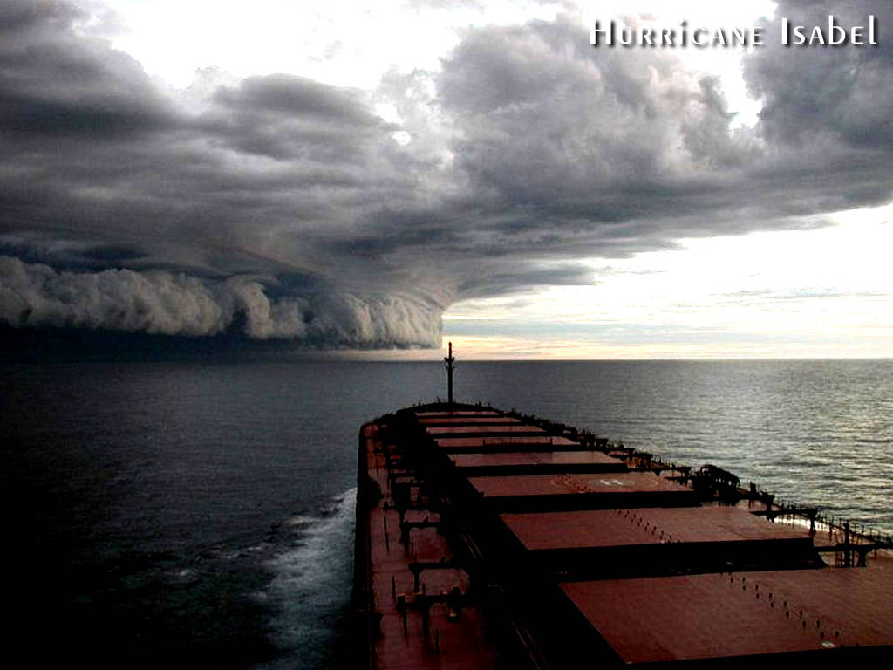
These conditions have different effects and there are safety concerns associated with each condition

Slide 4
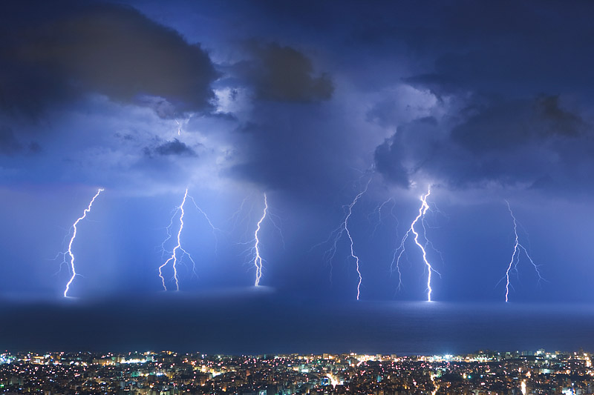
Thunderstorms

Slide 5
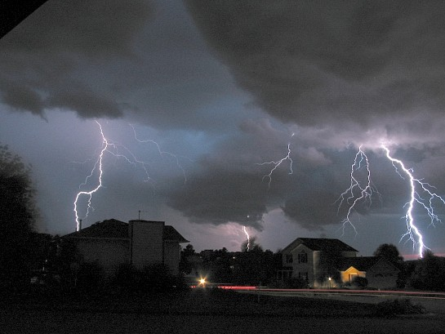
Thunderstorm • A severe storm with lightning, thunder, heavy rain and strong winds.

Slide 6
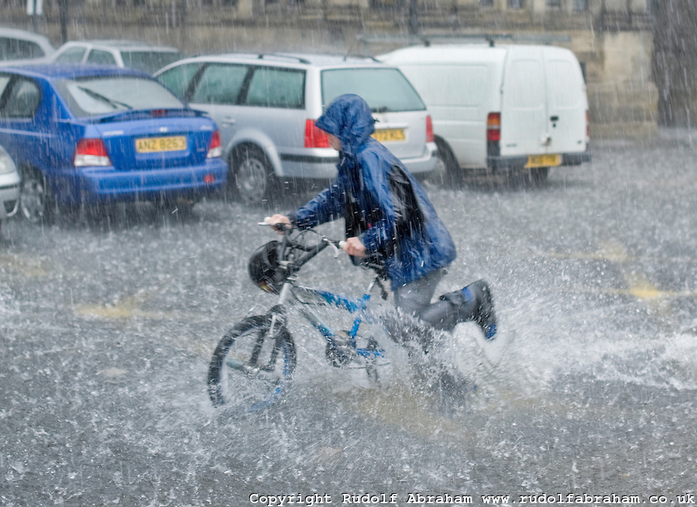
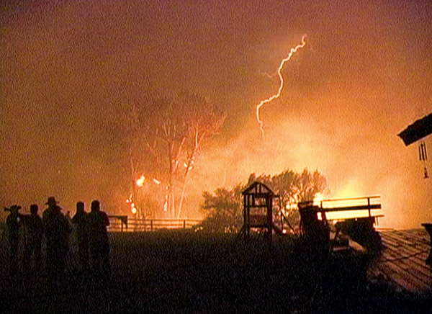
• Hail may also form. Some examples of the effects of thunderstorms may be: heavy rains can cause flooding; lightning can cause fires; strong winds can blow over trees or power lines.

Slide 7
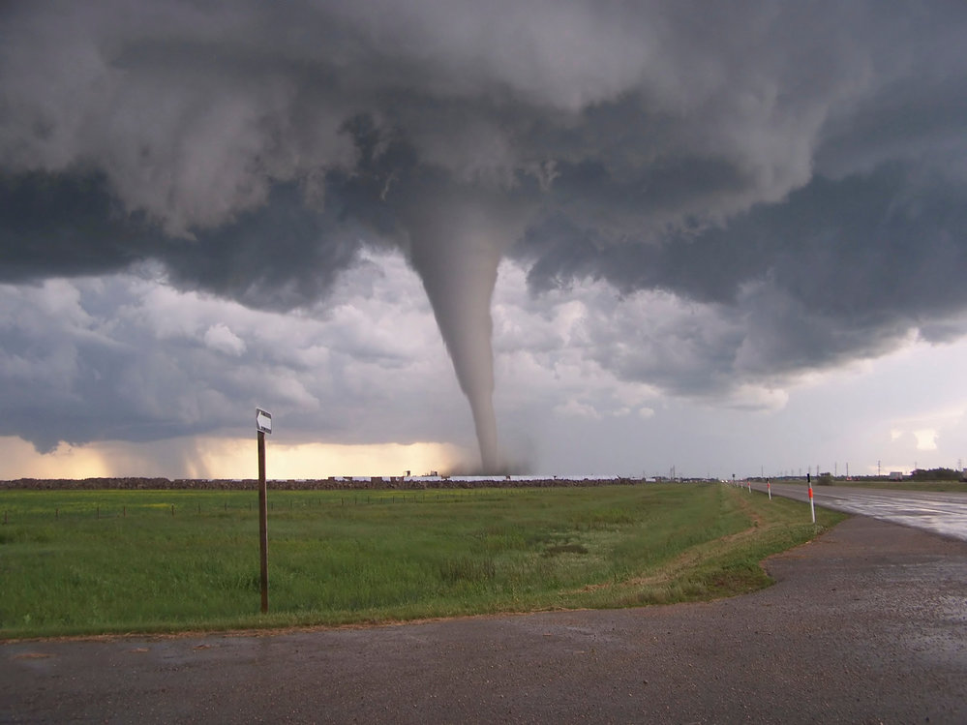
Tornado

Slide 8
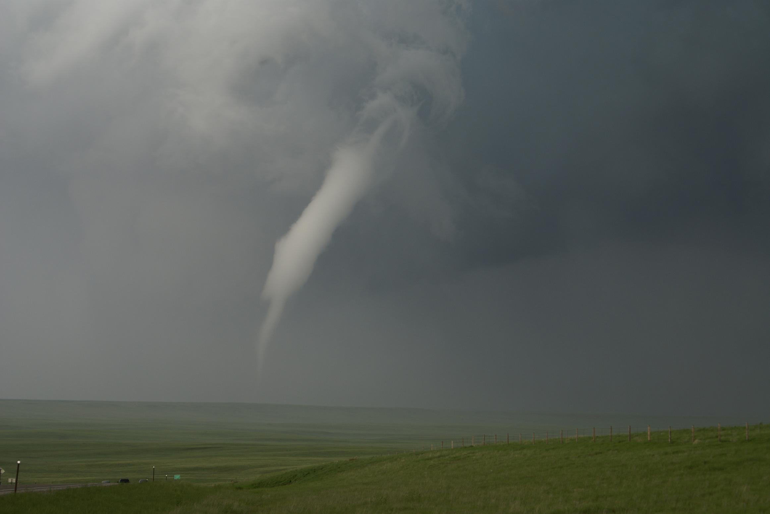
Tornado • A small, funnel-shaped cloud that comes down from a storm cloud with winds spinning at very high speeds.

Slide 9
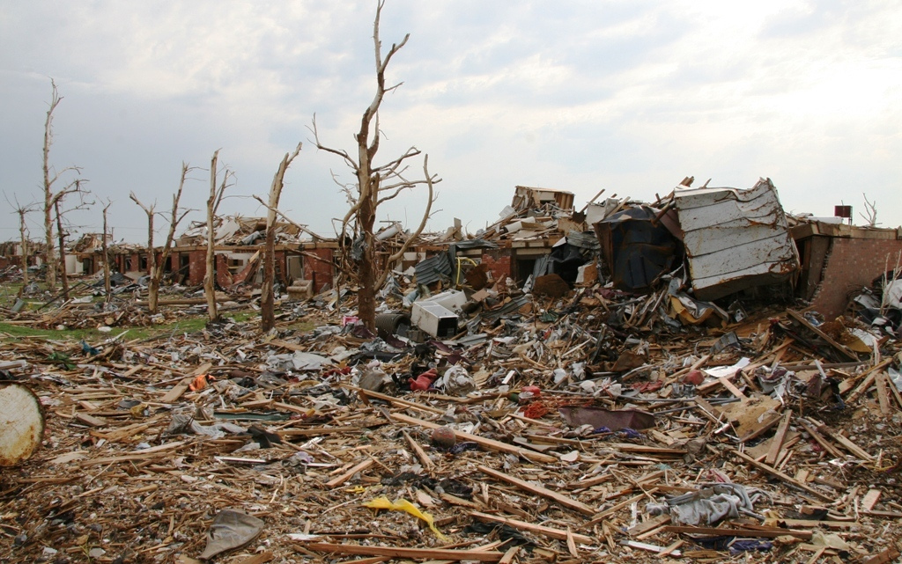
• Some examples of the effects of tornadoes may be: high winds can tear apart buildings; every time it touches the ground, it destroys everything in its path.

Slide 10
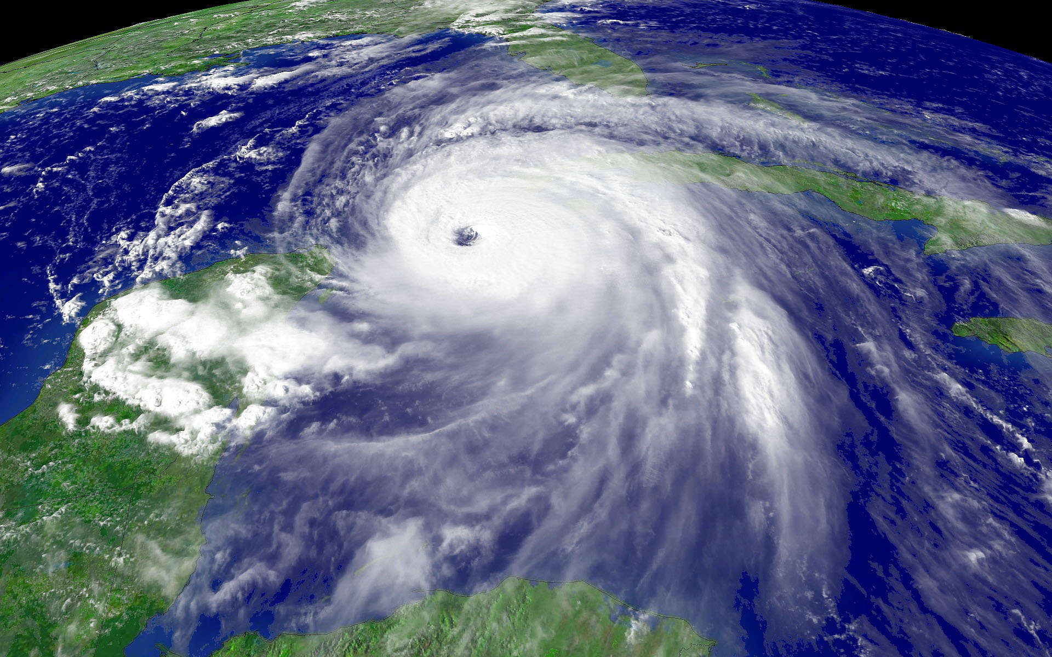
Hurricane

Slide 11
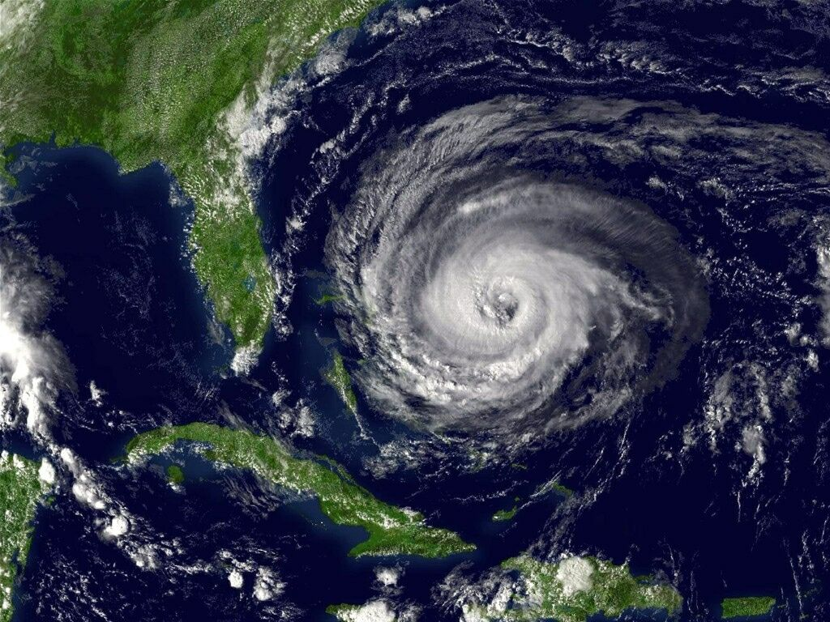
Hurricane • A large storm that forms over warm ocean water with very strong winds that blow in a circular pattern around the center, or eye, of the storm.

Slide 12
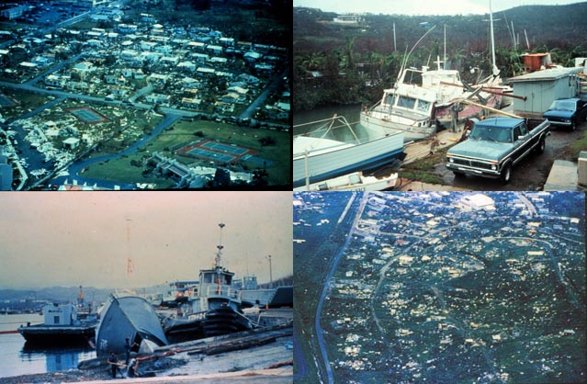
• Some examples of the effects of hurricanes may be: high winds can blow over trees, power lines, and even buildings; heavy rain can cause flooding; the storm waves on the ocean can come in at the beach and damage the coastal area;

Slide 13
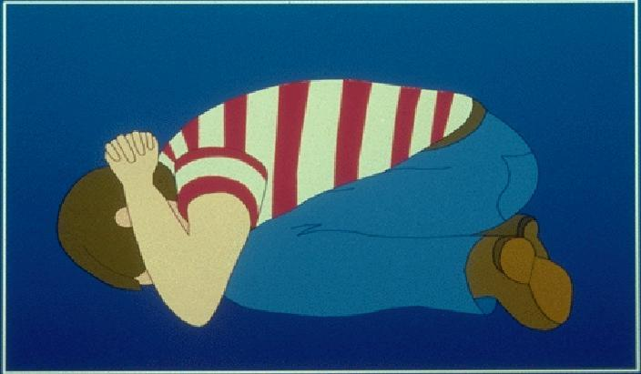
There are safety concerns related to these storms because of their conditions and effects.

Slide 14
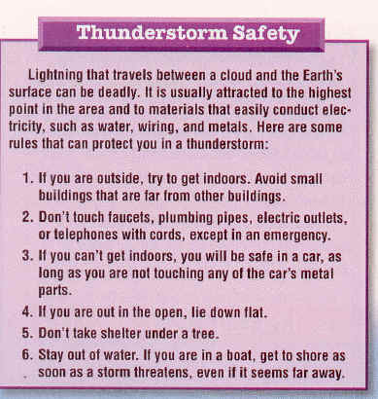
• During a thunderstorm, stay inside if possible; stay out of the water; and do not stand under trees.

Slide 15
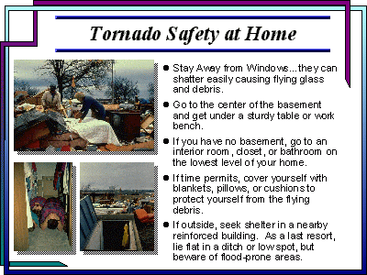
• During a tornado, find a safe place away from window; if you cannot find shelter lie flat in a ditch or other low place; and do not stay in your car.

Slide 16
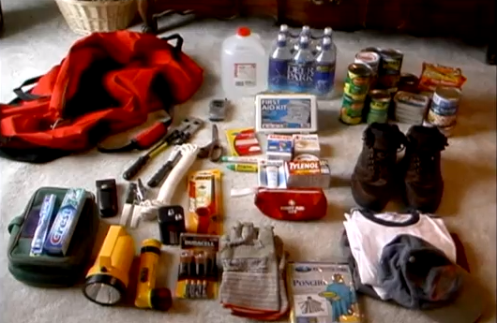
• During a hurricane, board up windows in your house; stay away from windows; and move further inland if you are near the coast.

Slide 17
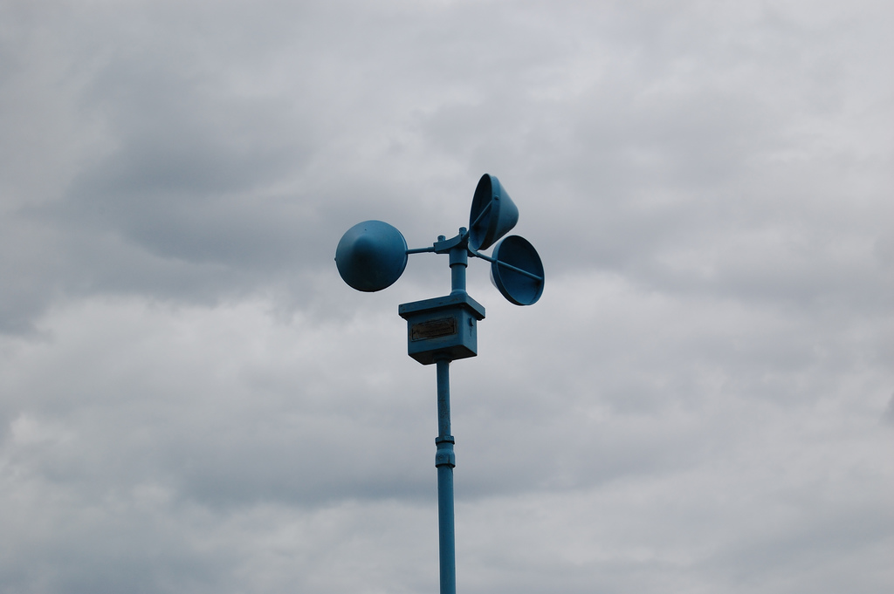
Wind Speed • Wind speed is measured with an anemometer as the wind causes the cups to spin.

Slide 18
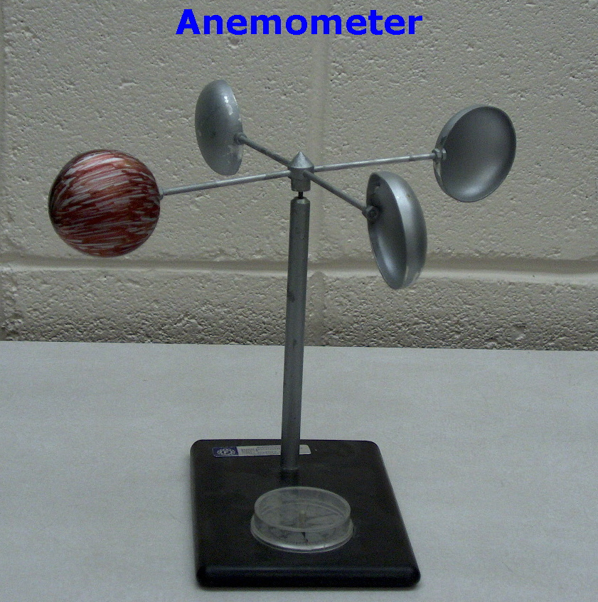
• As the cups spin, the anemometer counts how many times they spin in a given period of time

Slide 19
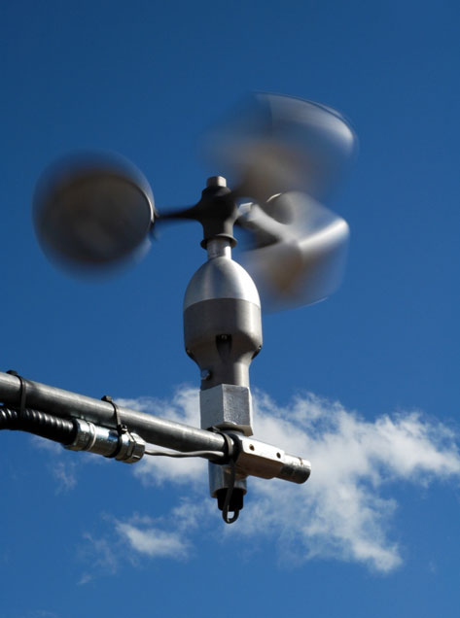
• The more turns, the faster the wind speed.

Slide 20
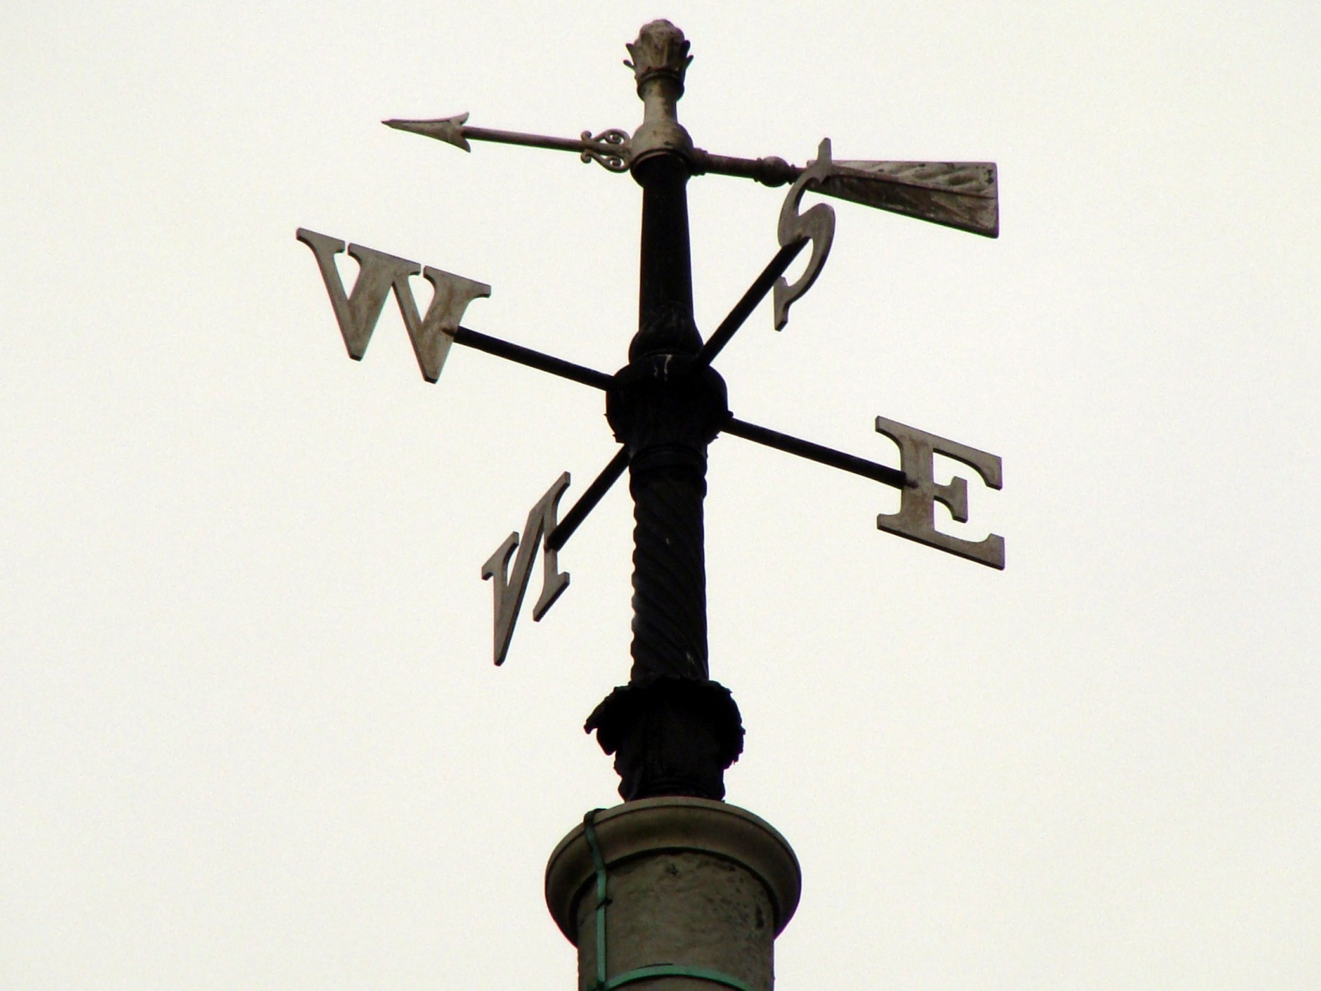
Wind Direction • Wind direction is determined with a wind (weather) vane.

Slide 21
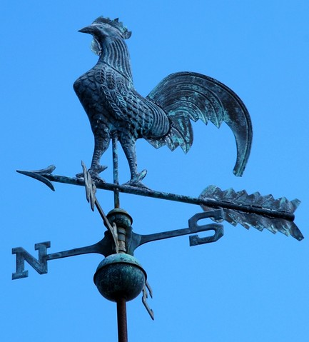
• Wind direction is described by the direction from which the wind is blowing.

Slide 22
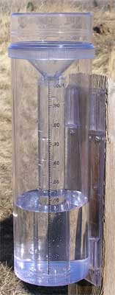
Precipitation • Amount of precipitation is measured in a rain gauge.

Slide 23
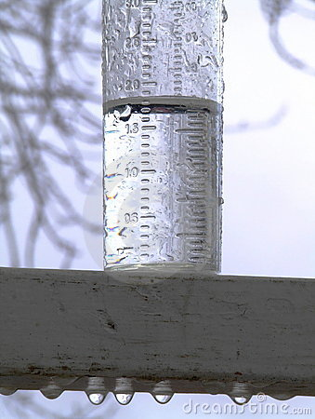
• Markings on the side show how much rain has fallen.

Slide 24
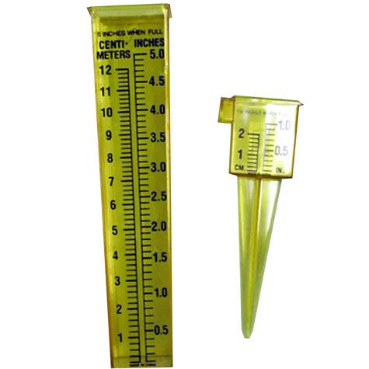
• A rain gauge measures rainfall in inches.

Slide 25
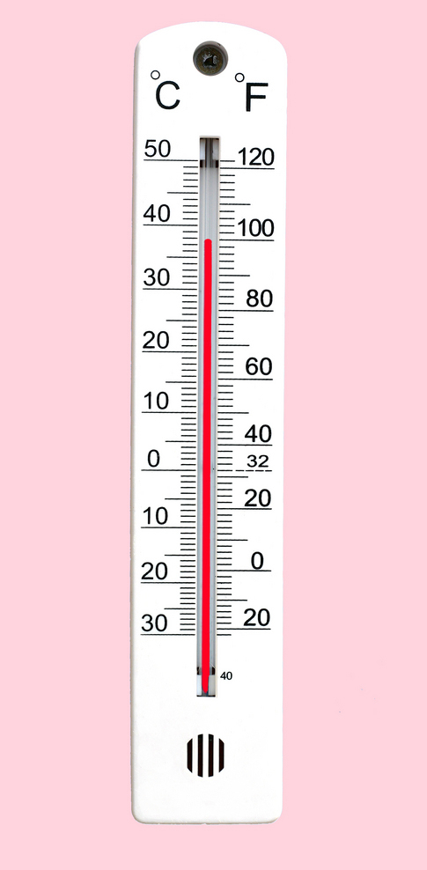
Temperature • Air temperature is measured using a thermometer.

Slide 26
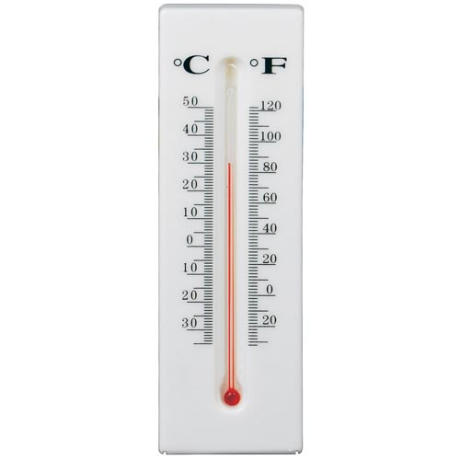
• The scale may be read in degrees Fahrenheit or Celsius

Slide 27
using data collected through daily or long term observations and measurements, patterns in weather can be seen.

Slide 28
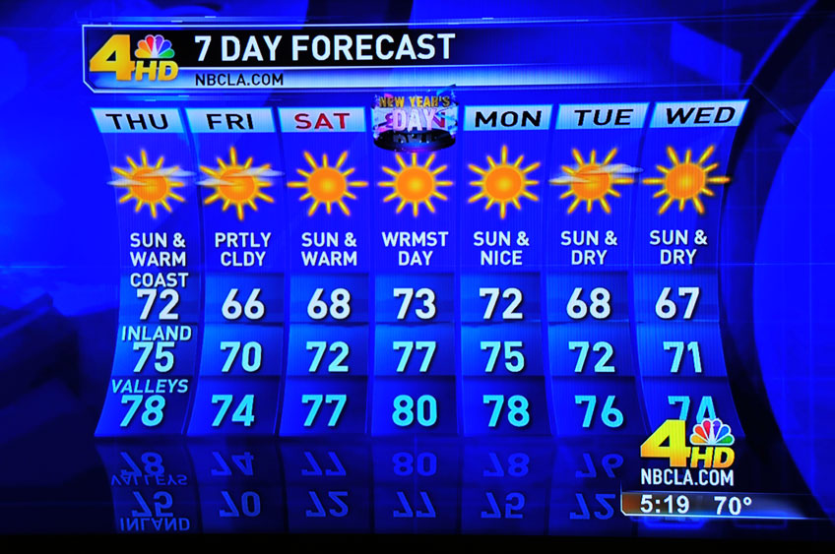
Weather predictions are based on qualitative and quantitative collected data; they are not just guesses.

Slide 29
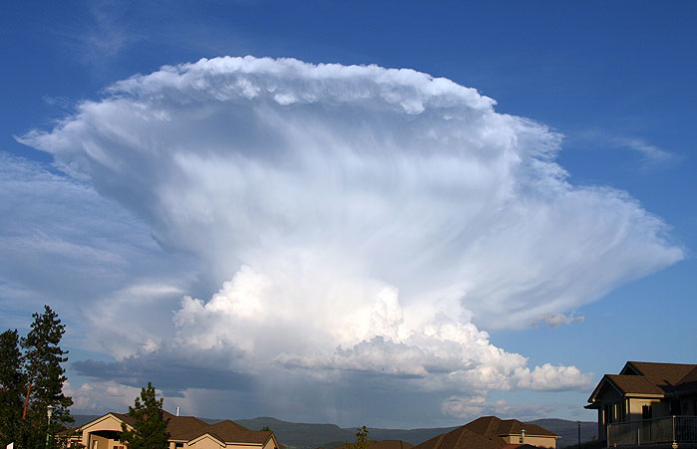
• Some weather signs can be seen by looking at clouds

Slide 30
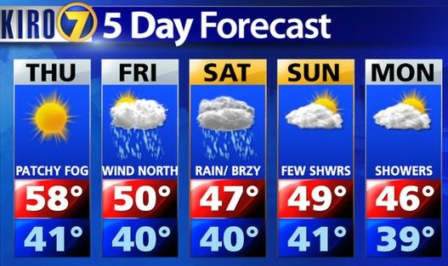
• Changes in wind speed or wind direction can indicate storms or temperature changes.

Slide 31
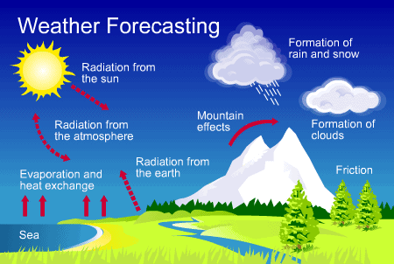
• Meteorologists interpret information from a variety of sources and use those sources to make predictions. The information they use is shown on a weather map.

Slide 32
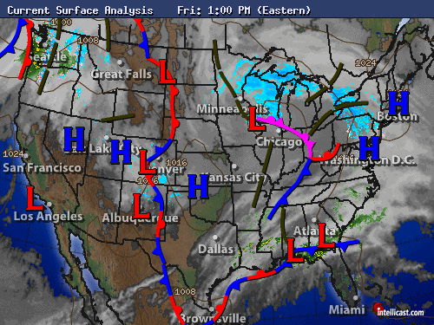
• Weather maps may show large masses of warm or cold moving air. Lines between the air masses are called fronts.

Slide 33
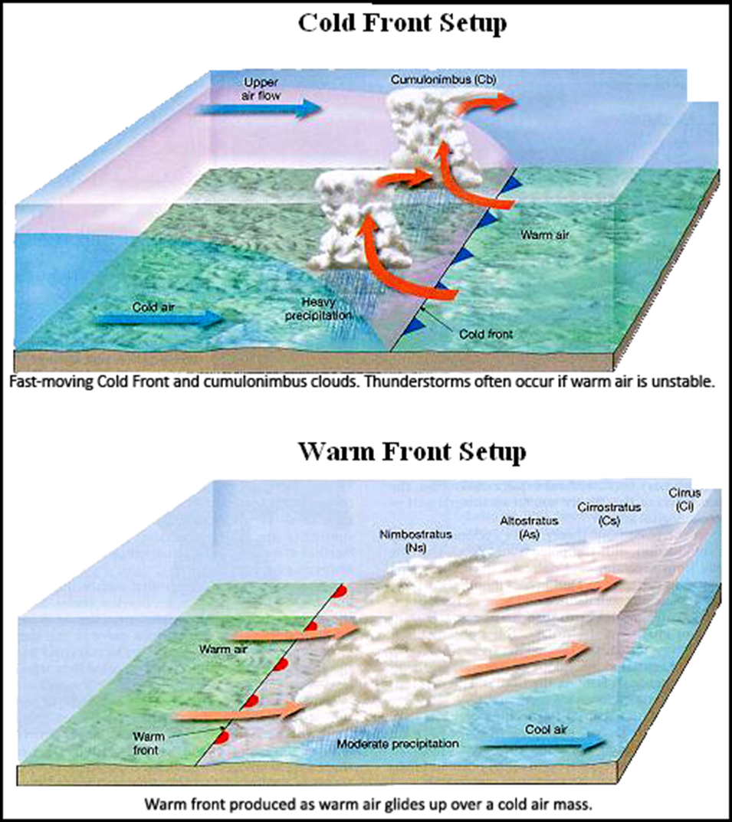
When a warm front passes over an area, the air temperature increases.

Slide 34
When a cold front passes over an area, the air temperature decreases.

Slide 35
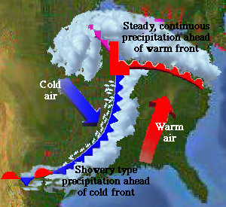
• Data related to temperature and precipitation can also be found on a weather map.

