Slide 1
Road to the Civil War
4-6.3

Slide 2
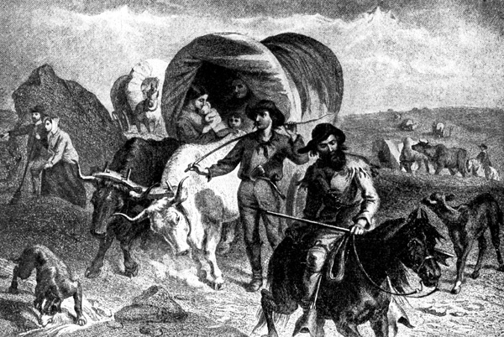
Many Westward expansion events led the Civil War

Slide 3
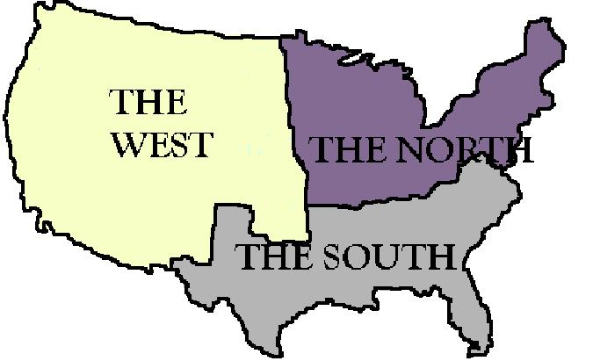
Sectionalism was the belief that each section of the country was more important than the country as a whole

Slide 4
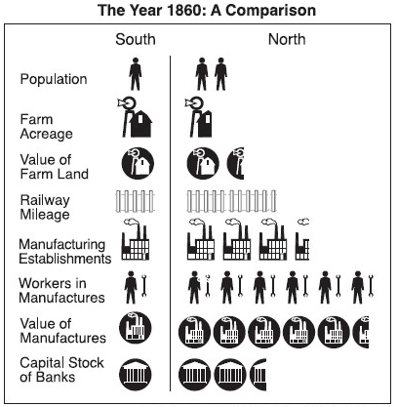
Sectionalism was the result of growing cultural and economic differences between regions particularly their differences over the issues of slavery in the western territories.

Slide 5
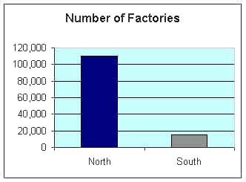
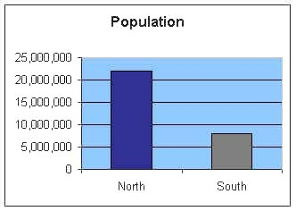
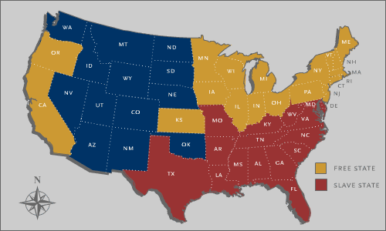
Sectionalism came about due to growing differences in culture and economy between the North, South and new states in the West.

Slide 6
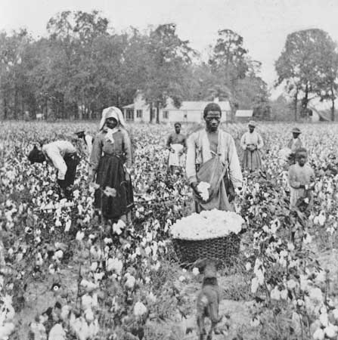
Specifically the argument over slavery in the new states

Slide 7
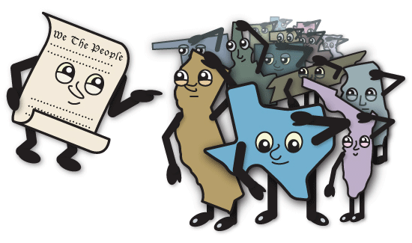
Farmers and plantation owners, usually in the south, supported the idea of states’ rights, in which the authority rests with the states, and they believed a government closer to the people was easier to influence.

Slide 8
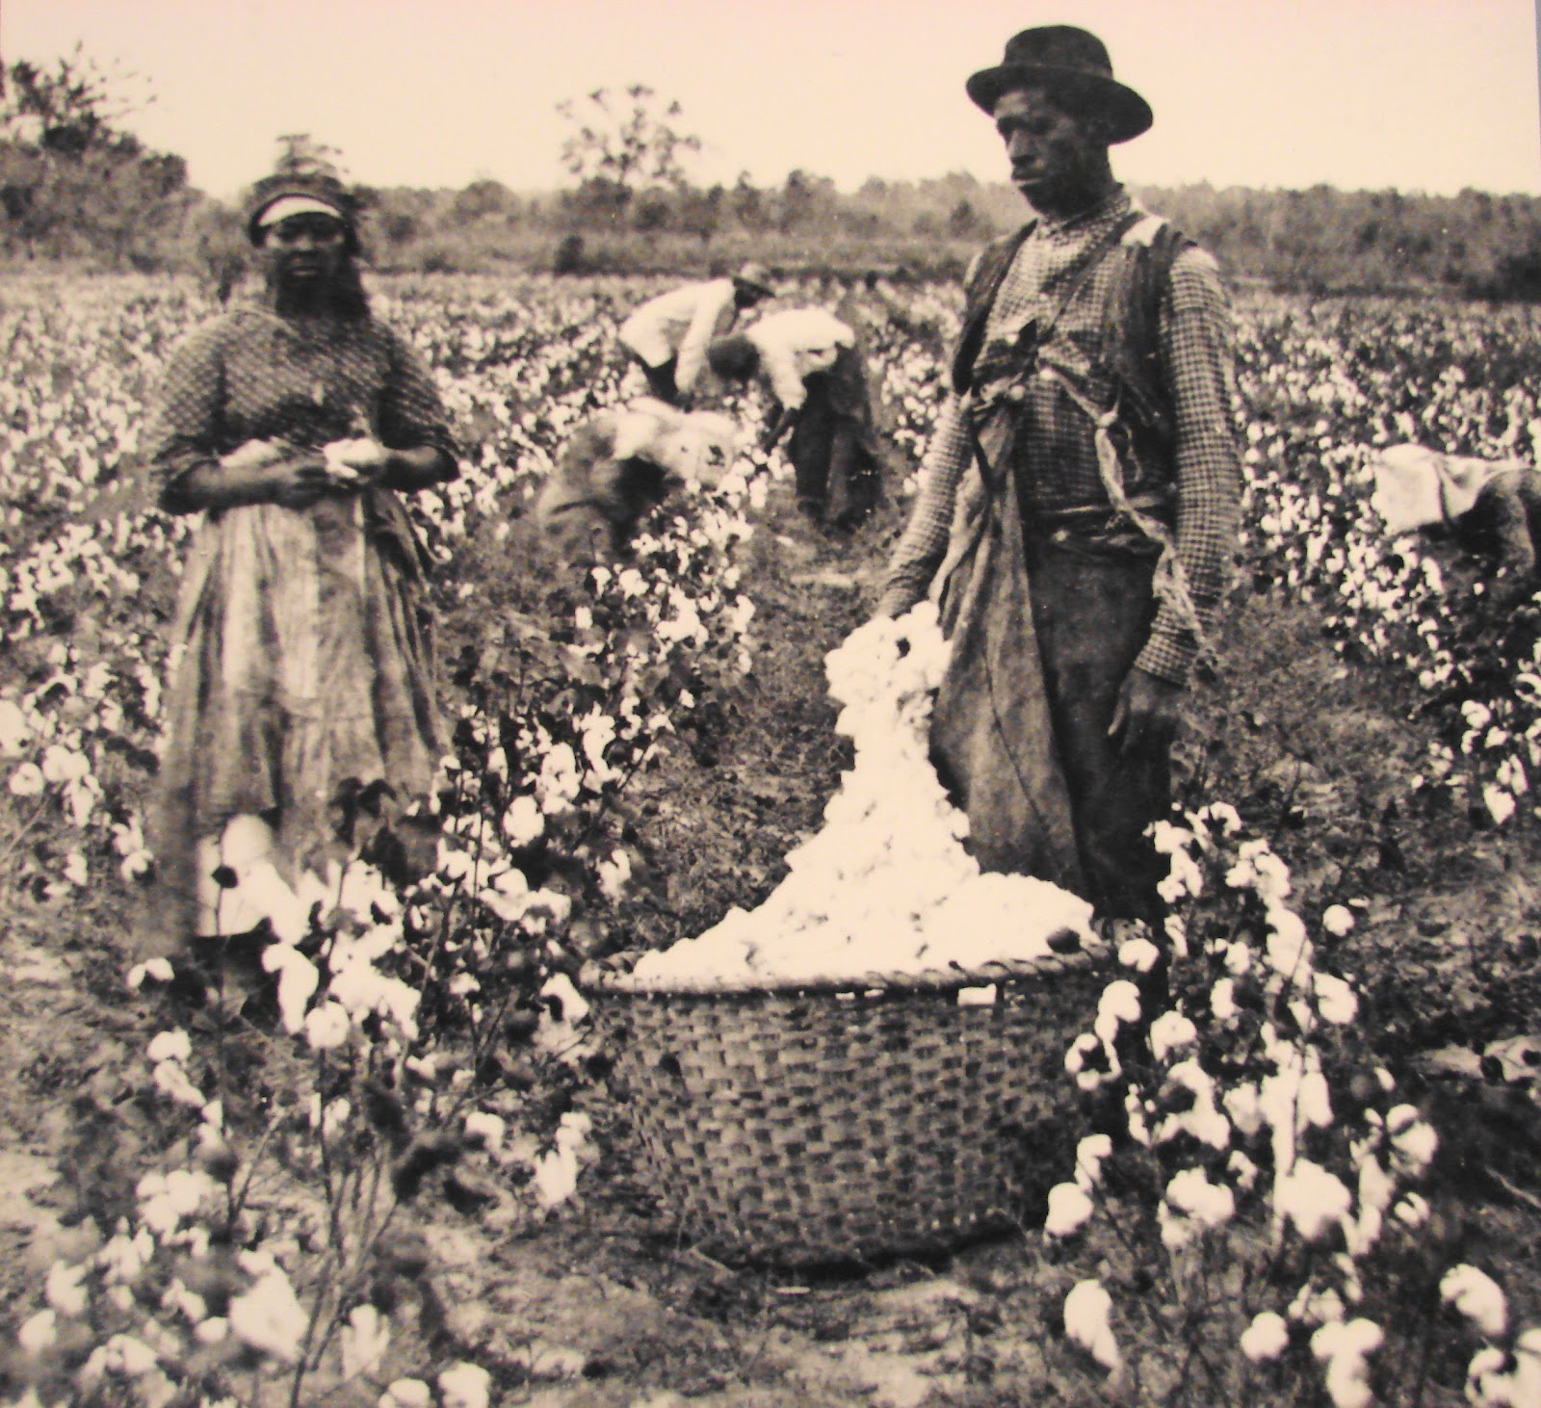
Southerners adopted state’s rights as a way to protect slavery.

Slide 9
Southern states supported states rights, fearing the federal government would take away the right to own slaves in the south like they did for new settlers moving west through the Northwest Land Ordinance and the Missouri Compromise

Slide 10
They feared that the federal government might take away the right to own slaves even though the federal government only had the power to limit the spread of slavery into the territories like the Northwest Ordinance and Missouri Compromise and could not affect the states where it was already established.

Slide 11
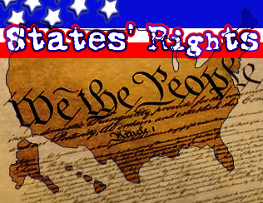
Many Southerners believed authority rested with states’ government NOT people represent by the federal government

Slide 12
Many northerners believed the federal government should make decisions for the entire country

Slide 13
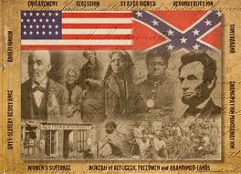
This deep philosophical differences about the structure and power of the federal system is one of the issues that led to the Civil War.

Slide 14
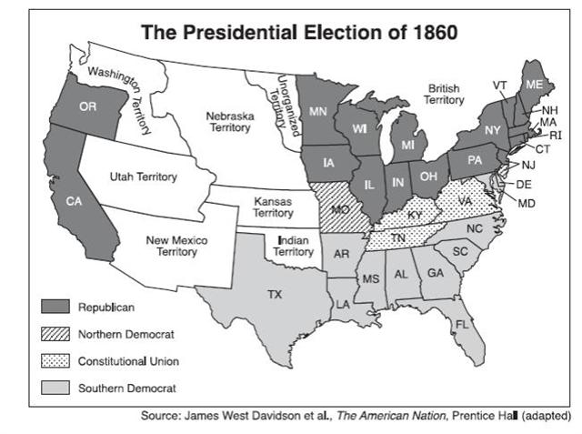
The Presidential Election of 1860 was very controversial too!

Slide 15
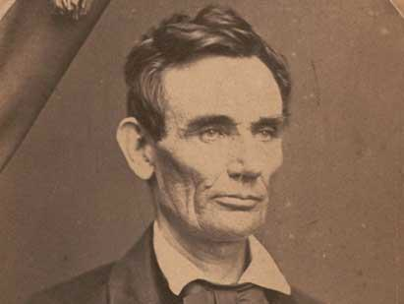
The southern states feared the election of Lincoln as a Republican (seen as an abolitionist party) despite the fact that his ‘free soil’ position on slavery in the territories was well known (that it should not expand into the territories, but was legally established in areas where it already existed).

Slide 16
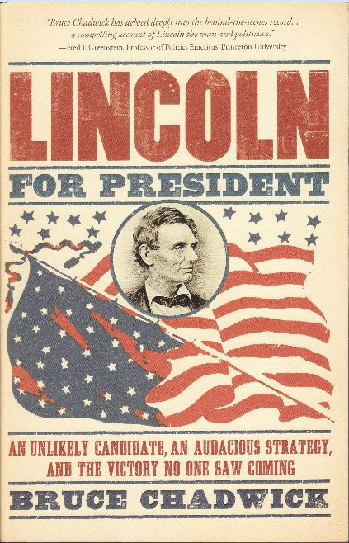
The Republicans were soon convinced that Lincoln best articulated their platform and chose him as the party’s candidate for president in 1860.

Slide 17
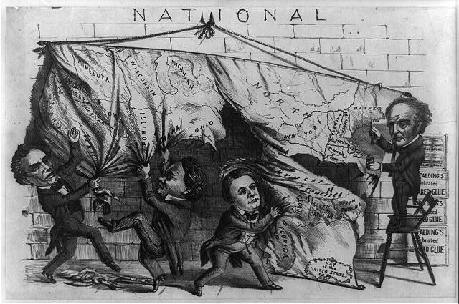
The well-established Democratic Party failed to keep their northern and southern factions together (Southerners insisted on a plank in the party platform that endorsed slavery, causing Northerners to leave the nominating convention.)

Slide 18
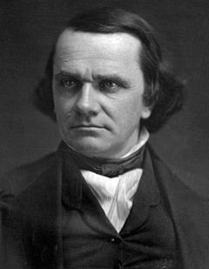
Douglas did indeed become the presidential candidate for the Democratic party in 1860, but the southern half of the party splintered off and formed a third party with their own candidate, as did another political group.

Slide 19
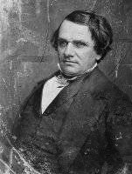
Stephen A Douglas wrote the Kansas-Nebraska Act .

Slide 20
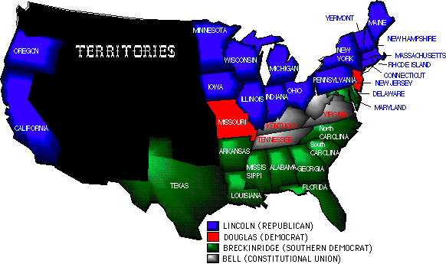
Southerners feared that if Lincoln was elected they would lose power in government as new states became “free states”

Slide 21
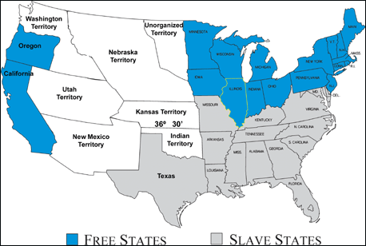
More representatives in the House would come from “Free states” and may lead to the government completely outlawing slavery in the United States

Slide 22
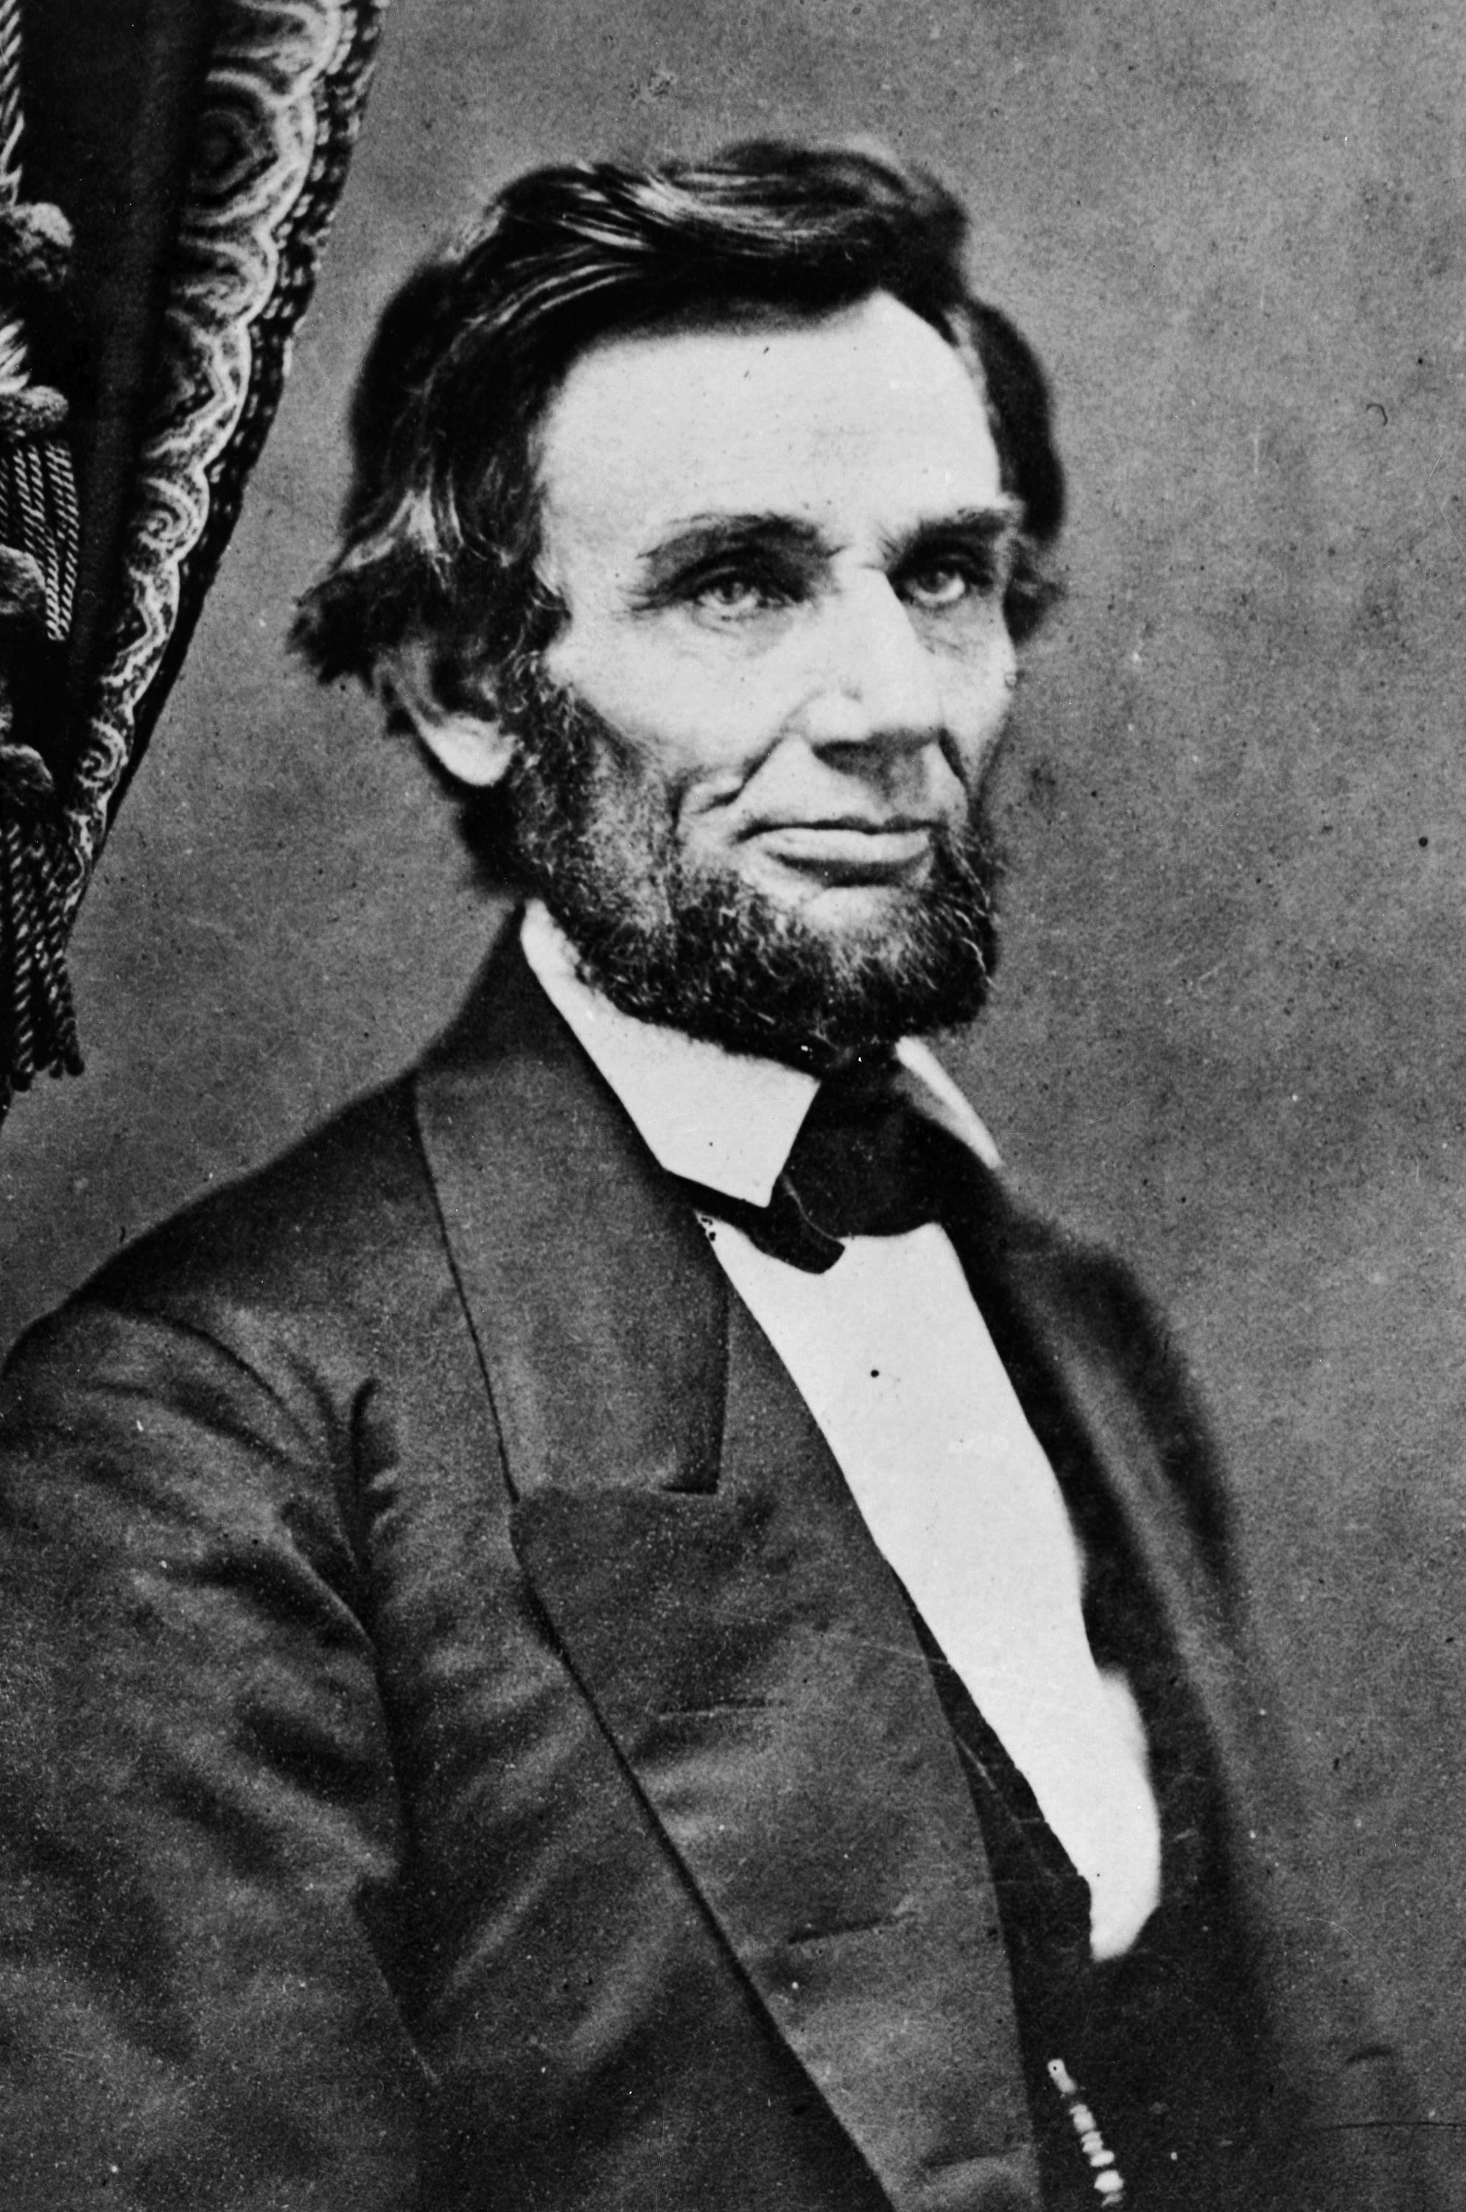
Lincoln’s stated priority was upholding the federal Union.

Slide 23
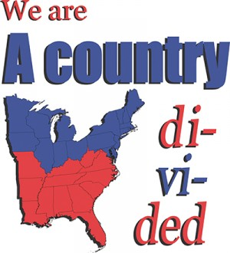
In an atmosphere of heightened sectional distrust, however, an accurate understanding of the candidates’ positions and what could or couldn’t be legally achieved in office (ending slavery?) by one branch of the federal government was greatly biased.

Slide 24
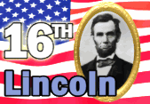
None of the four candidates won a majority of the votes, but Lincoln won a plurality and thus enough electoral votes to become the next president.

Slide 25
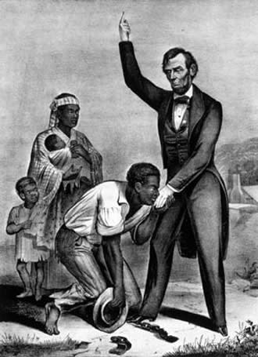
Although they were mistaken, many Southerners thought Lincoln would free all slaves.

Slide 26
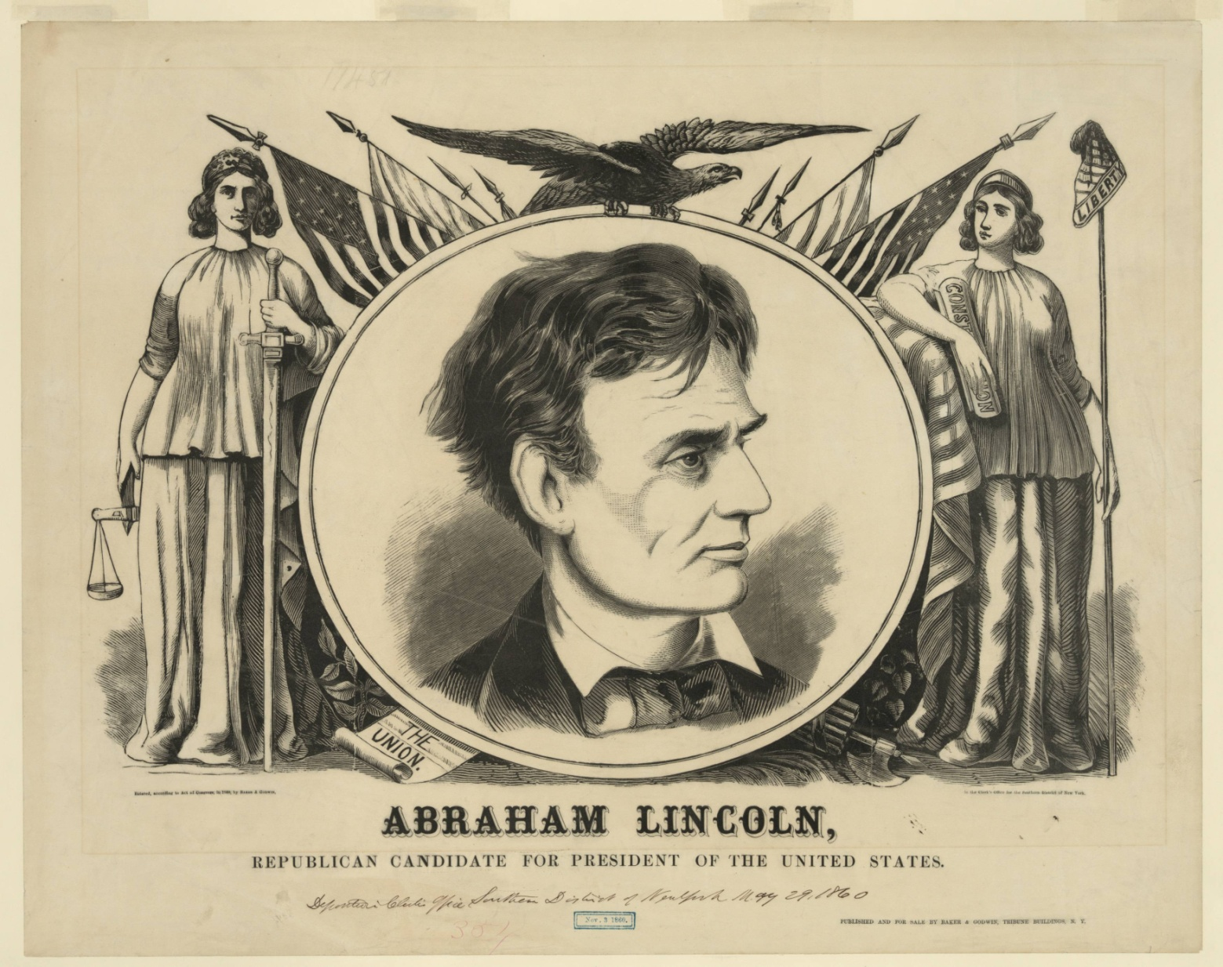
As he campaigned, Lincoln repeatedly said he would respect slavery where it already existed.

Slide 27
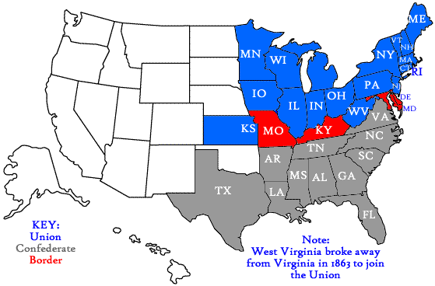
Claiming that they were protecting states’ rights and their way of life, with a few months of the election and prior to the inauguration, seven of the southern states, led by South Carolina seceded from the Union. (An additional 4 states seceded after the firing on Fort Sumter in April 1861.)

Slide 28
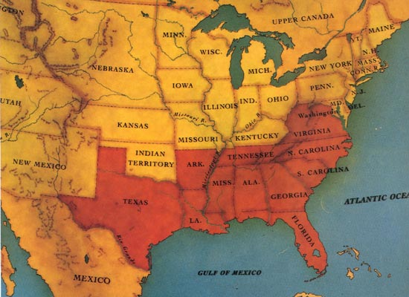
These seceded states declared they were a new country –the Confederate States of America

Slide 29
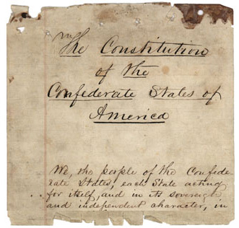
They quickly wrote a constitution that endorsed both slavery and states’ rights

Slide 30
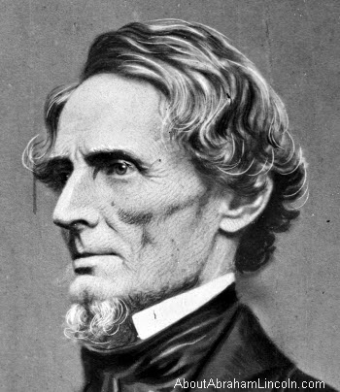
Jefferson Davis was elected as their president

Slide 31
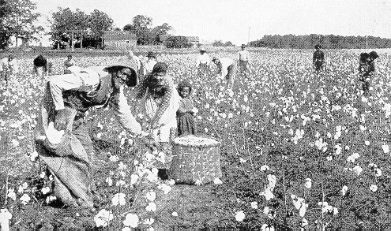
When the Civil War began in 1861 neither the Union nor Confederacy had any intention to change the status of African-Americans in the country.

