Slide 1
Magnets
4-5.9 Summarize the properties of magnets and electromagnets (including polarity, attraction/repulsion, and strength).

Slide 2
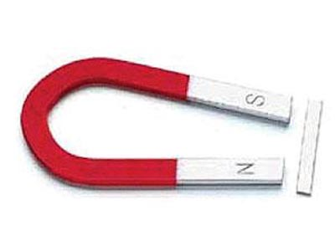
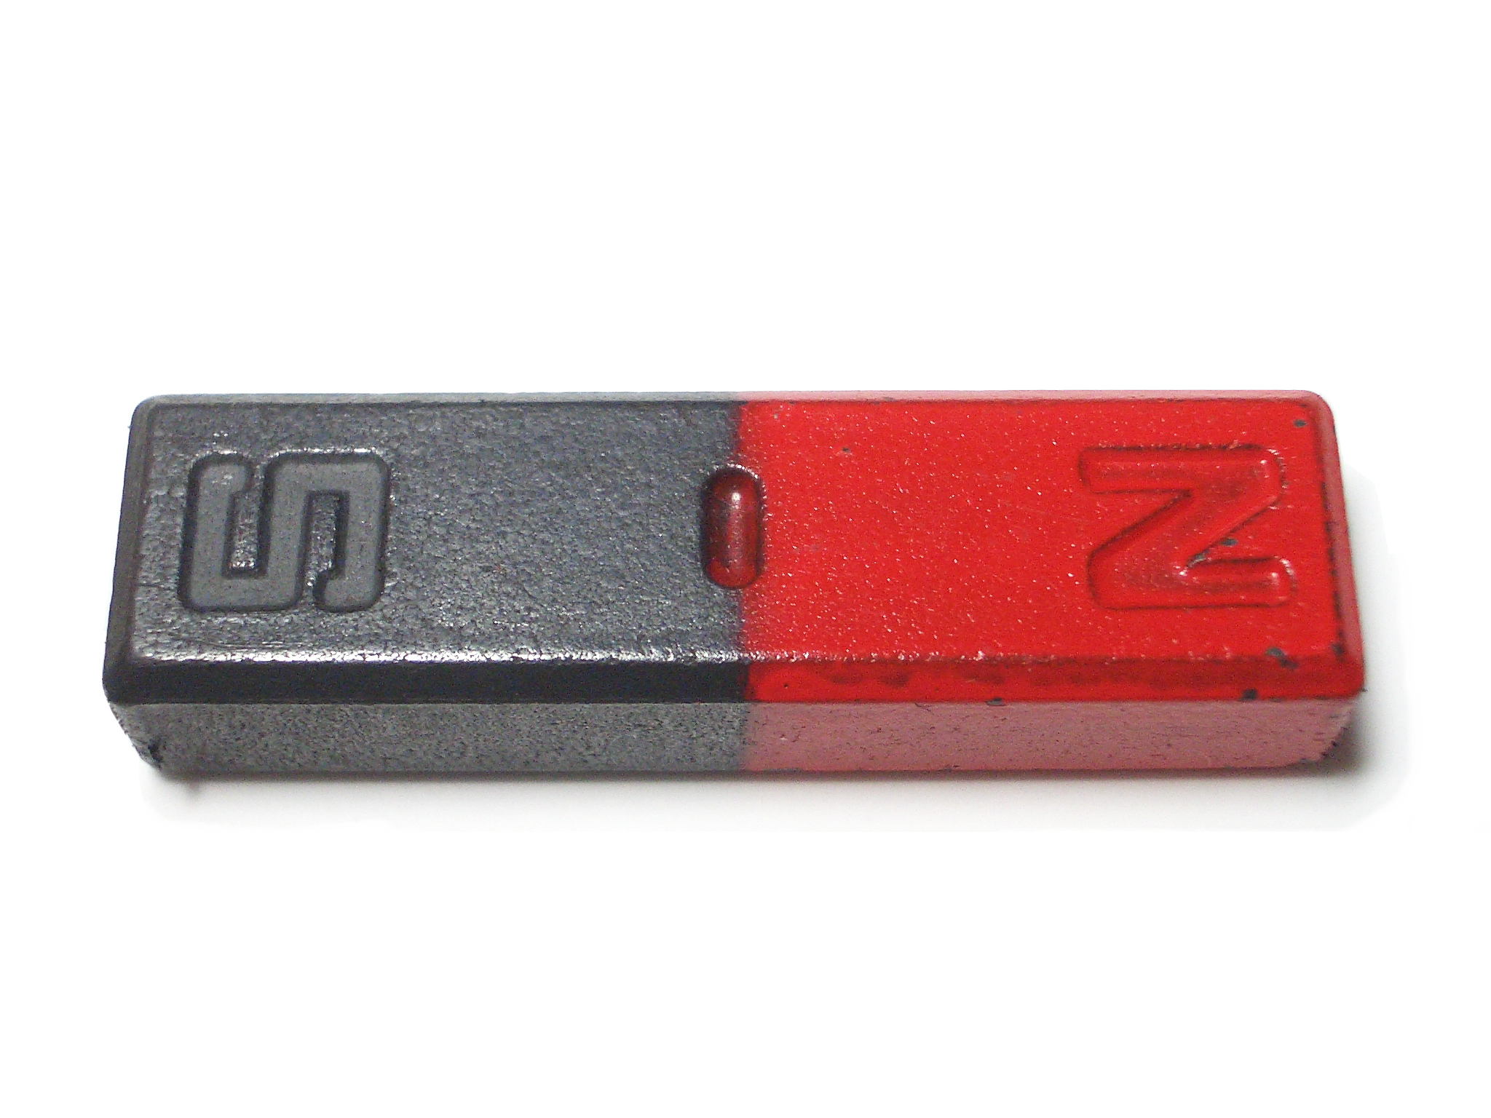
Polarity Magnets and electromagnets have areas on their ends (if bar or horseshoe magnets) or on their tops and bottoms (if ceramic, plastic, or “donut” magnets) that are called poles.

Slide 3
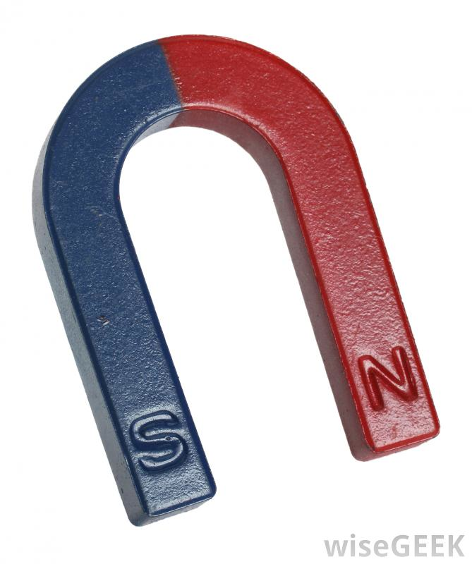
The magnetic pull or attraction is strongest at these poles. Every magnet has a North pole and a South pole.

Slide 4
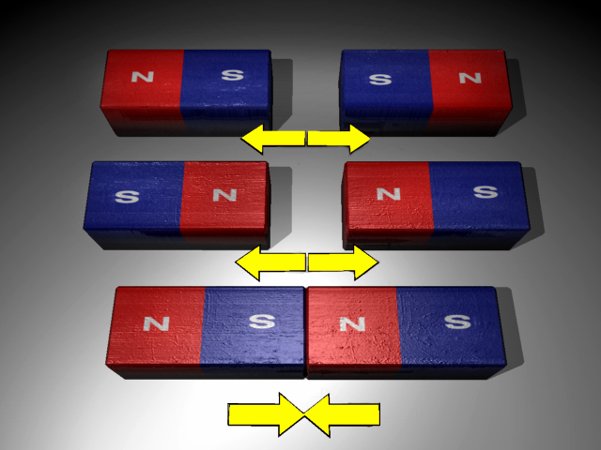
The poles of magnets affect each other in the following ways: Like poles If the North pole of one magnet and the North pole of another magnet are brought close to each other, they will move away from each other or repel.

Slide 5
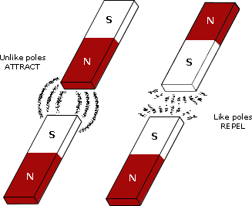
The same thing happens if the South pole of one magnet and the South pole of another magnet are brought close to each other.

Slide 6
Like poles repel each other.

Slide 7
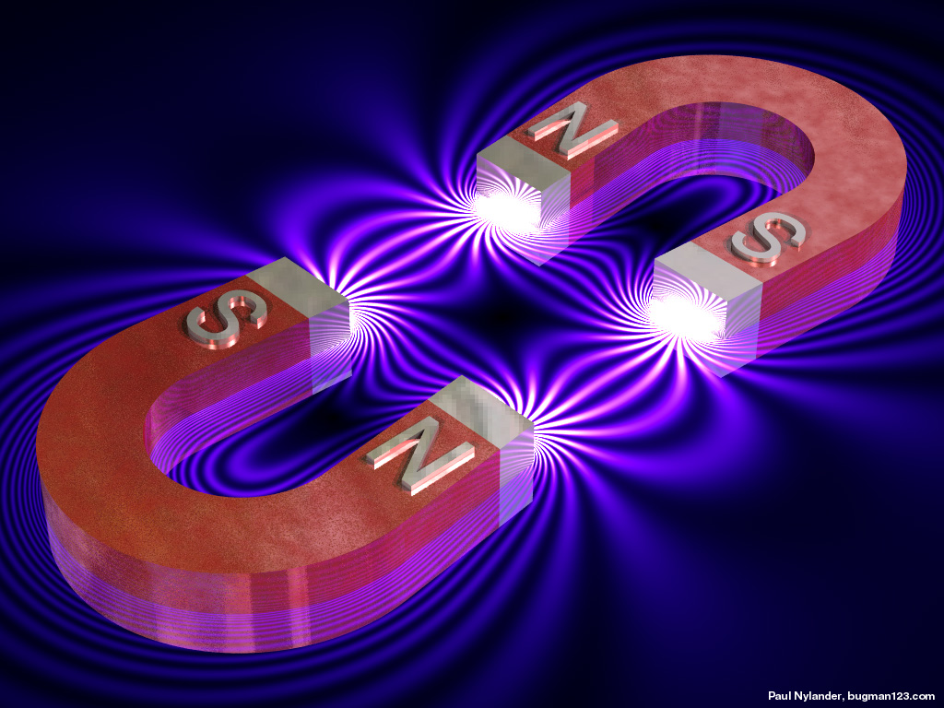
Unlike poles If the North pole of one magnet and the South pole of another magnet are brought close to each other, they will move toward each other or attract.

Slide 8
Unlike poles attract each other.

Slide 9
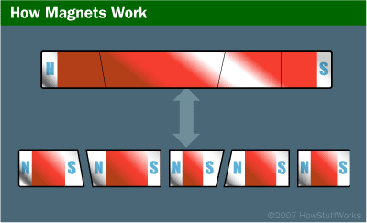
Attraction Magnets and electromagnets attract or tend to move toward each other (if unlike poles are near each other) and certain types of metals (mainly iron or steel).

Slide 10
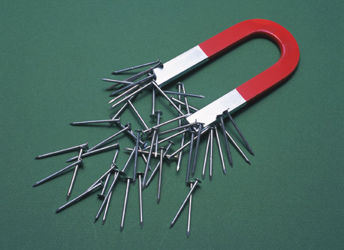
When iron nails or steel paper clips are held near a magnet, they will move toward or be attracted to the magnet.

Slide 11
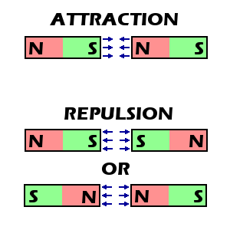
Repulsion Magnets and electromagnets can repel or move away from each other if their like poles (North-North or South-South) are brought near each other.

Slide 12
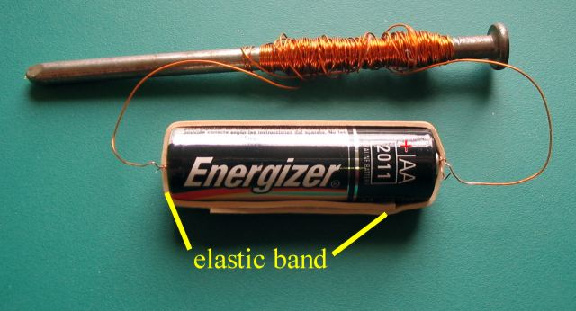
an electromagnet becomes a magnet when an electric current passes through an insulated wire that is wrapped around an iron core nail

Slide 13
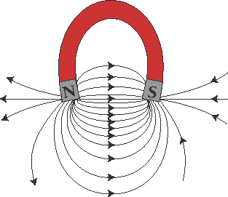
Strength The attractive strength of a magnet or electromagnet is greatest at its poles.

Slide 14
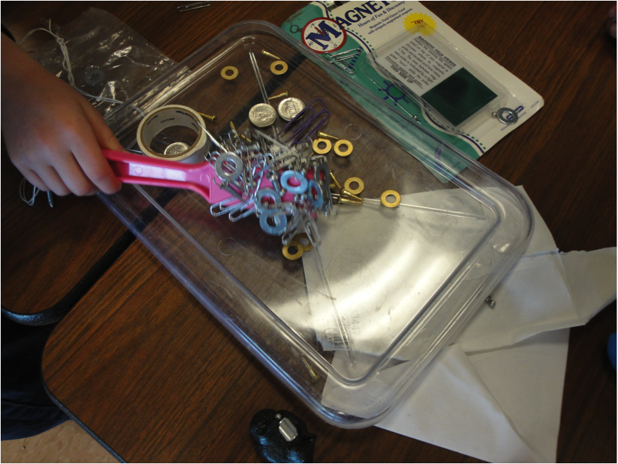
Some magnets have a greater attraction for magnetic materials than others.

Slide 15
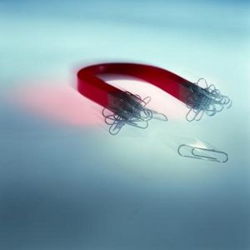
The size of the magnetic attraction of a magnet or electromagnet can be measured by counting the number of objects, for example paper clips that a magnet can pick up.

