Slide 1
Key Battles of the Revolutionary War
4-3.3: Summarize the importance of the key battles of the Revolutionary War and the reasons for
the American victories including Lexington and Concord, Bunker (Breed’s) Hill, Charleston,
Saratoga, Cowpens, and Yorktown.

Slide 2
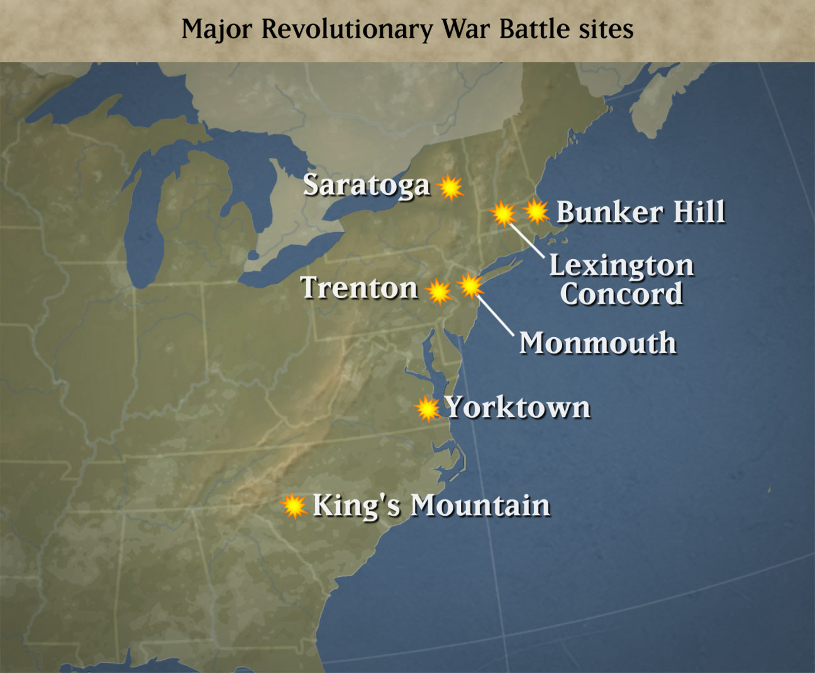
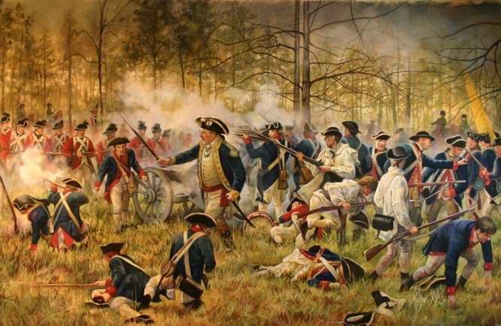
Some events and battles of the Revolutionary War were so significant that historians refer to them as “key.”

Slide 3
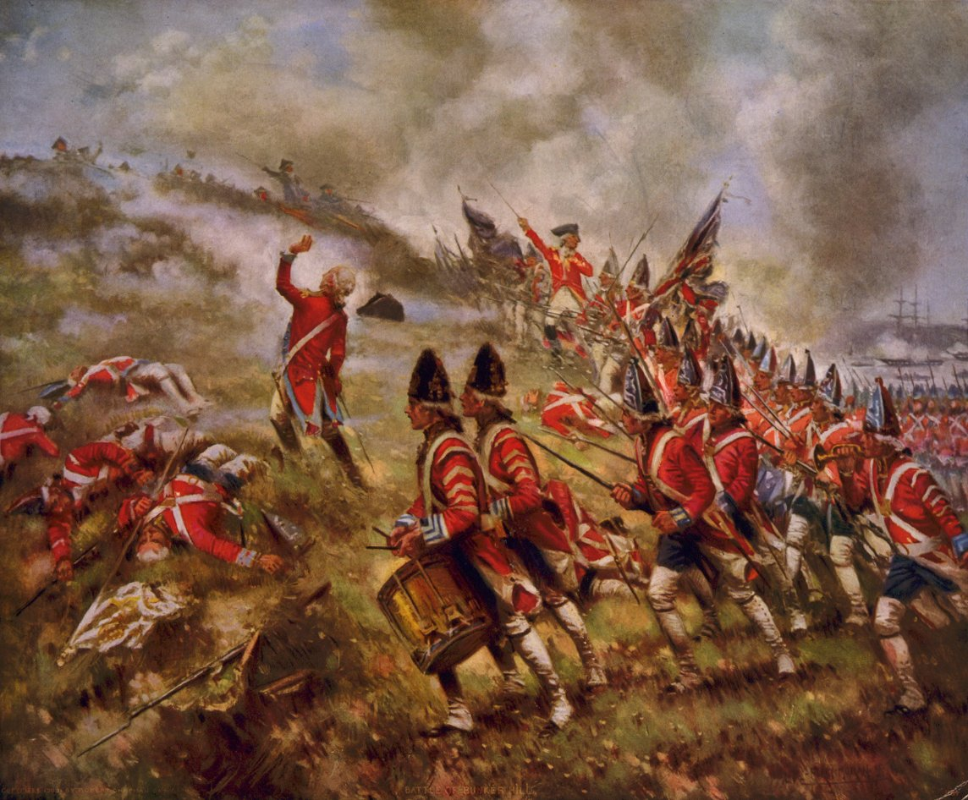
We will talk about why these particular battles were turning points in the fighting of the Revolution.

Slide 4
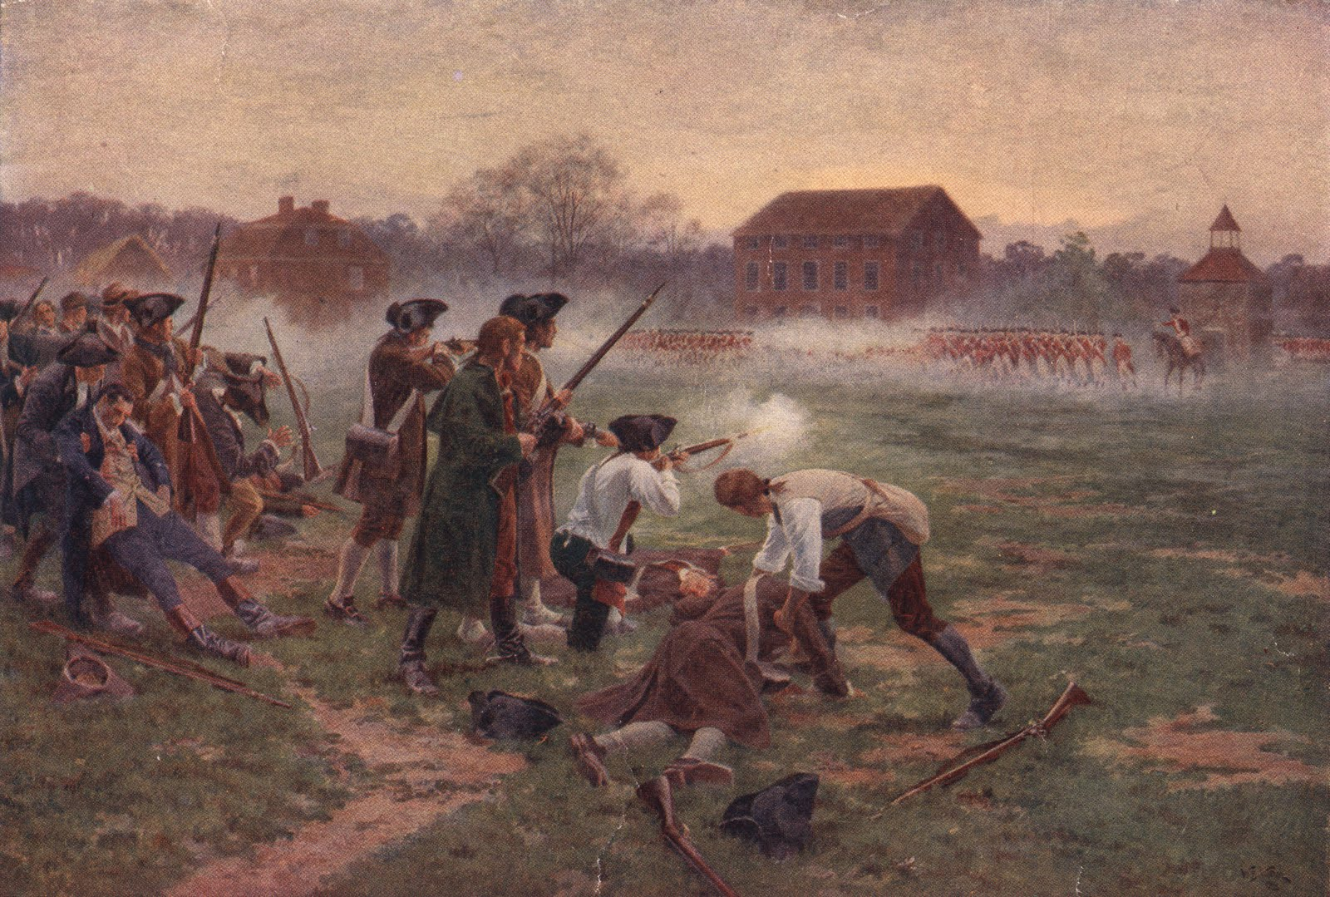
1. Lexington and Concord

Slide 5
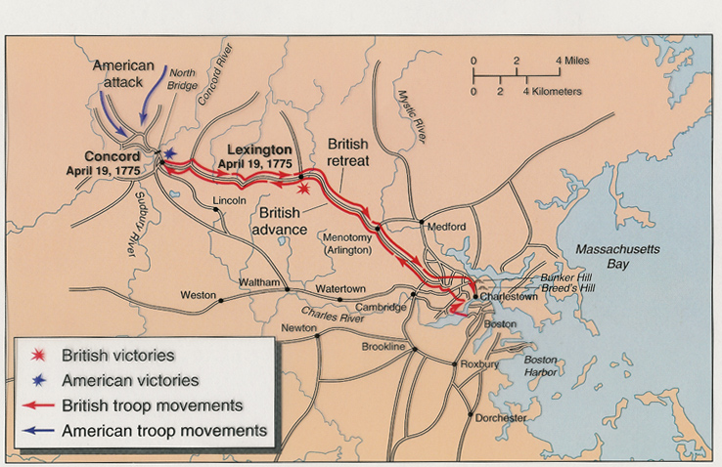
Lexington and Concord were small towns outside of Boston.

Slide 6
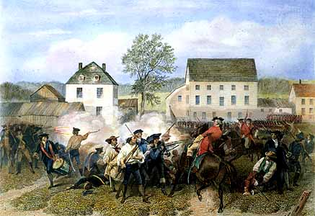
The first shots of the Revolution were fired at Lexington.

Slide 7
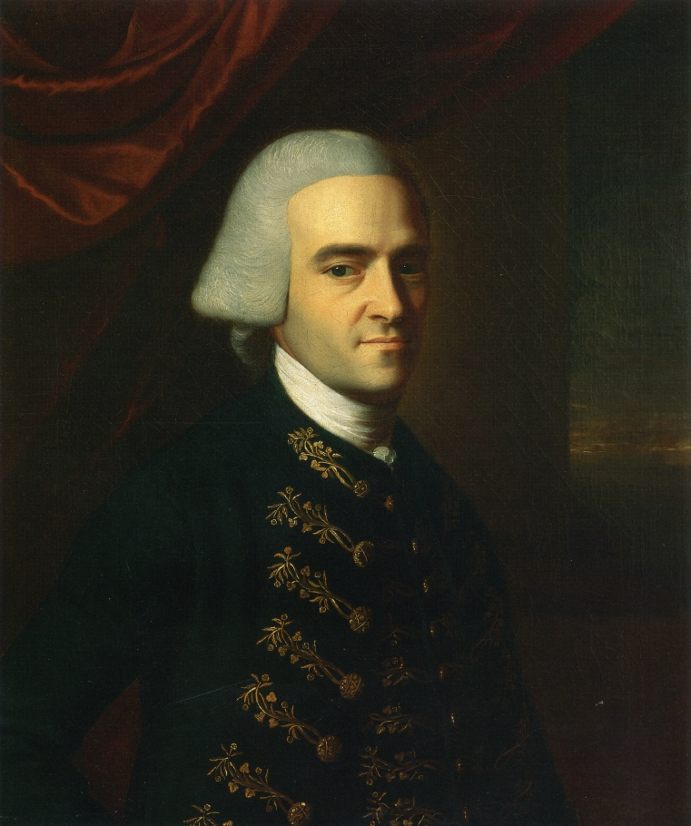
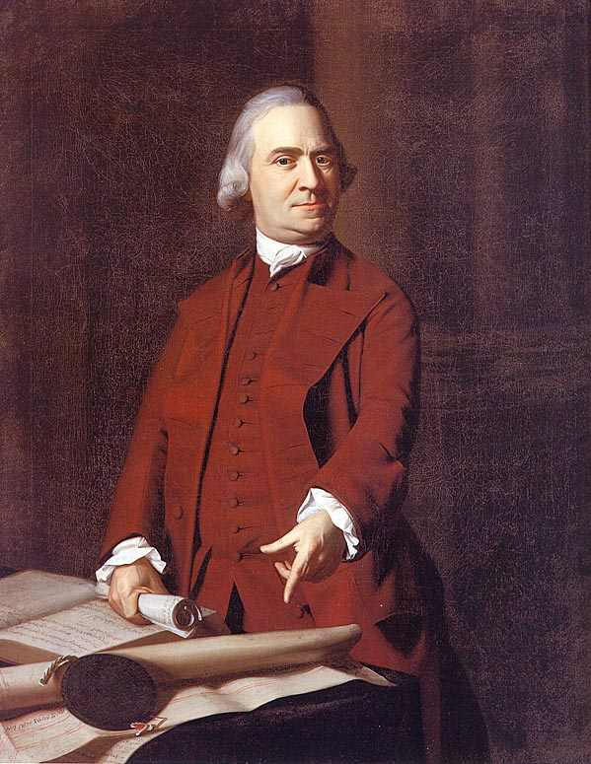
The British marched out of the city of Boston to capture suspected troublemakers (members of the Sons of Liberty, Sam Adams and John Hancock on their way to the Continental Congress) at Lexington and destroy the military supplies that were stored by the colonists at Concord.

Slide 8
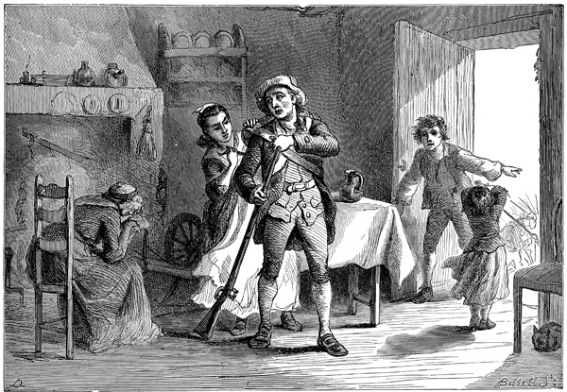
Minutemen were ready when the British Redcoats arrived at Lexington.

Slide 9
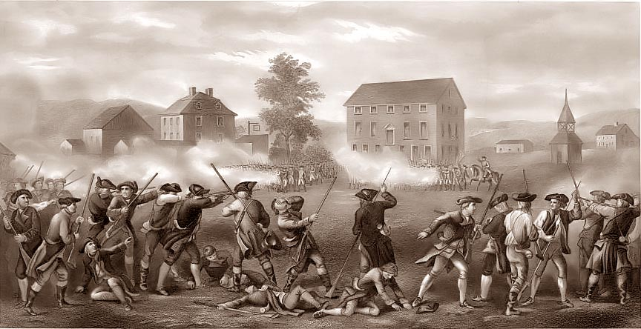
This event is sometimes referred to as the “shot heard round the world” because of the impact of American revolutionary ideals on other nations.

Slide 10
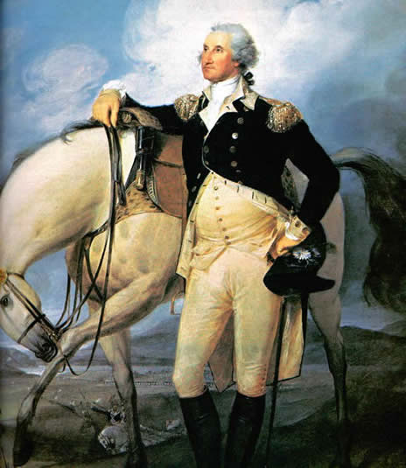
As a result, the Second Continental Congress met and named George Washington Commander-in-Chief of the army that gathered around Boston after Lexington and Concord.

Slide 11
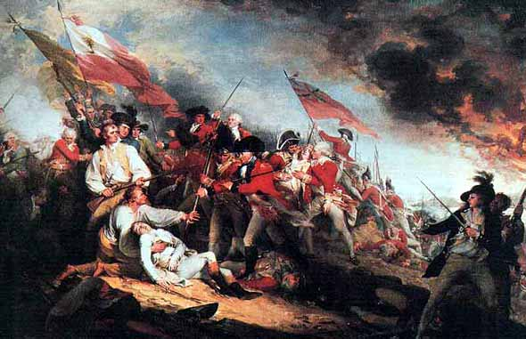
2. The Battle of Bunker (Breed’s) Hill

Slide 12
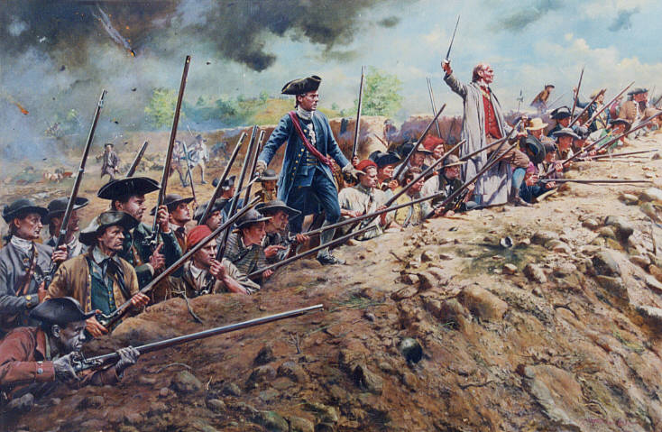
The Battle of Bunker (Breed’s) Hill was significant because of what the Americans learned.

Slide 13
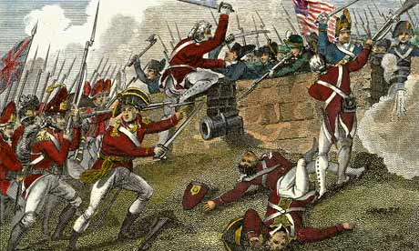
Although the untrained American troops were forced to surrender when they ran out of gunpowder, they inflicted heavy casualties on the British regular army.

Slide 14
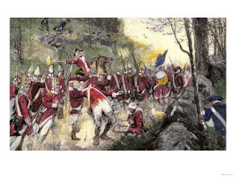
The battle demonstrated the power of the Americans fighting from behind rocks and trees on the British formations (then called “Indian style” and presently known as guerrilla warfare).

Slide 15
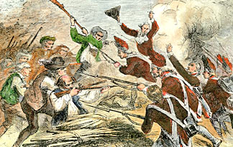
It also showed that Americans would need allies to supply ammunition and assistance.

Slide 16
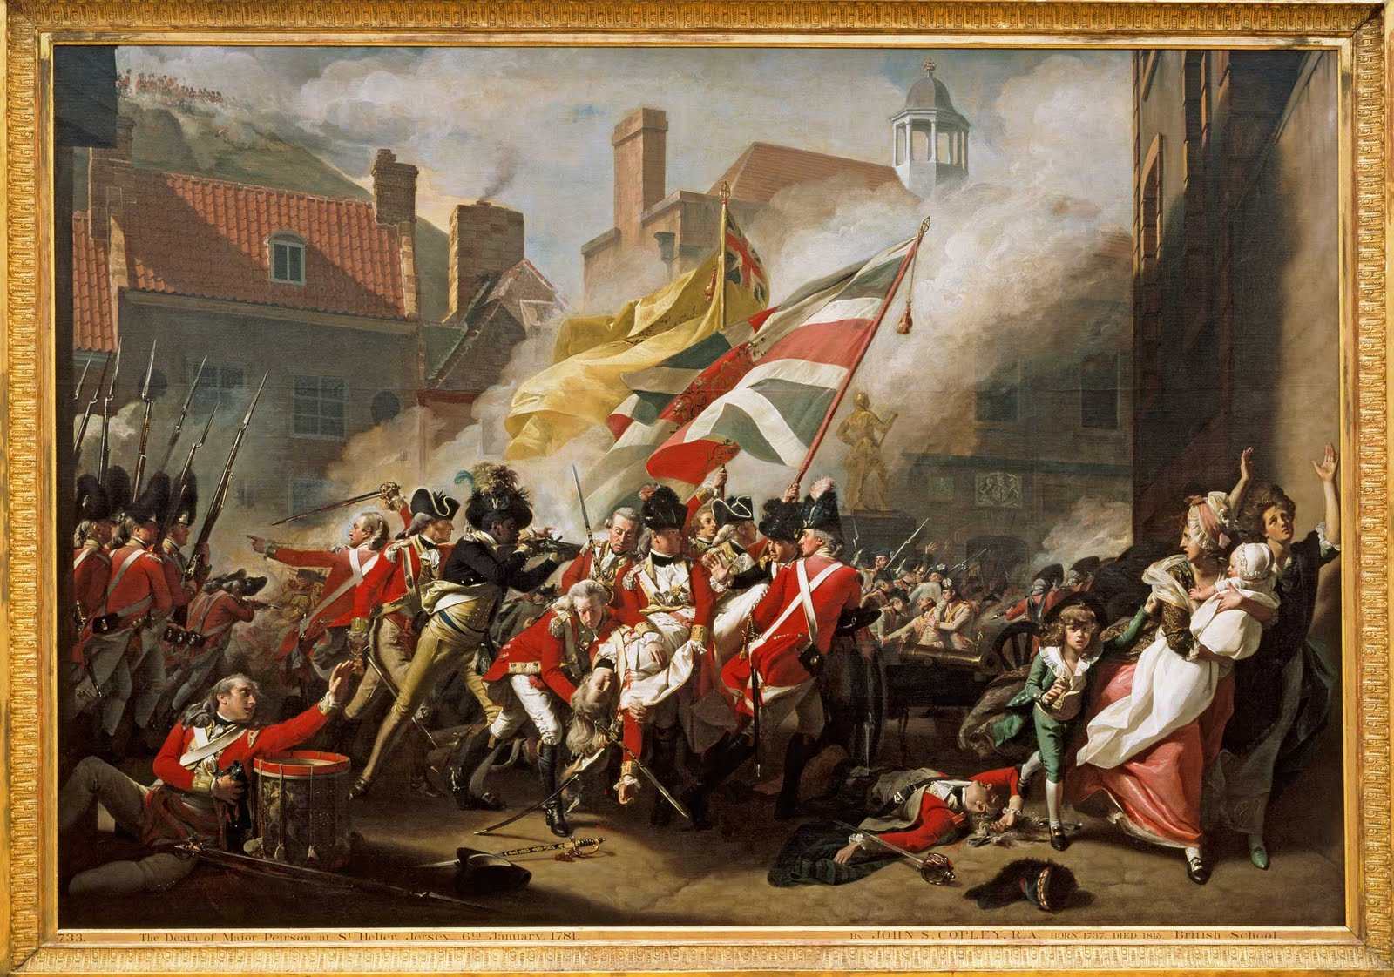
The British soon evacuated Boston and sailed to New York where they hoped to find Americans who were still loyal to King George III.

Slide 17
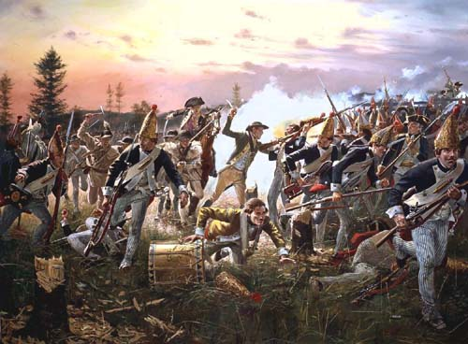
3. The Battle of Saratoga, New York

Slide 18
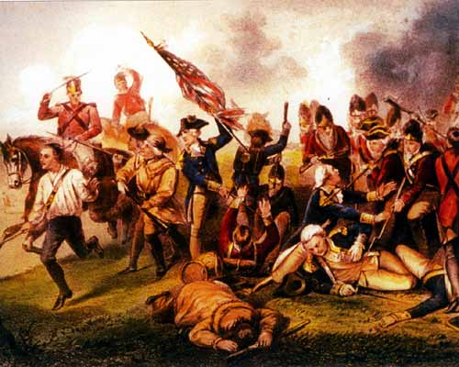
The Battle of Saratoga, New York was the turning point of the war for the American Patriots.

Slide 19
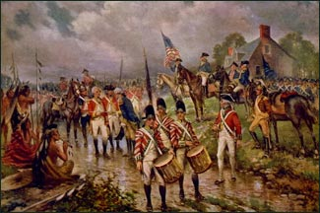
American forces defeated the British in their attempt to split the colonies at the Hudson River.

Slide 20
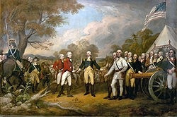
Because of this victory, the French (and the Spanish and Dutch, to a lesser degree) were willing to enter into an alliance with the Americans.

Slide 21
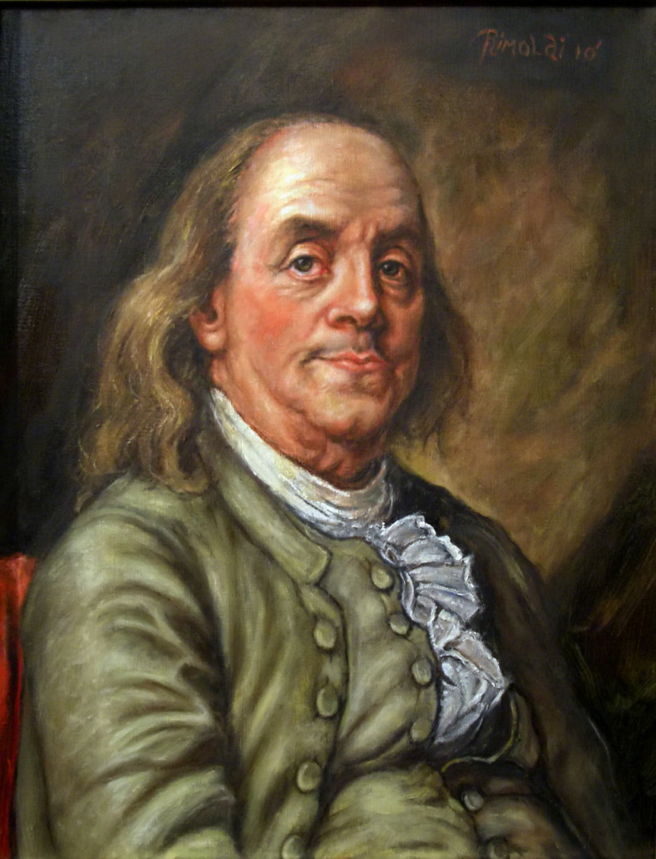
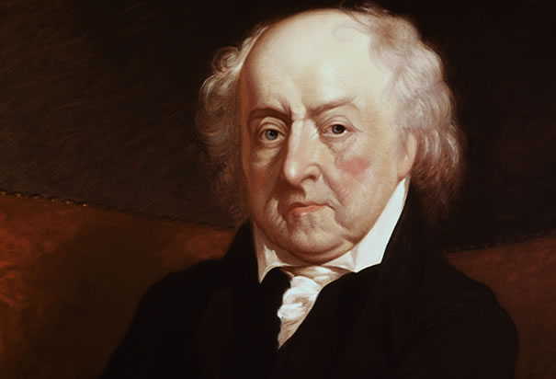
This alliance, brought about by Benjamin Franklin’s and John Adam’s efforts, provided aid in the form of ships, soldiers, supplies, and financial assistance in return for opportunities to settle old scores in rivalries as well as benefit economically by continuing to trade with the new nation.

Slide 22
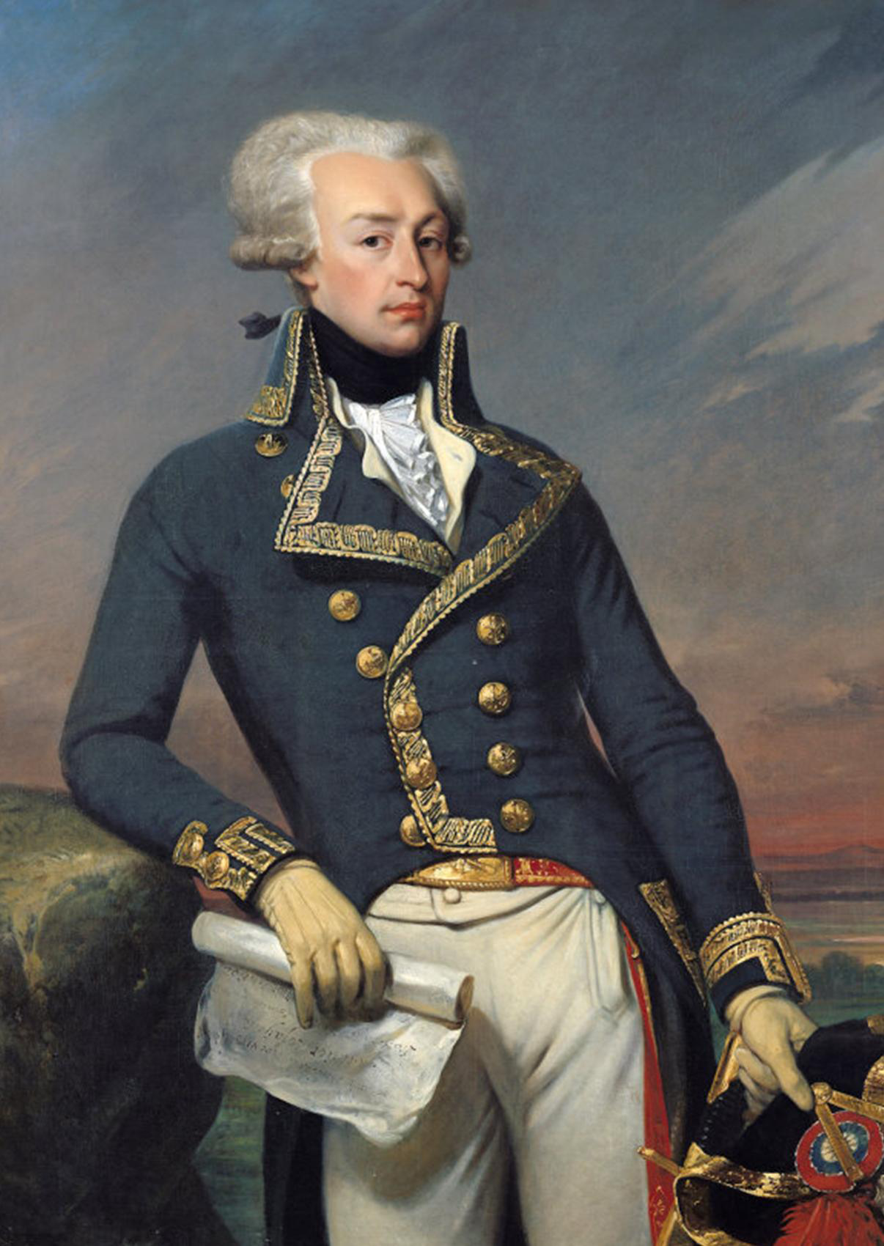
(Individuals enamored with the American cause had already volunteered their military assistance /expertise, such as the Marquis de Lafayette.)

Slide 23
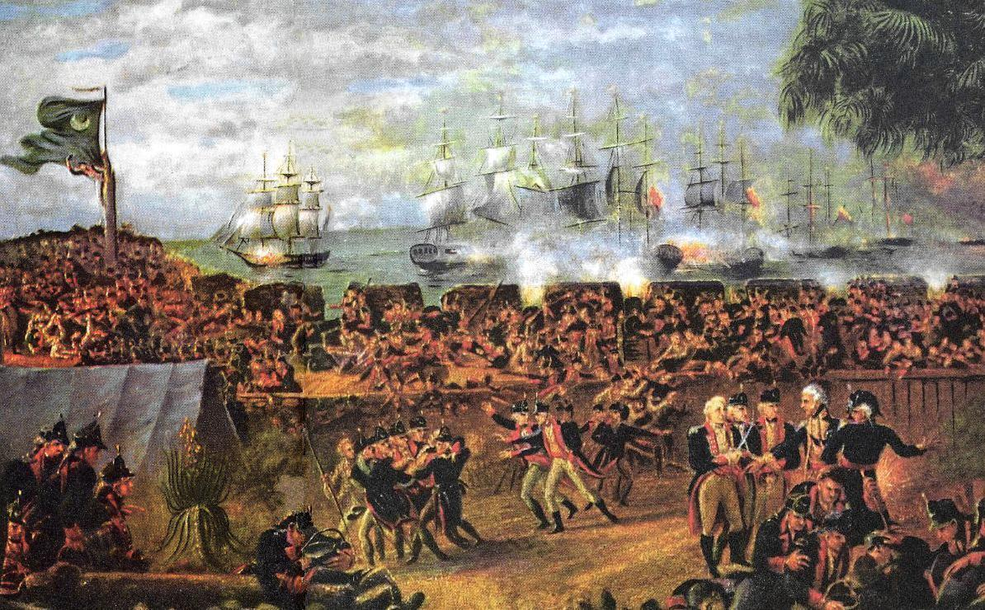
4. Charleston, South Carolina

Slide 24
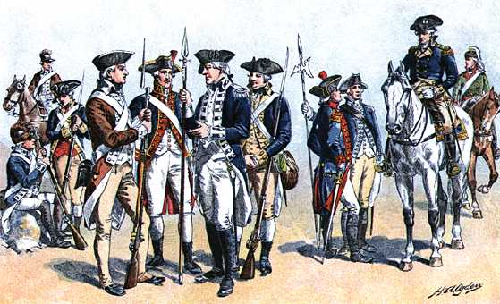
Soon after their defeat in New York, the British turned their attention to South Carolina where they hoped to find a large number of Loyalists.

Slide 25
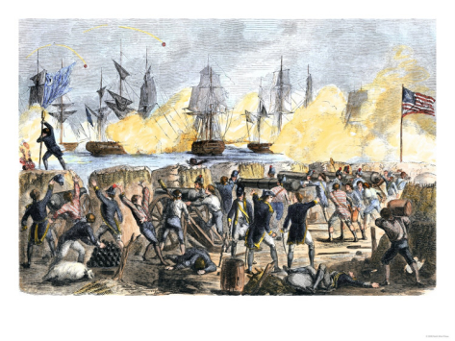
Although the first attempt by the British to capture Charleston was thwarted by the tides and the resilience of the palmetto log fort that became known as Fort Moultrie, the British were successful the second time around.

Slide 26
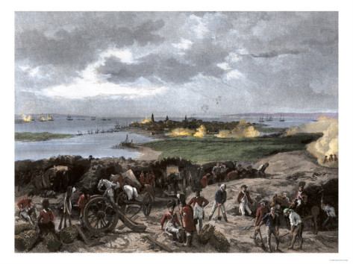
The port of Charleston, South Carolina was under siege by the British for many days.

Slide 27
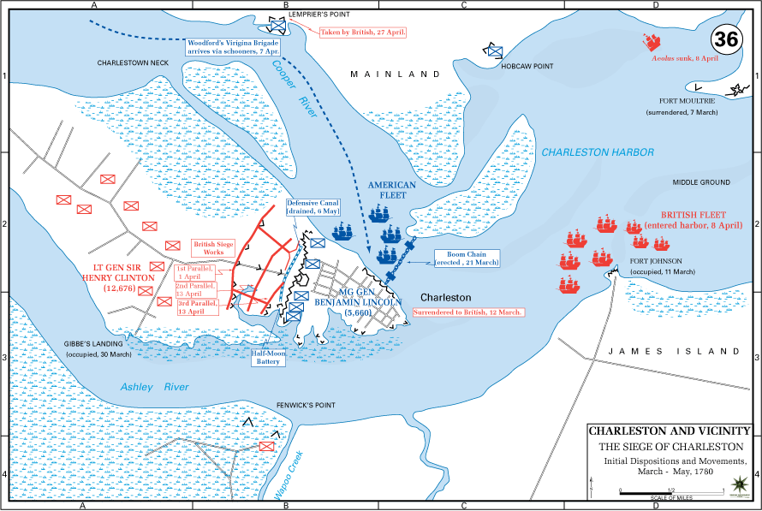
It was attacked by blockading the harbor and cutting off supply lines, until it fell to the British.

Slide 28
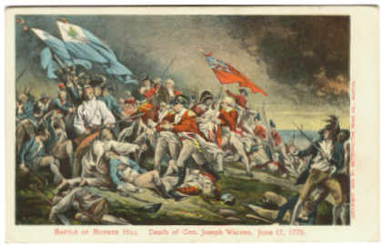
Soon Patriot partisans were fighting the British regular troops and Loyalists forces using hit and run tactics.

Slide 29
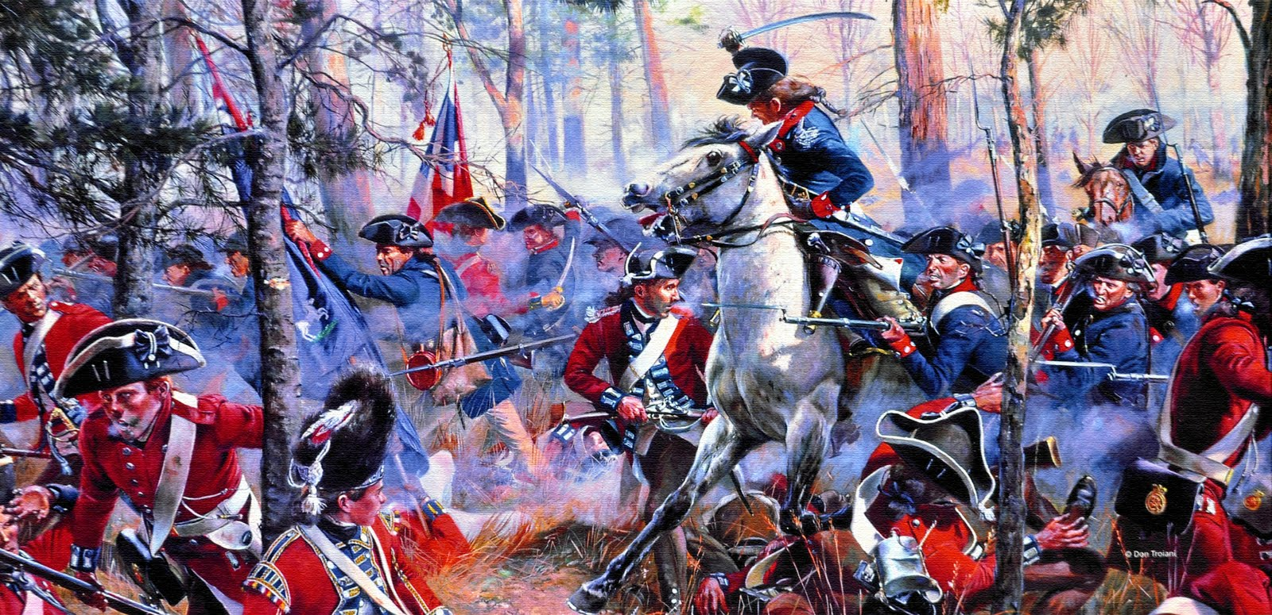
5. Cowpens, South Carolina

Slide 30
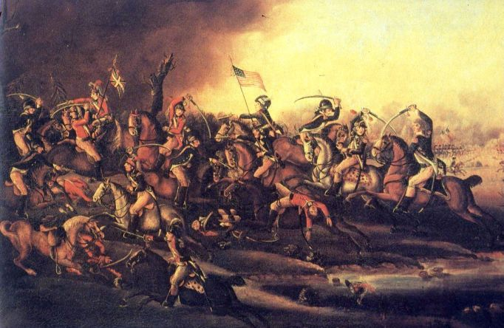
Cowpens was an important battle in South Carolina and showed the cooperation of the regular Continental Army and the irregular partisan forces.

Slide 31
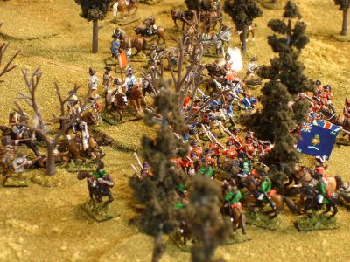
The partisans led the attack and then fled the field, tricking the British regulars into thinking that the Americans were retreating.

Slide 32
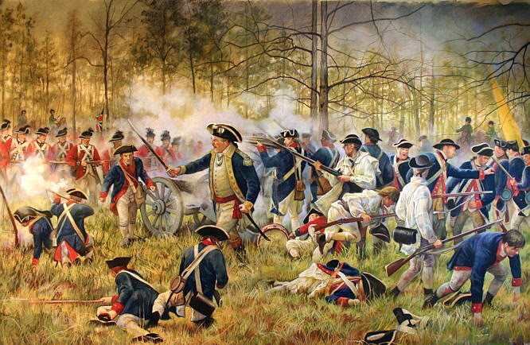
Instead the partisans lured the British forces into the range of the regular American army.

Slide 33
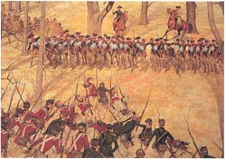
The British were soundly defeated and retreated northward toward Virginia, where they would temporarily camp while awaiting transport by the navy to their winter quarters.

Slide 34
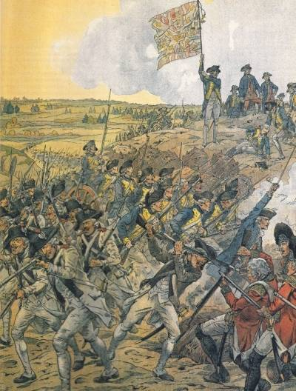
6. Yorktown, Virginia

Slide 35
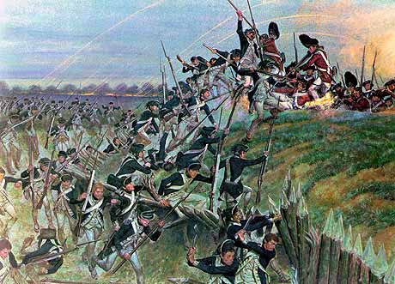
Yorktown (a peninsula in Virginia) thus became the final battle of the war.

Slide 36
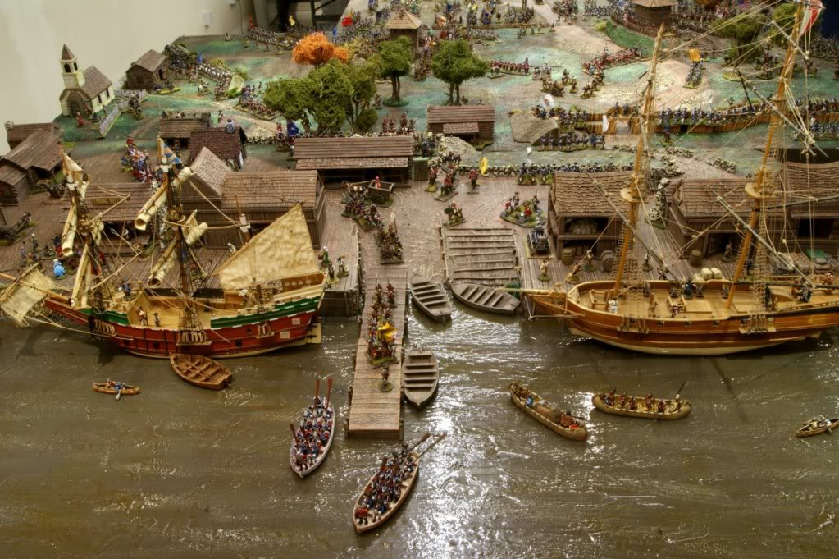
The French navy assisted General George Washington and his army by blockading the harbor.

Slide 37
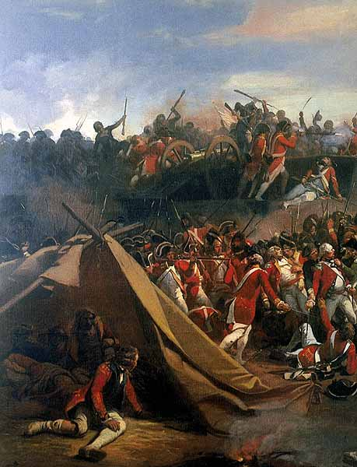
The blockade prevented British ships from entering the harbor and allowing the British army to escape the American troops on land.

Slide 38
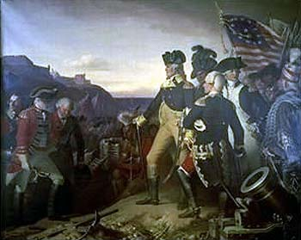
Surrounded by American and French forces on land and sea, the British were out-maneuvered, defeated and therefore surrendered.

Slide 39
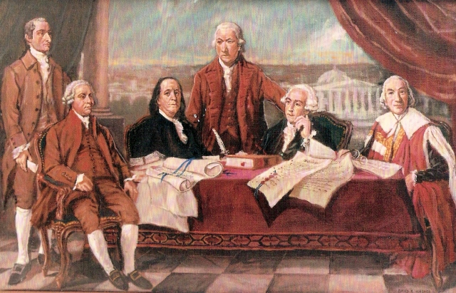
A peace treaty was negotiated by Benjamin Franklin, John Adams and John Jay was finally agreed upon two years later [Peace of Paris 1783]

