Slide 1
Great Basin Native American tribes
4.1

Slide 2
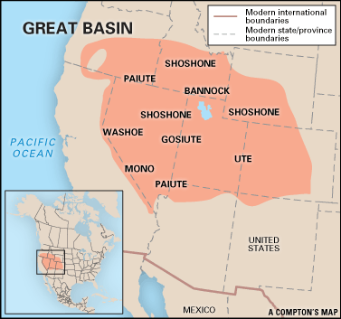
Great Basin Native Americans lived in the region east of the Northwest coast in today’s Nevada, Idaho, and Utah.

Slide 3
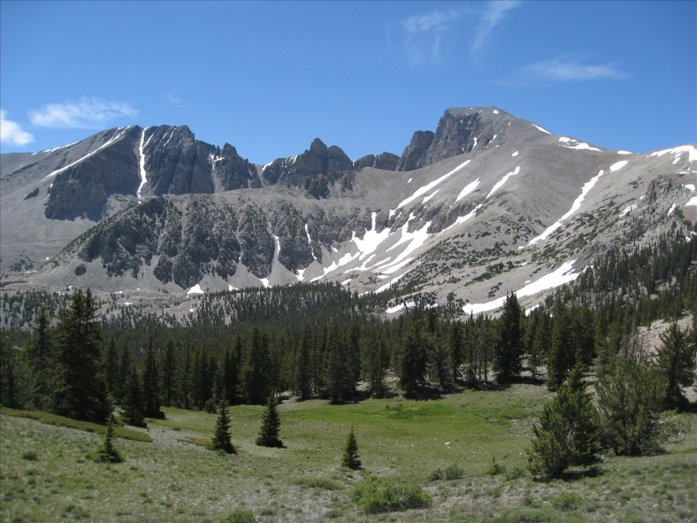
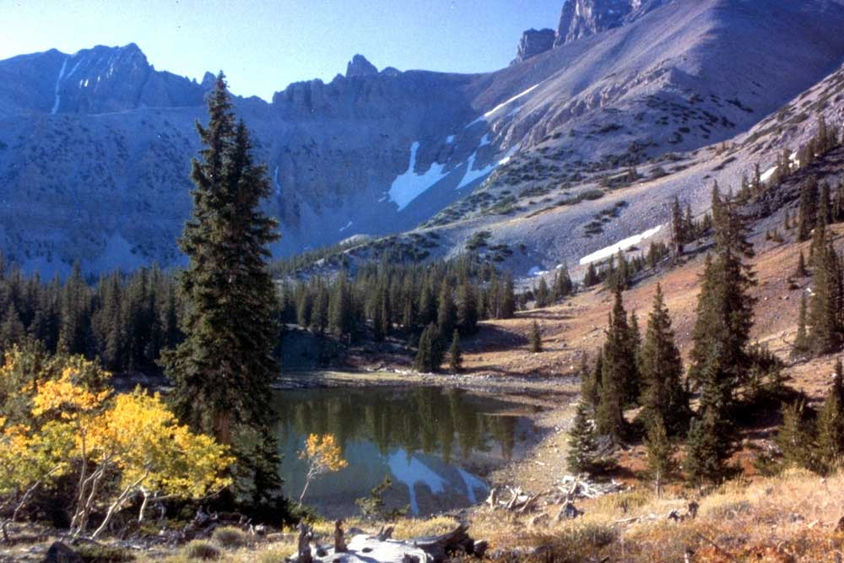
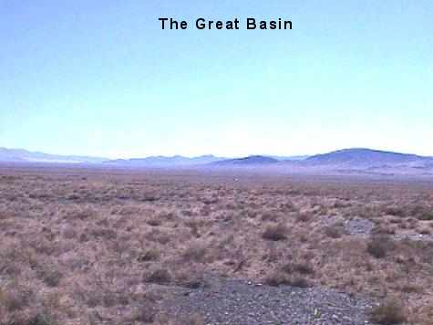
The Great Basin is a land of great environmental diversity and dramatic contrasts -- high mountains and arid plains, deep canyons and occasional bountiful lakes .

Slide 4
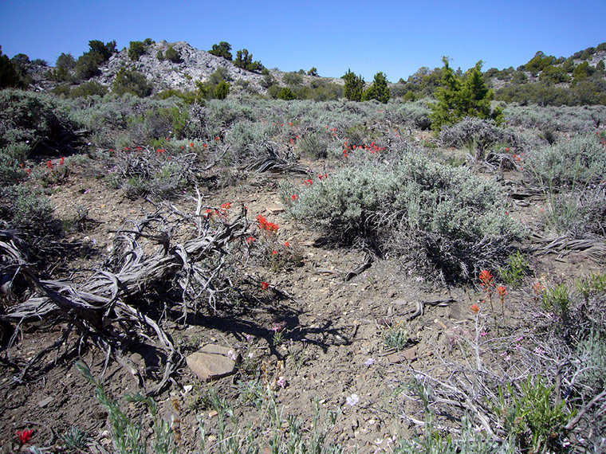
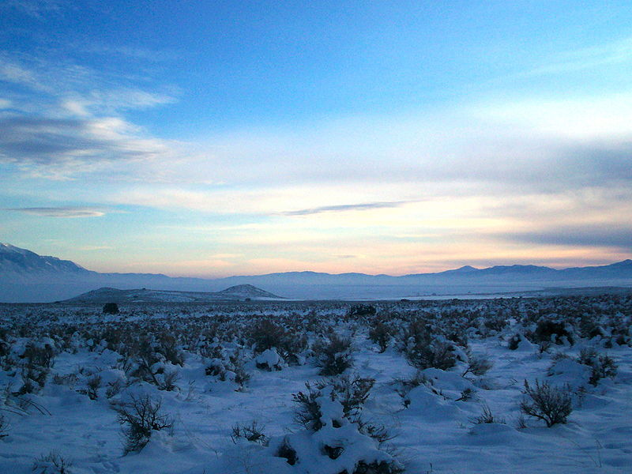
The climate changes, average summer temperatures are high (often over 100 degrees), winters are cold (temperatures sometimes falling to 20 degrees below zero).

Slide 5
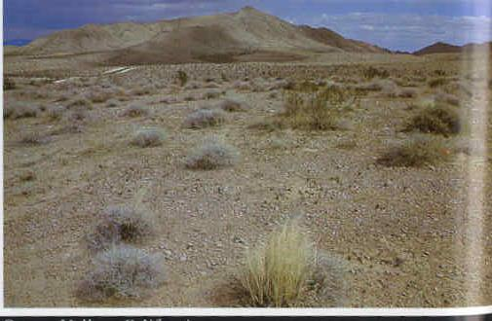
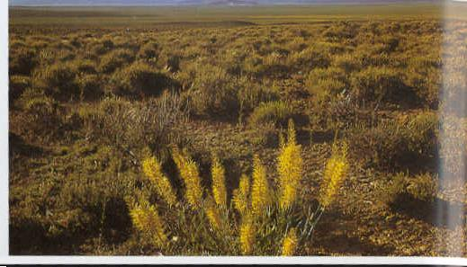
In addition, the amount of rainfall varies dramatically from year to year. Thus, in one year a potential plant food source can be anywhere from two to six times more plentiful than it was last year; or it can be two to six times less plentiful.

Slide 6
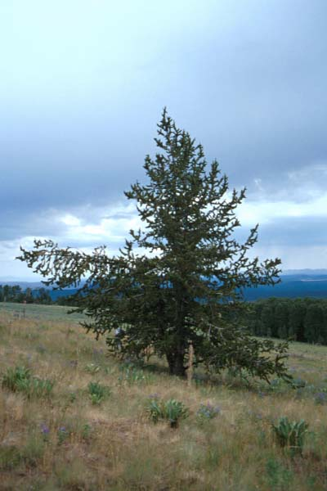
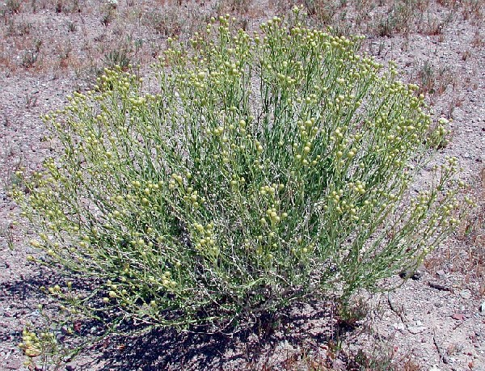
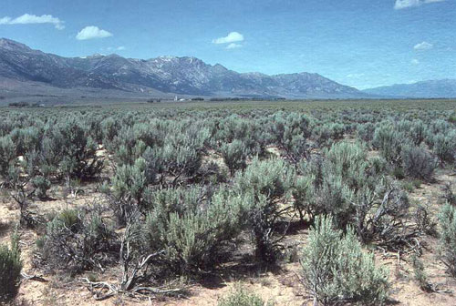
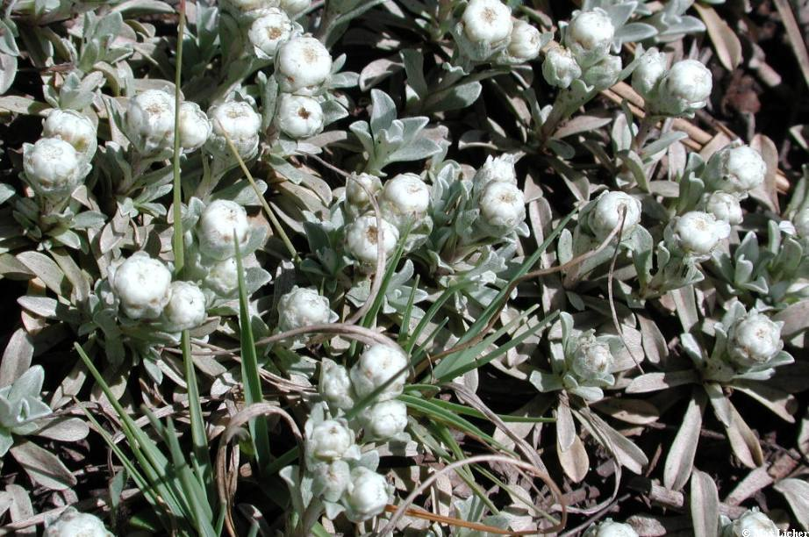
Vegetation varies widely throughout the Basin. The lower slopes of the mountain ranges support sagebrush grasslands, while juniper and pinyon woodlands occur at higher elevations, followed, by forests of scrub oak, ponderosa pine, aspen, spruce and fir. In the low basins of the Mohave Desert of southern California and Nevada, creosote bush and rabbit bush are the dominant plants, while the high deserts are blanketed with saltbush and sagebrush. Numerous seed-bearing grass species, such as Indian rice grass and wheatgrass, are common in the high desert areas.

Slide 7
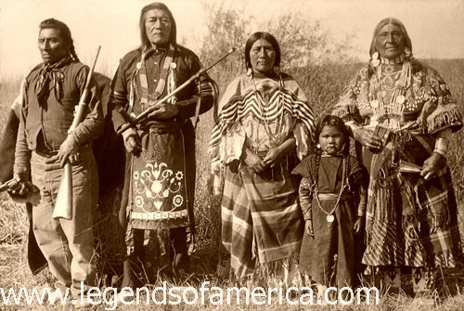
Nearly all Great basin people were highly mobile gatherers and hunters, following a seasonal cycle of movements designed to exploit available plant and animal resources in the most efficient manner.

Slide 8
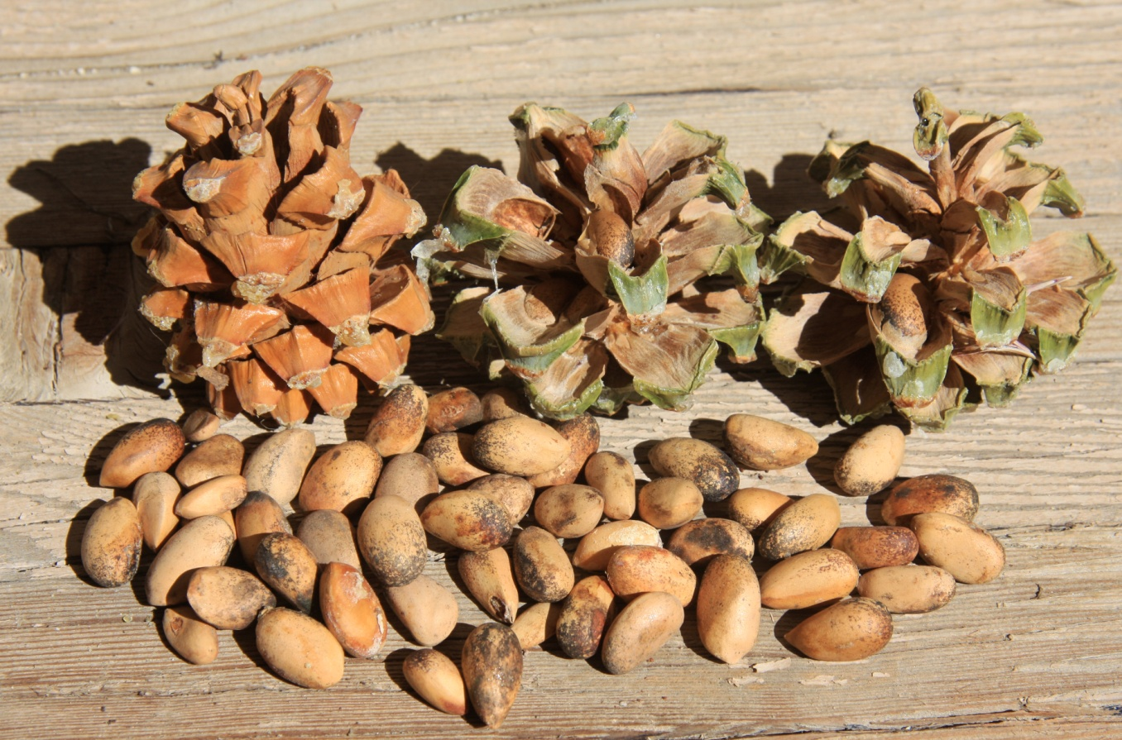
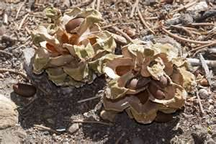
The majority of their food (between 70-80%) was procured by gathering plants, and the main source were pinyon nuts. Pine nuts were for most all groups the major winter staple, allowing people to establish multi-family camps near pinyon groves. The nuts were harvested during the late summer and early fall and. When needed, the nuts were cracked open, the nut meat extracted and parched, then ground into flour with milling stones, and eaten in the form of a mush or gruel.

Slide 9
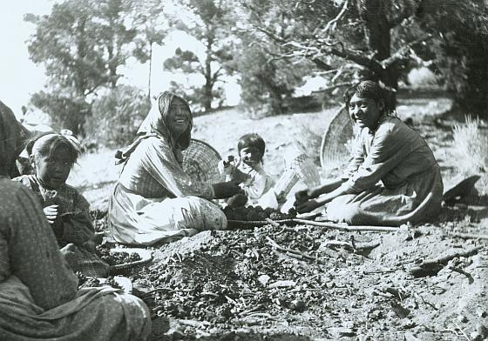
Because of the importance of pinyon nuts in the lives of the Great Basin people, a certain amount of ceremonialism was associated with the pinyon harvest .

Slide 10
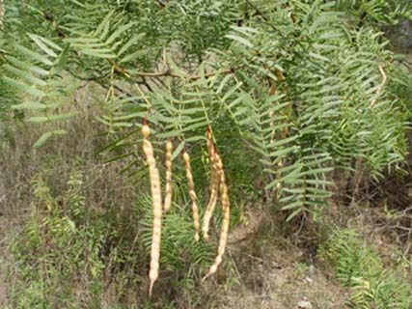
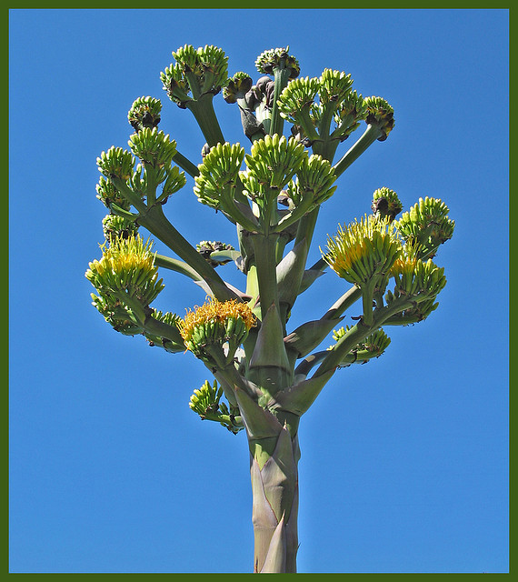
In addition to pinyon nuts, seeds of a variety of grasses, including Indian ridge grass, blazing star, wheatgrass, and wild rye, were major resources for all the Great Basin groups. Where found, acorns, marsh plants, camas roots often formed major resources, while in the southwestern part of the Great Basin, mesquite beans and agave were critical resources for other groups. The mesquite beans were gathered in the spring and eaten either raw or cooked or ground into flour for later use. Agave stalks were cut from the plant, placed in earth ovens, and cooked.

Slide 11
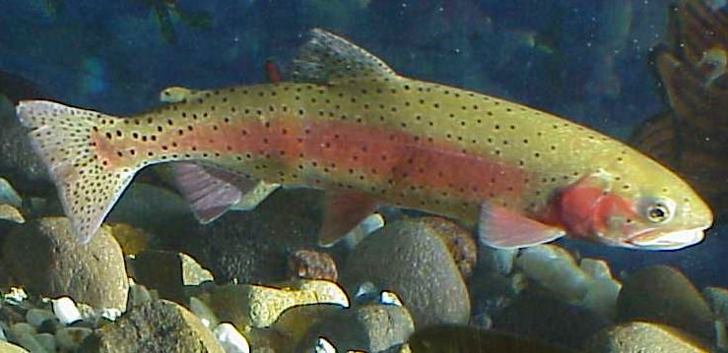
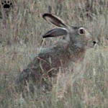
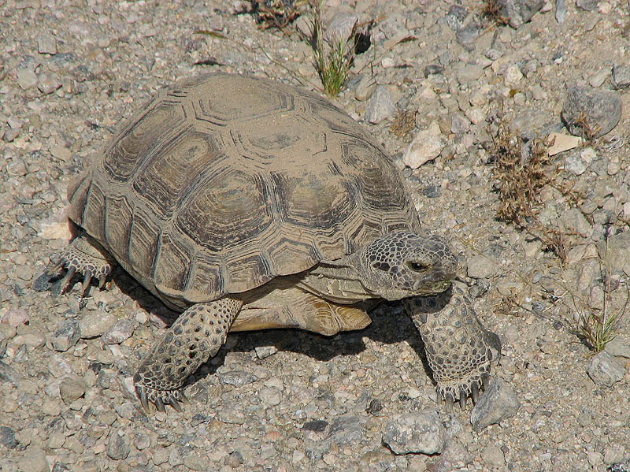
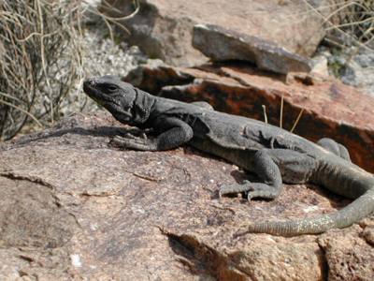
Animals, especially hares, pronghorn antelope, mule deer, bighorn sheep and insects were also important and formed a major aspect of Great Basin subsistence. Hares were important for both their meat and their skins, being processed into a number of useful items including clothing, blankets. And in the southern Great Basin, several large reptiles (such as the desert tortoise and the chuckwalla) were eaten. Insects (including crickets, grasshoppers, shore flies, caterpillars, ants) also formed an important and highly nutritious food source and were purposefully hunted or gathered. Waterfowl were also heavily utilized, as were a number of fish species. Two large fish, the Lahontan cutthroat trout and the cui-ui sucker were heavily exploited by the Northern Paiute.

Slide 12
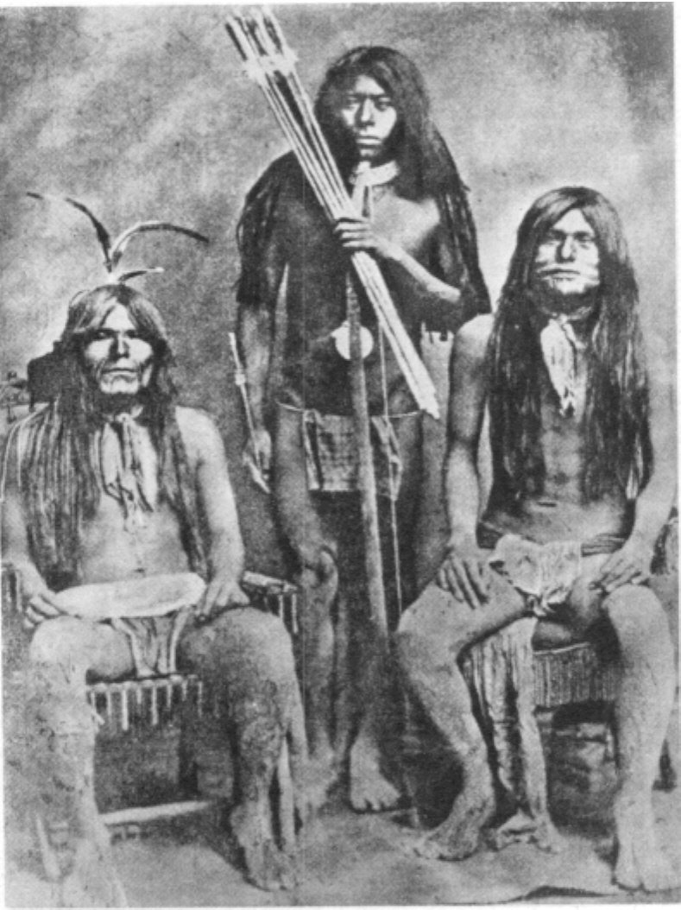
Men did most of the hunting, although women and children trapped small game while out gathering. Women were the primary providers and preparers of most of the plant foods, collecting the seeds, roots, insects, but men and children assisted during the pinyon harvest.

Slide 13
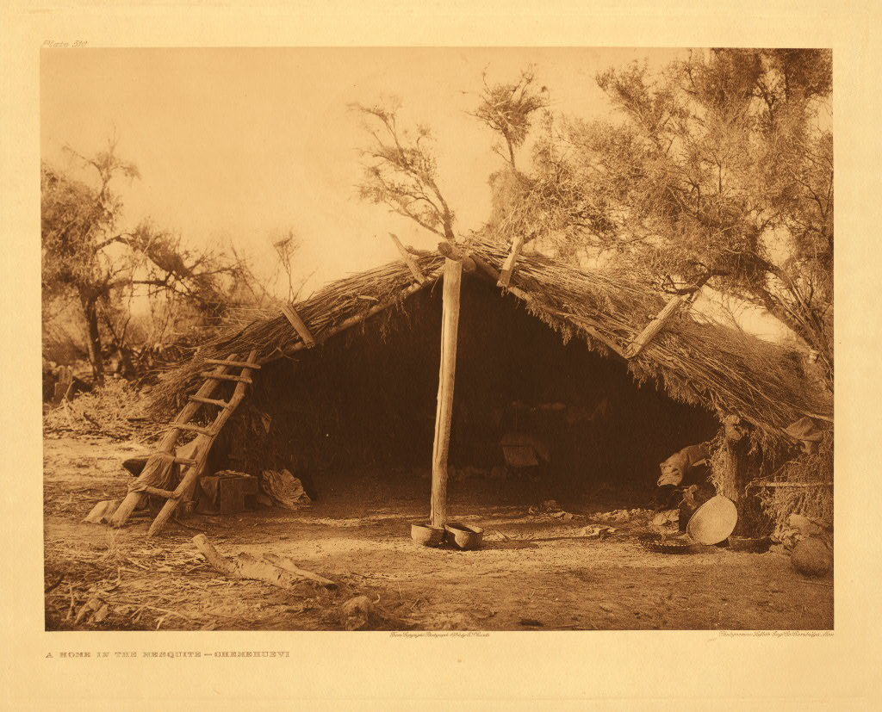
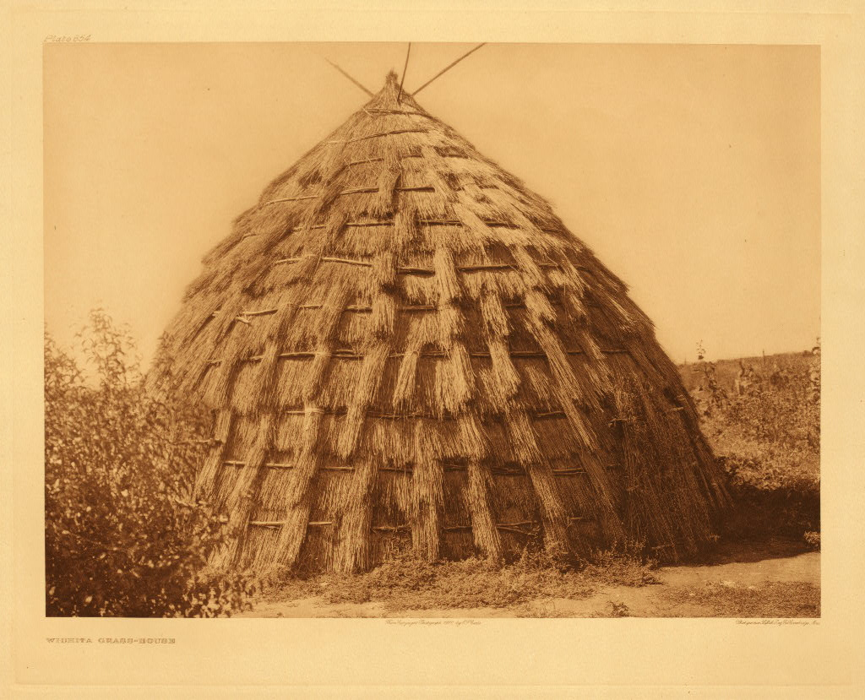
Some groups lived in exceptionally rich lake-side or marshy environments and dwelt in larger, more sedentary camps for most of the year. Where conditions allowed, winter encampments often were made up of many family units, where large semi-subterranean houses were maintained. When late spring arrived, the band tended to disperse into smaller family units who would move through the territory hunting and collecting.

Slide 14
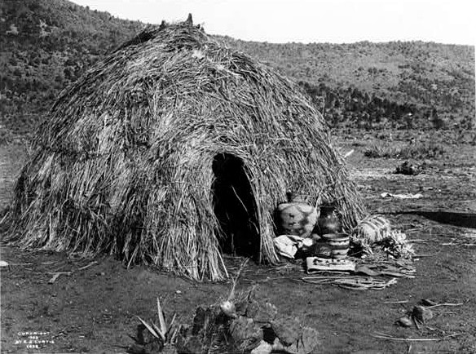
During the summer, housing usually consisted of windbreaks and shade or lightly built, dome shaped structures made of brush.

Slide 15
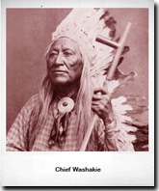
Each family had a headman who was given responsibility by consensus. A headman's title, degwani, meaning "talker" ,and indicates his most important function: being responsible for keeping track of plant and animal resources and relating this information to families in order to facilitate scheduling of resource procurement activities.

Slide 16
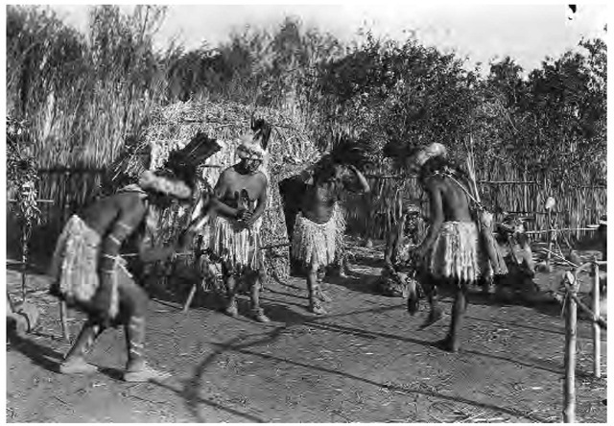
Religious activity among the Great Basin peoples can be divided into two basic categories: individual, and group ceremonies. In terms of individual religious activities, nearly all adults sought "power" through a spirit helper that appeared during a dream or during a vision quest. Such helpers aided people in certain activities such as hunting, fishing, gambling, or doctoring. Certain forms of individual life crises, such as birth and death were also marked by religious rituals.

Slide 17
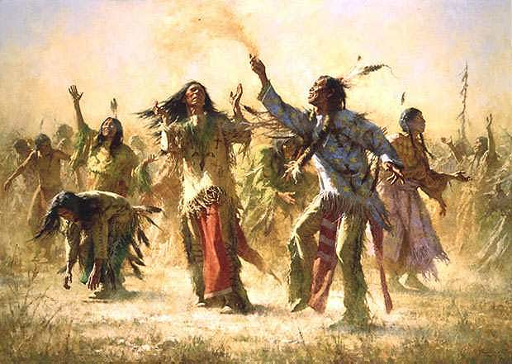
Ceremonial activities were limited to dances held following activities, such as the pinyon harvest, or fish runs, or communal rabbit or pronghorn antelope hunts. The Round Dance, a circle dance with a hopping and shuffling step, and held in a corral. It functioned both as a recreational activity as well as a rite of thanks and fertility, aimed at increasing the food supply and bringing rain.

Slide 18
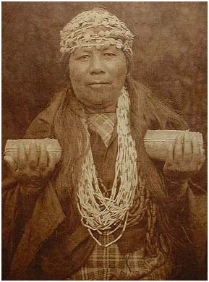
The primary religious figures were the shamans, part-time specialists who possessed considerable "power" and used it for curing illnesses, controlling animals and the weather. Although most Great Basin shamans were males, female shamans were not uncommon.

