Slide 1
Clouds
4-4.2 Classify clouds according to their three basic types (cumulus, cirrus, and stratus) and summarize how clouds form.

Slide 2
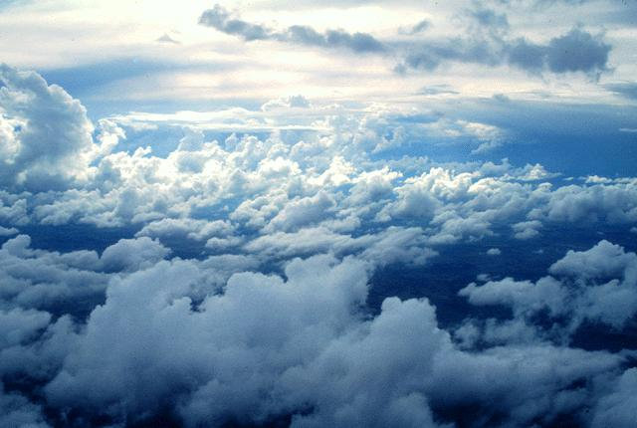
there are three basic types of clouds

Slide 3
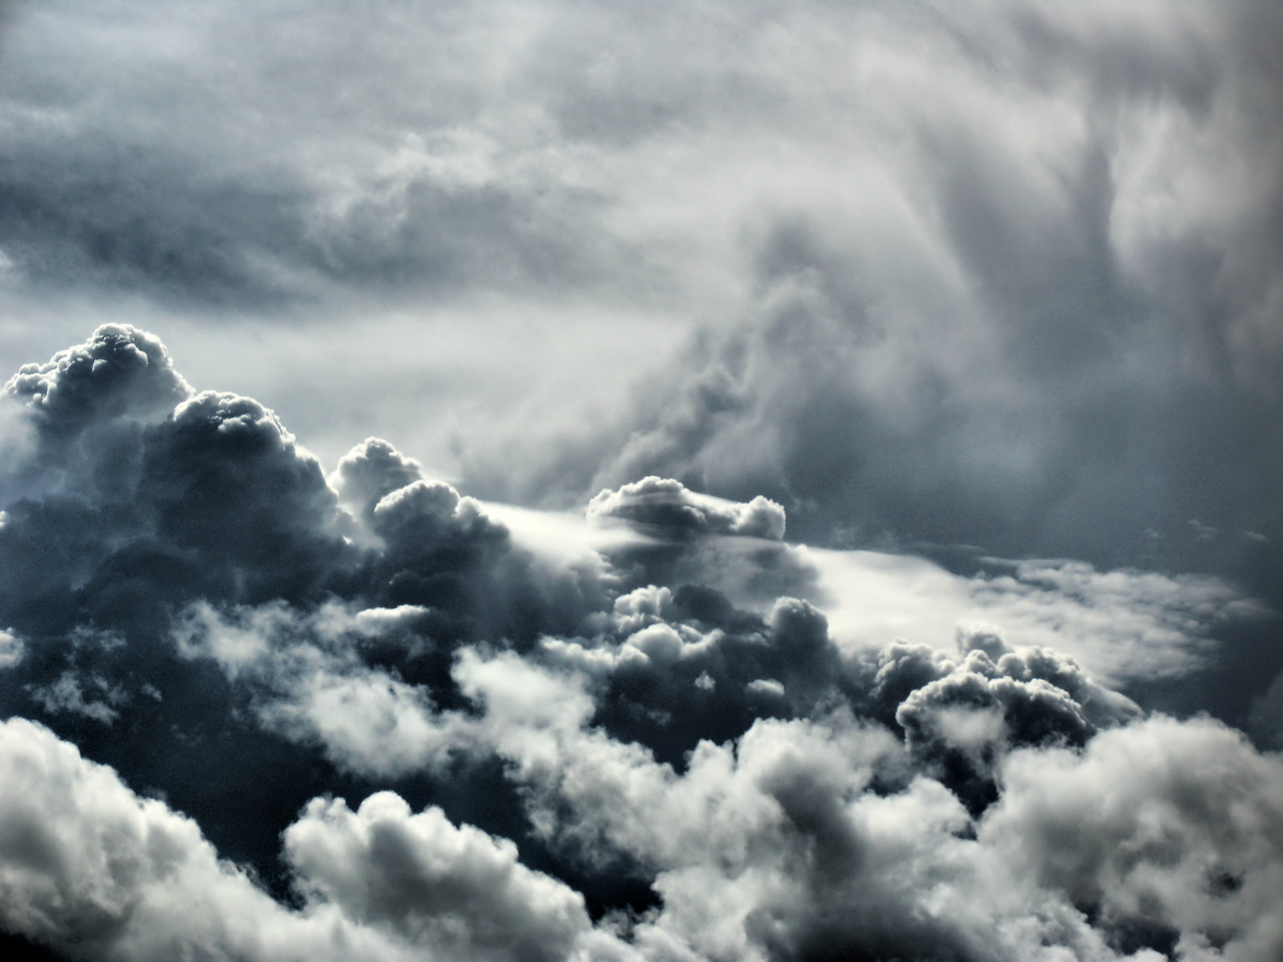
These clouds can be classified based on their observable characteristics.

Slide 4
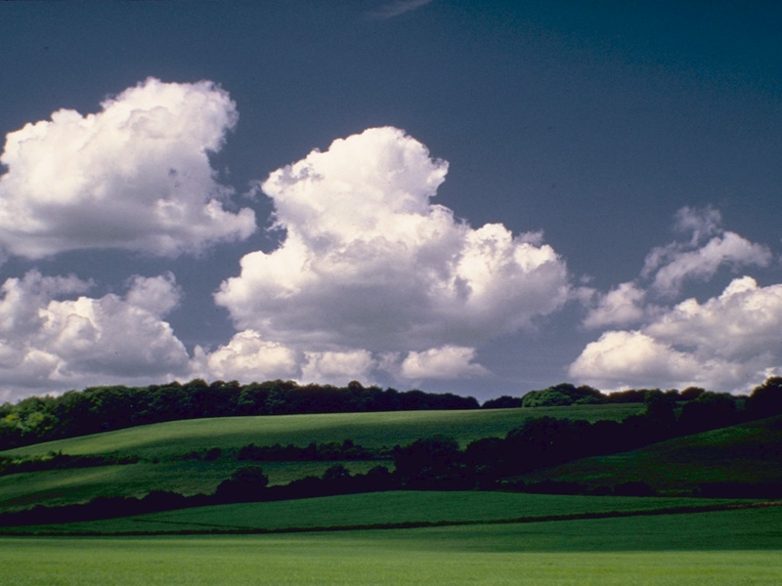
Cumulus

Slide 5
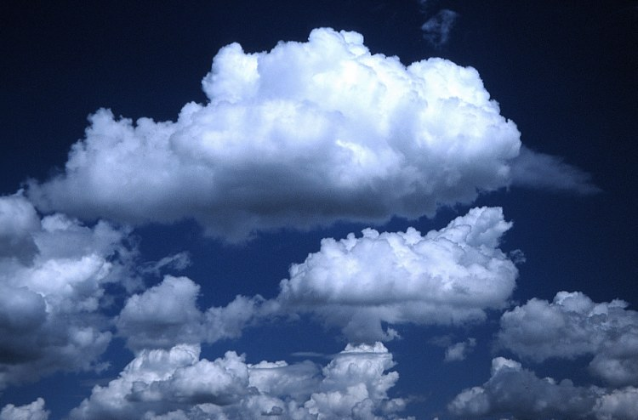
Puffy, lumpy-looking clouds often with a flat bottom.

Slide 6
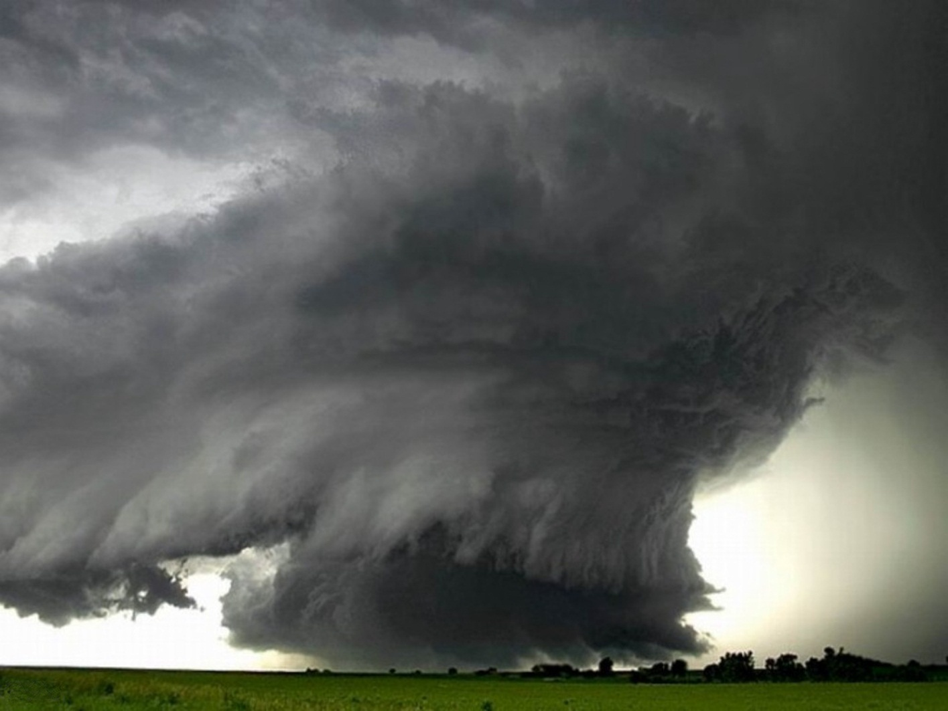
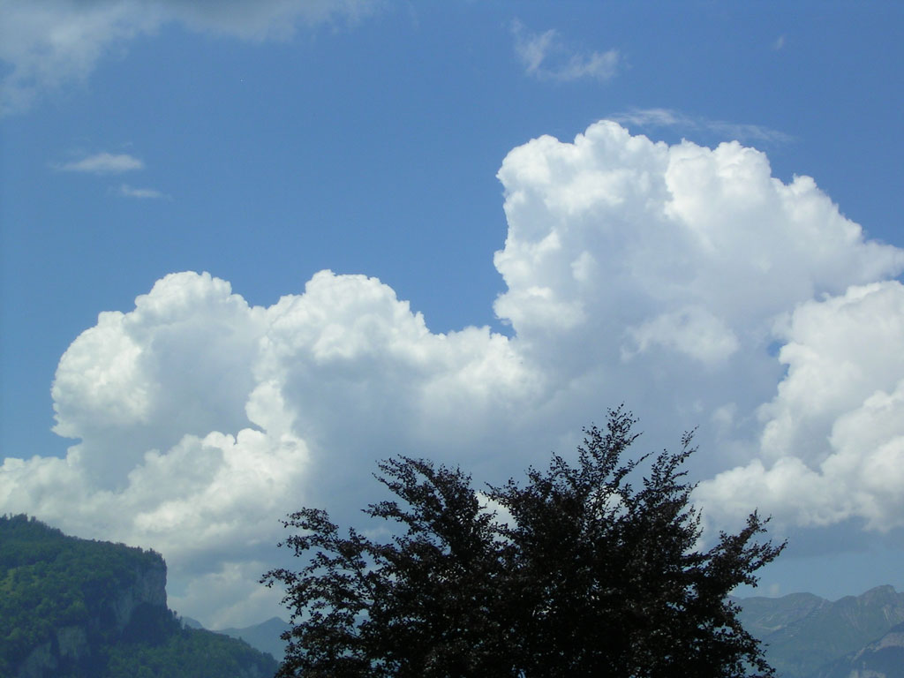
When cumulus clouds are dark they usually bring rain; white cumulus clouds do not bring rain.

Slide 7
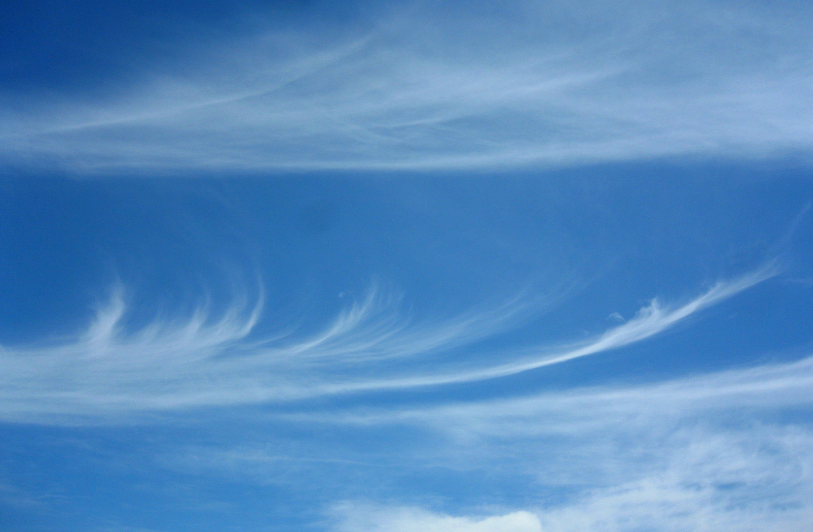
Cirrus

Slide 8
High, thin, wispy clouds

Slide 9
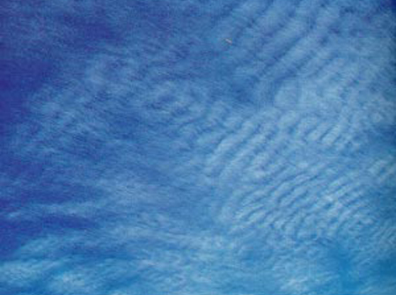
They are formed mostly of ice crystals

Slide 10
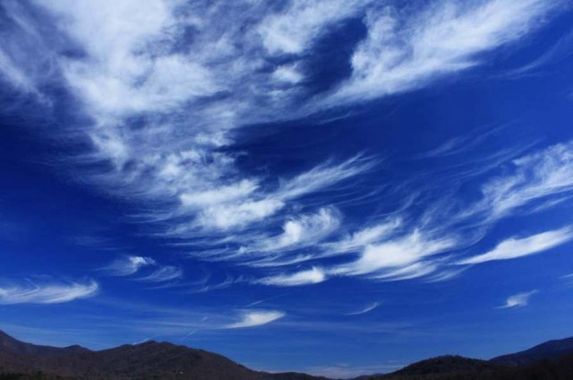
Cirrus clouds are most often associated with fair weather.

Slide 11
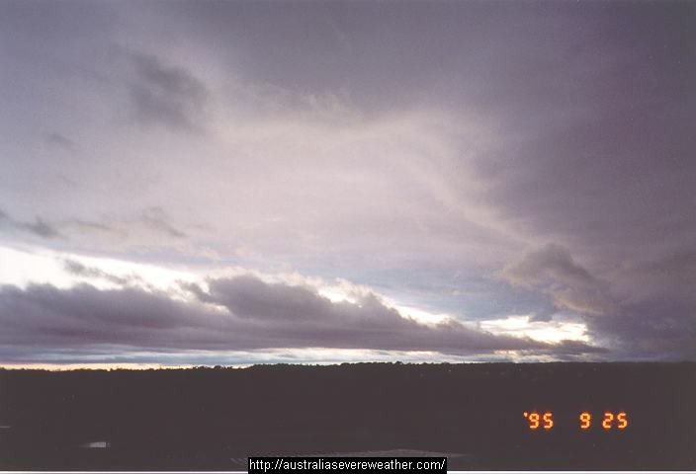
Stratus

Slide 12
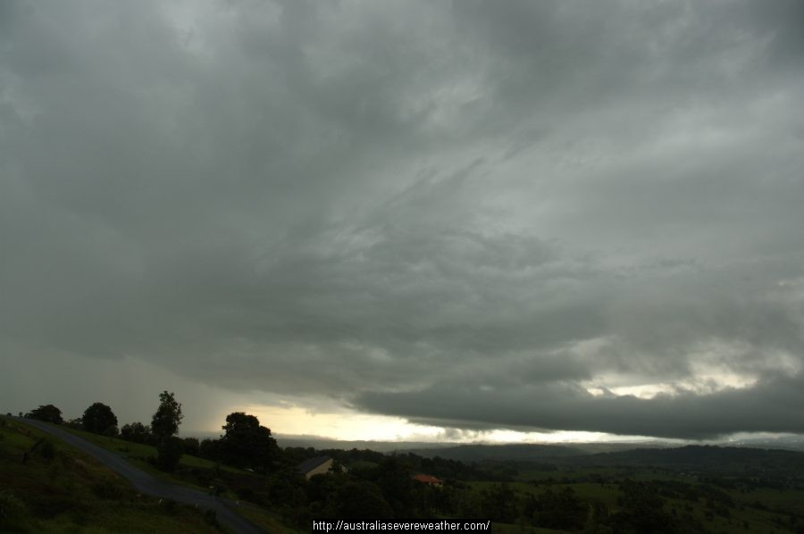
Layers of clouds that spread out covering a large area.

Slide 13
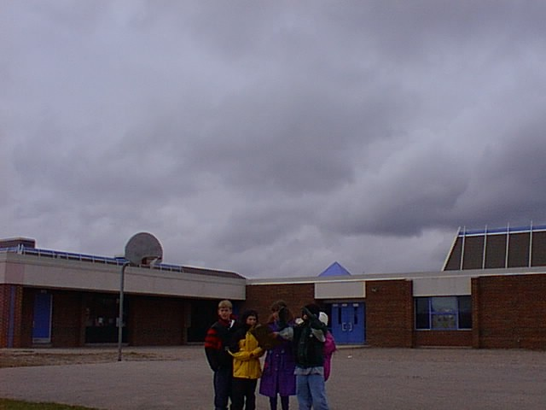
Stratus clouds are often lower in the sky.

Slide 14
The formation of clouds happens when water vapor in the air rises, cools and condenses (or moves from a warm place to a cool place and condenses), forming the water droplets that make up a cloud.

Slide 15
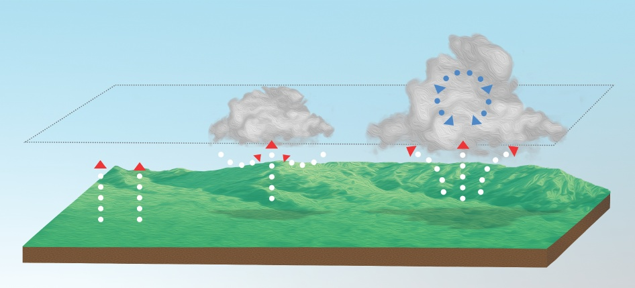
A cloud is a collection of tiny, liquid water droplets not water vapor gas.

