Slide 1
Bloody effects of Westward Expansion
Indicator 4-5.5: Explain how the Missouri Compromise, the fugitive slave laws, the annexations of Texas, the Compromise of 1850, the Kansas-Nebraska Act, and the Dred Scott decision affected the institution of slavery in the United States and its territories.

Slide 2
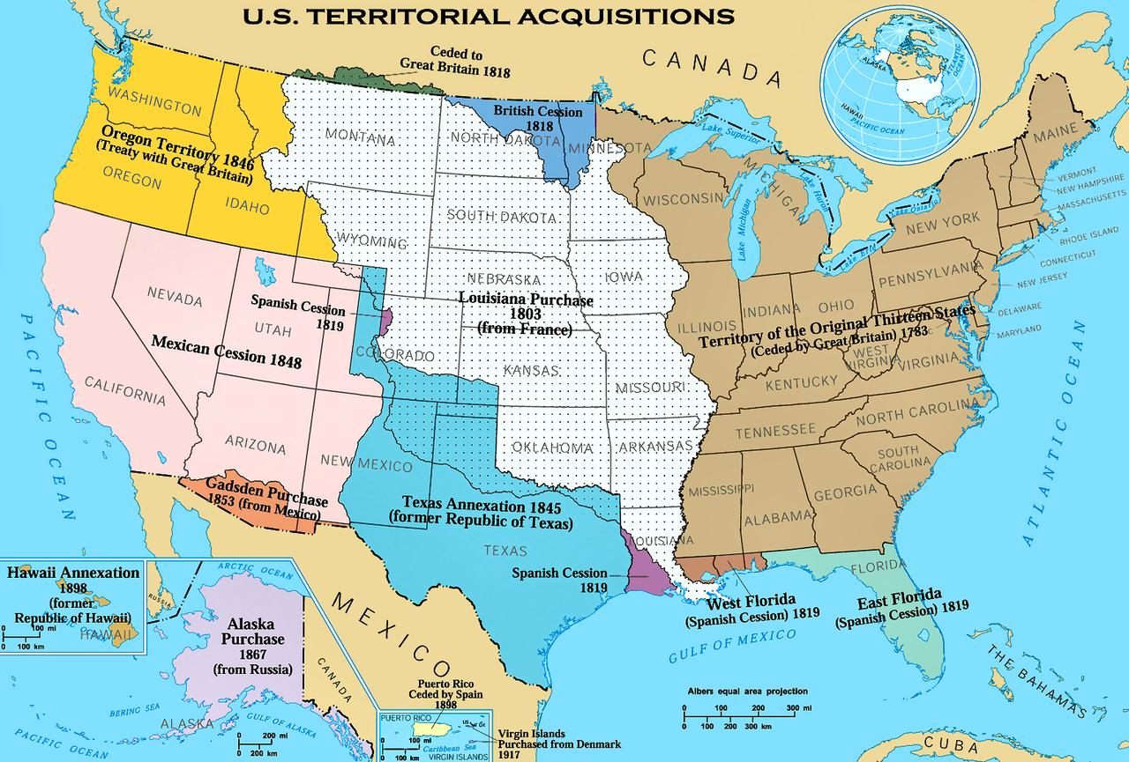
As Americans moved west, the United States added more territories raising the issue of whether or not to allow slavery in these new states.

Slide 3
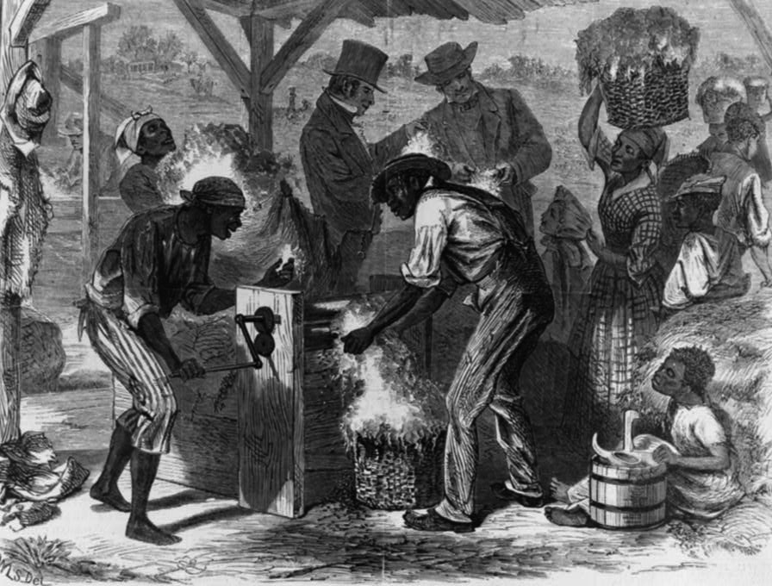
The cotton gin had been invented and southern states were even more dependent on slave labor than they had been at the time of the American Revolution.

Slide 4
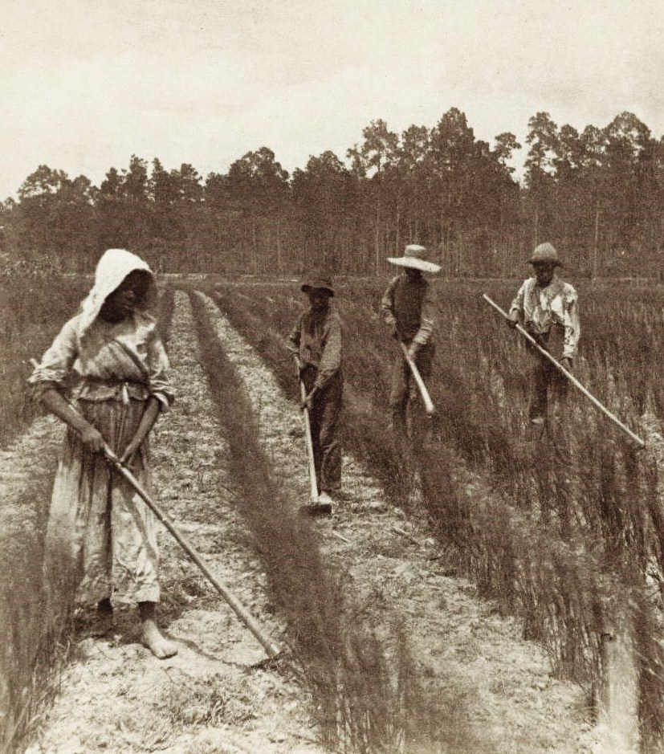
Northern states were gradually emancipating their slaves. Some northerners wanted slaves in Missouri to be gradually emancipated as well.

Slide 5
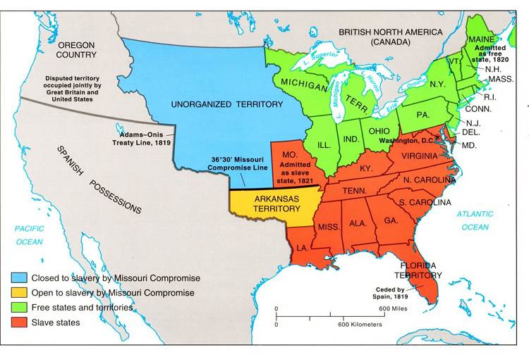
Southern states worried that they would lose power in Congress if there were more free states than slave states.

Slide 6
Already representatives of the free northern states outnumbered the representatives from the slave states in the House of Representatives because of population increase due to immigration, so the South was even more determined to hold on to equal representation in the Senate.

Slide 7
The Missouri Compromise tried to avoid future controversy by prohibiting slavery in the Louisiana Territory, north of the 36 30’ latitude line that was the southern boundary of Missouri.

Slide 8
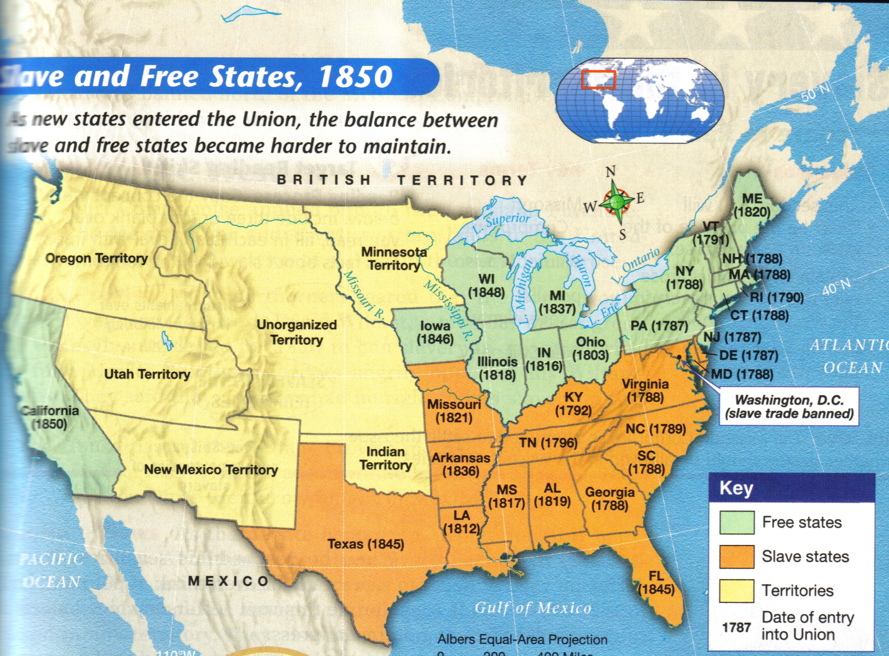
The admission of Missouri as a slave state was balanced by the admission of Maine as a free state, balancing power and therefore numbers of senators.

Slide 9
The annexation of Texas was delayed for nine years because the Republic of Texas wanted to be admitted to the United States as a slave state.

Slide 10
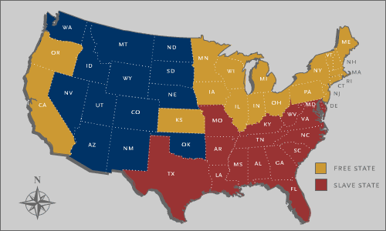
Texas was finally annexed as a slave state in 1845 and the resulting Mexican War led to more controversy over slavery.

Slide 11
Some northerners wanted Congress to declare that all parts of the territory that was from Mexico (the Mexican cession) would be “free soil.”

Slide 12
Southerners wanted the area to be open to slavery.

Slide 13
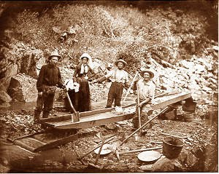
After the discovery of gold in 1849, people flocked to California to get rich quick.

Slide 14
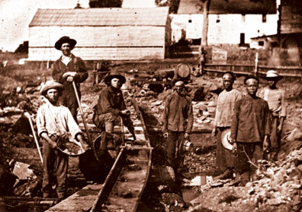
They did not want to compete with slave owners who would use their slaves to mine for gold.

Slide 15
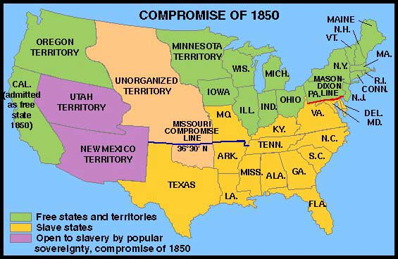
Because Californians wanted their state to also be “free soil” they applied for admission as a free state. This would upset the balance of slave and free states.

Slide 16
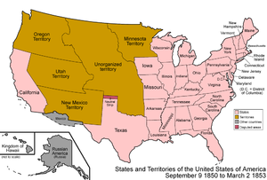
The Compromise of 1850 allowed California to be a free state but also outlawed the slave trade, but not slavery itself, in the nation’s capital, Washington, D.C.

Slide 17
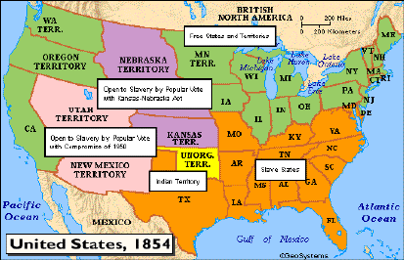
It also allowed the remainder of the Mexican Cession to decide whether or not the residents wanted to be a slave or free state though a vote, a concept known as popular sovereignty.

Slide 18
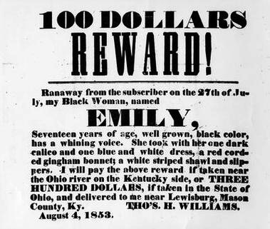
Southerners also were also delighted with a new Fugitive Slave Law that gave them more opportunity to have their escaped slaves caught and returned to their masters in the South.

Slide 19
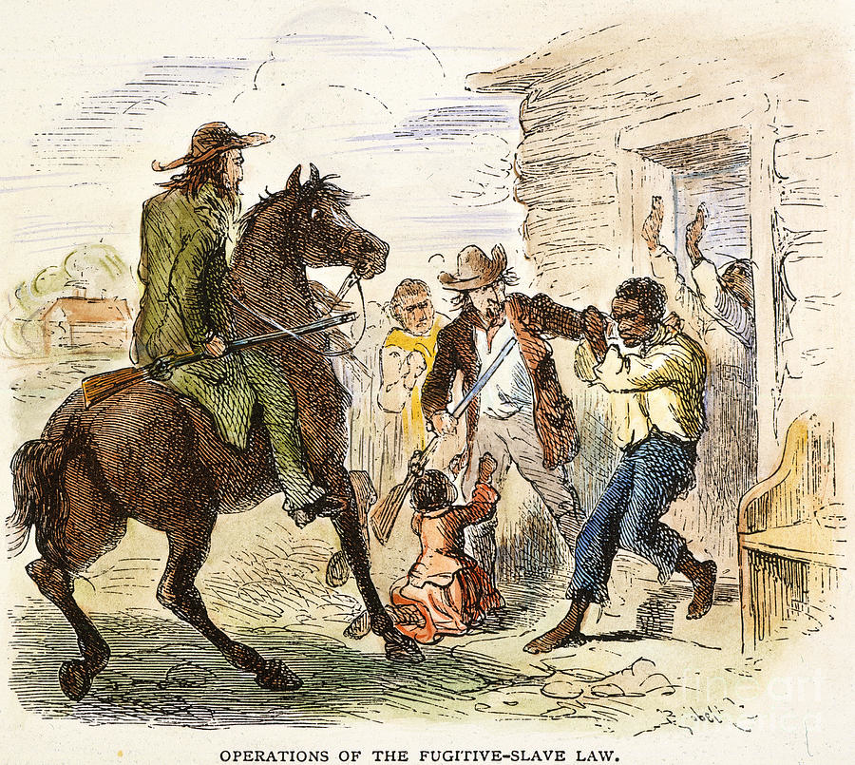
Free African Americans were required to provide necessary proof or run the risk of being taken and sold in the South, a scenario made worse by unscrupulous slave catchers who often ignored or destroyed proffered proof.

Slide 20
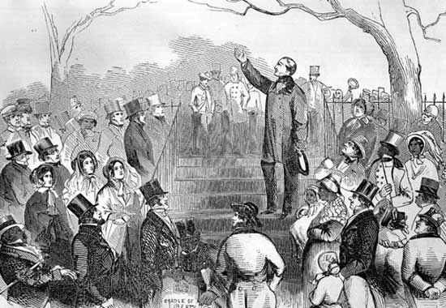
In defiance of this latter provision, many Northern states passed personal liberty laws that legalized disobedience of the fugitive slave law.

Slide 21
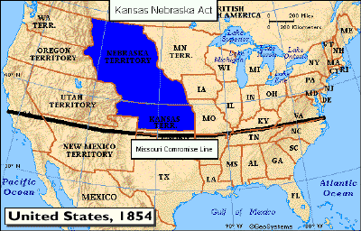
The Kansas Territory was in the Northern part of the Louisiana Territory and therefore, according to the Missouri Compromise, it could not be a slave state.

Slide 22
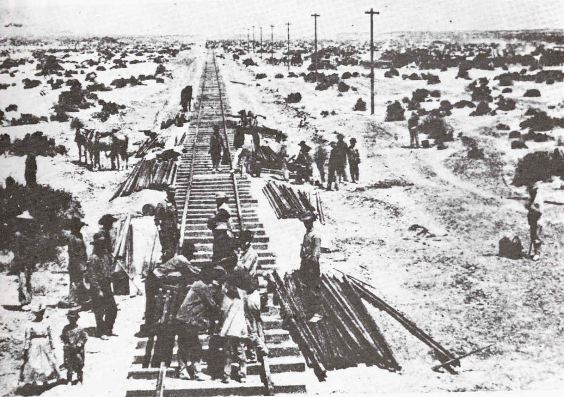
However, some politicians wanted to build a transcontinental railroad through Kansas and they needed to get southern support.

Slide 23
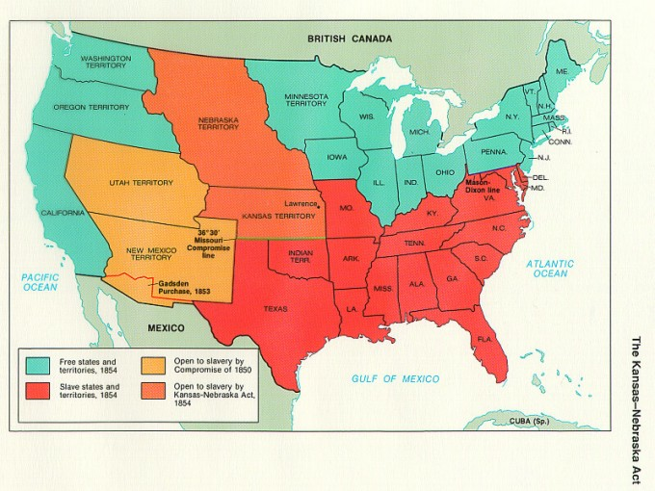
The Kansas- Nebraska Act repealed the 36 30’ slavery line (in the Louisiana Purchase) of the Missouri Compromise.

Slide 24
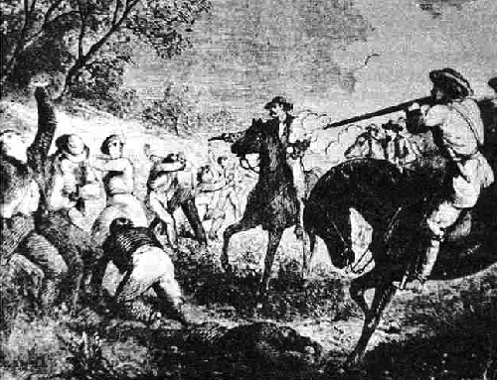
It allowed people in these territories to instead decide for themselves whether or not to allow slavery within their borders through the concept of ‘popular sovereignty.’

Slide 25
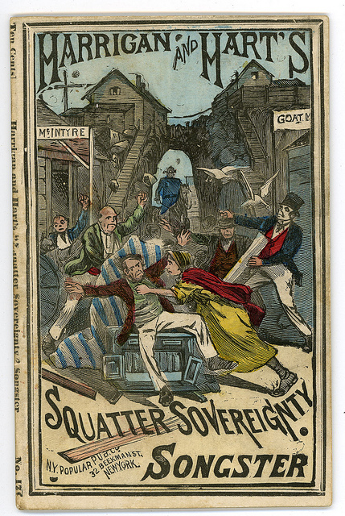
The concept, however, had not taken into account people’s misguided willingness to move to a territory temporarily for the express purpose of being there to influence the vote (called “squatter sovereignty”)!

Slide 26
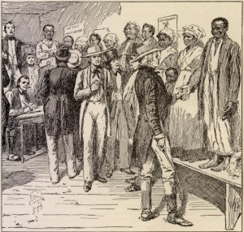
In order to affect that vote, northern abolitionists (free-staters) and southern slave owners (slave-staters) moved into the Kansas Territory until the election and violence predictably erupted between towns purposefully populated by opposing camps.

Slide 27
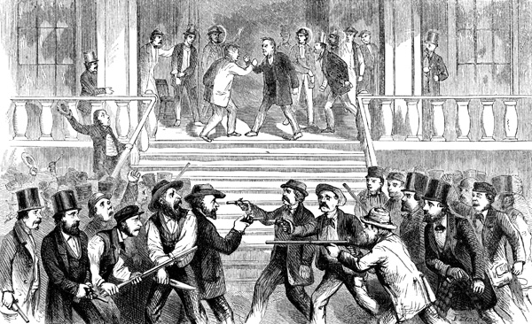
Soon their fighting led people to call the area “Bleeding Kansas.”

Slide 28
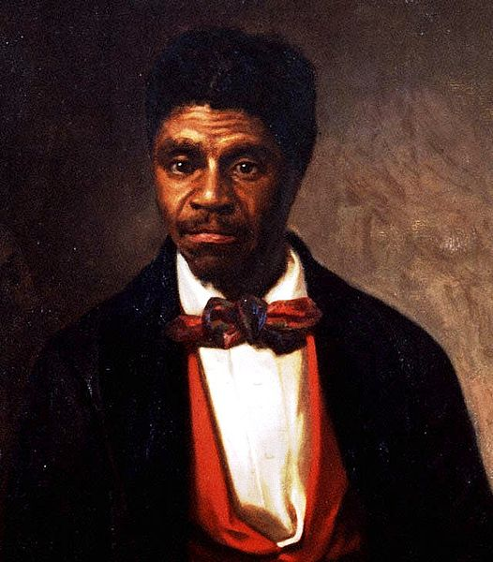
The Dred Scott decision (1858) was a test case taken by the Supreme Court (which was comprised of a majority of proslavery Southerners) to settle the controversy over slaves taken (or escaped to) areas where slavery was not legal.

Slide 29
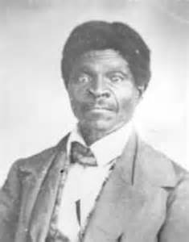
Dred Scott was a slave whose master had taken him into free territory.

Slide 30
With the help of northern abolitionists, Scott sued his master for his freedom, claiming ‘once free, always free.’

Slide 31
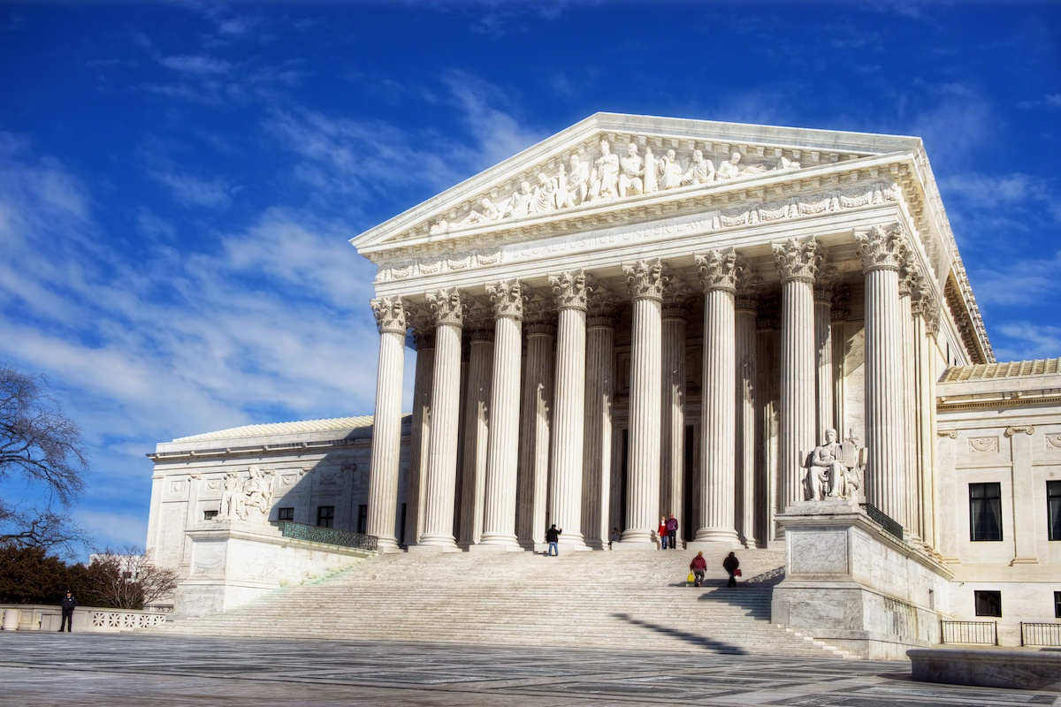
The Supreme Court decided that African Americans were not citizens of the United States, even if they had been born in the U.S., and therefore they had no right to sue in the Supreme Court.

Slide 32
Furthermore, the court ruled that slaves were instead property and, as such, they had no rights at all and could thus be taken anywhere in the United States.

Slide 33
By extension, this ruling meant that slavery was legal throughout the United States and this concept then affected all legislation that Congress had passed regarding the expansion of slavery into the western territories and states, beginning with the Missouri Compromise.

Slide 34
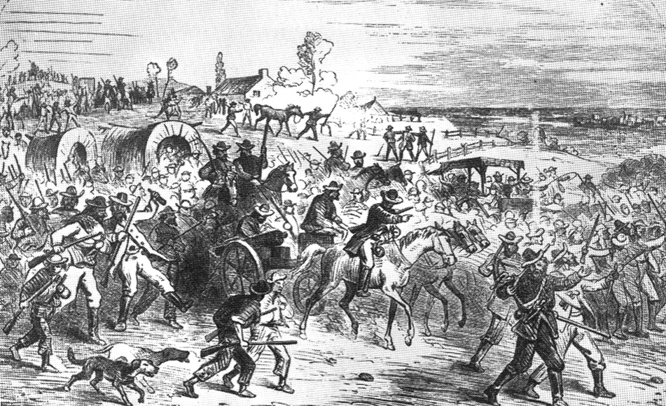
Instead of settling the controversy over slavery, the Dred Scott decision fanned the flames of sectional discord further.

Slide 35
Northerners saw the ruling as denying them the right to outlaw slavery in their states as well as in the territories through popular sovereignty, thus creating an entire country in which slavery was legalized, and democracy was limited.

Slide 36
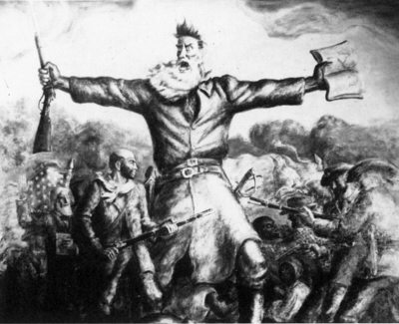
Southerners, on the other hand, were overjoyed. Sectional distrust and discord was at its zenith at this point when radical abolitionist John Brown (infamous after Kansas) reappeared, this time in Harper’s Ferry, Virginia.

