Slide 1
Founding Fathers
4-4.4 Compare the roles and accomplishments of early leaders in the development of the new
nation, including, George Washington, John Adams, Thomas Jefferson, Alexander Hamilton,
John Marshall, and James Madison.

Slide 2
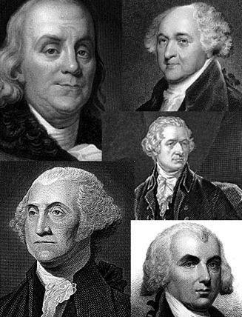
Specific leaders played significant roles in establishing the new government of the United States. Their accomplishments contributed to the development of the new nation. We will learn about 6 of these men.

Slide 3
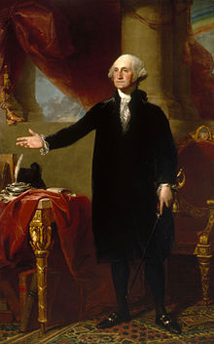
George Washington was elected as the first president of the United States after he had served as president of the Constitutional Convention and Commander of the Continental Army in the Revolutionary War .

Slide 4
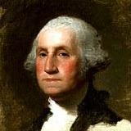
As president, Washington established precedents that were followed by later presidents.

Slide 5
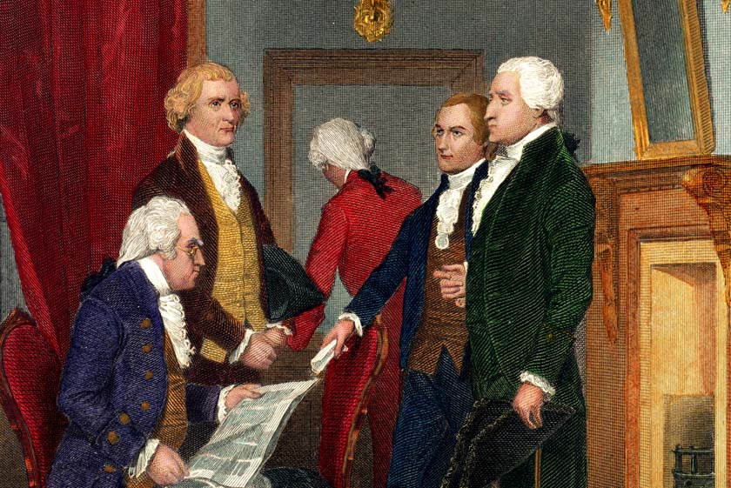
For instance, he regularly consulted the Cabinet he created and only served for two terms.

Slide 6
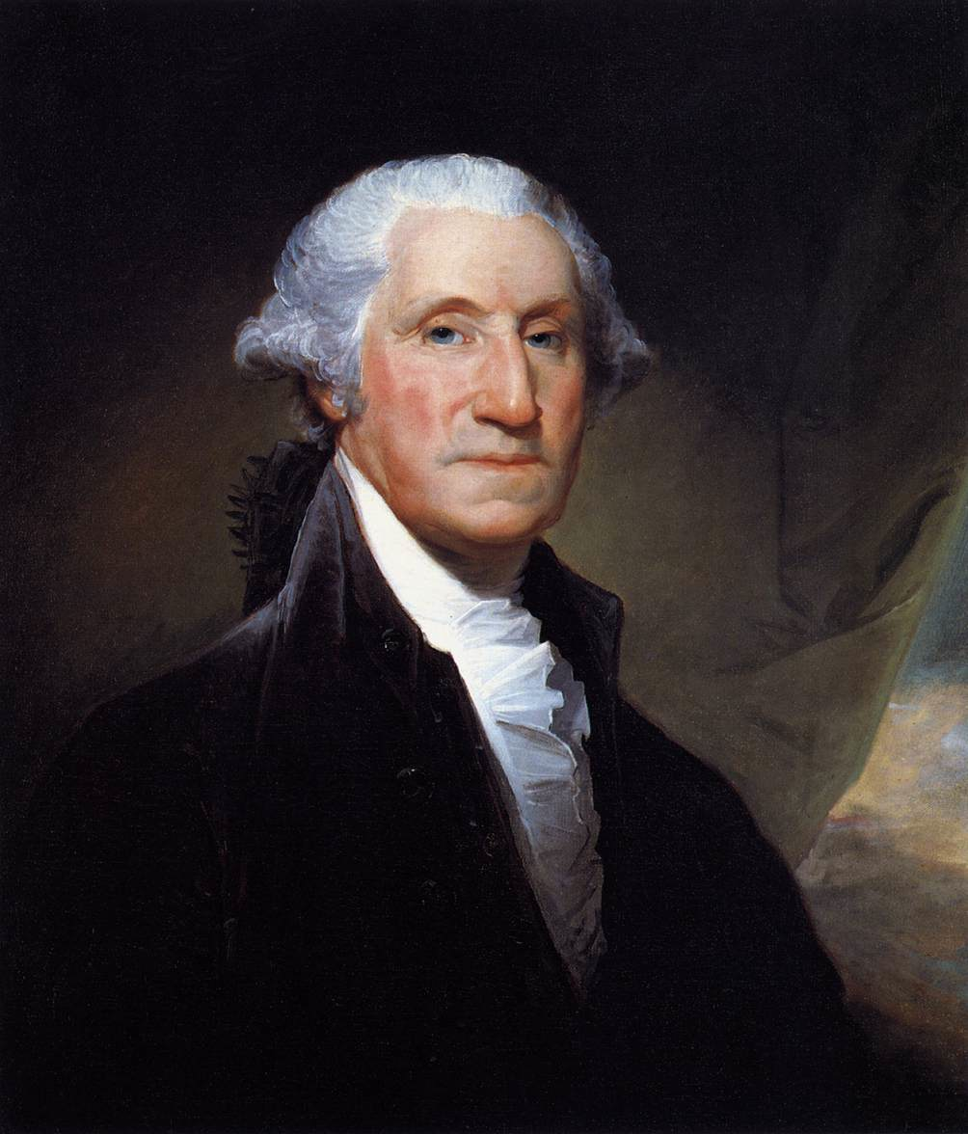
Because Washington was so widely respected during the Revolutionary War, he was trusted not to take too much power for the new national government.

Slide 7
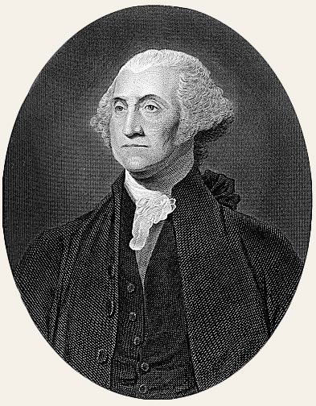
This trust laid a foundation for trust in the new nation.

Slide 8
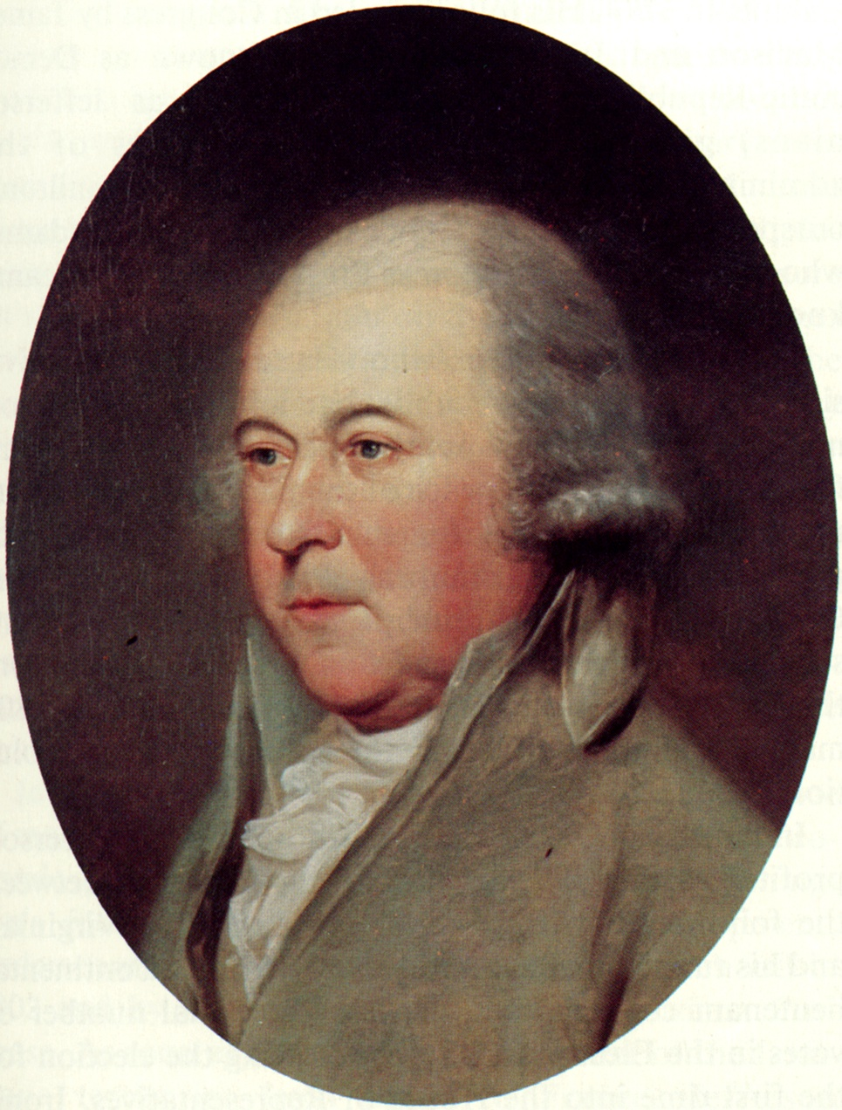
John Adams served in the Continental Congress.

Slide 9
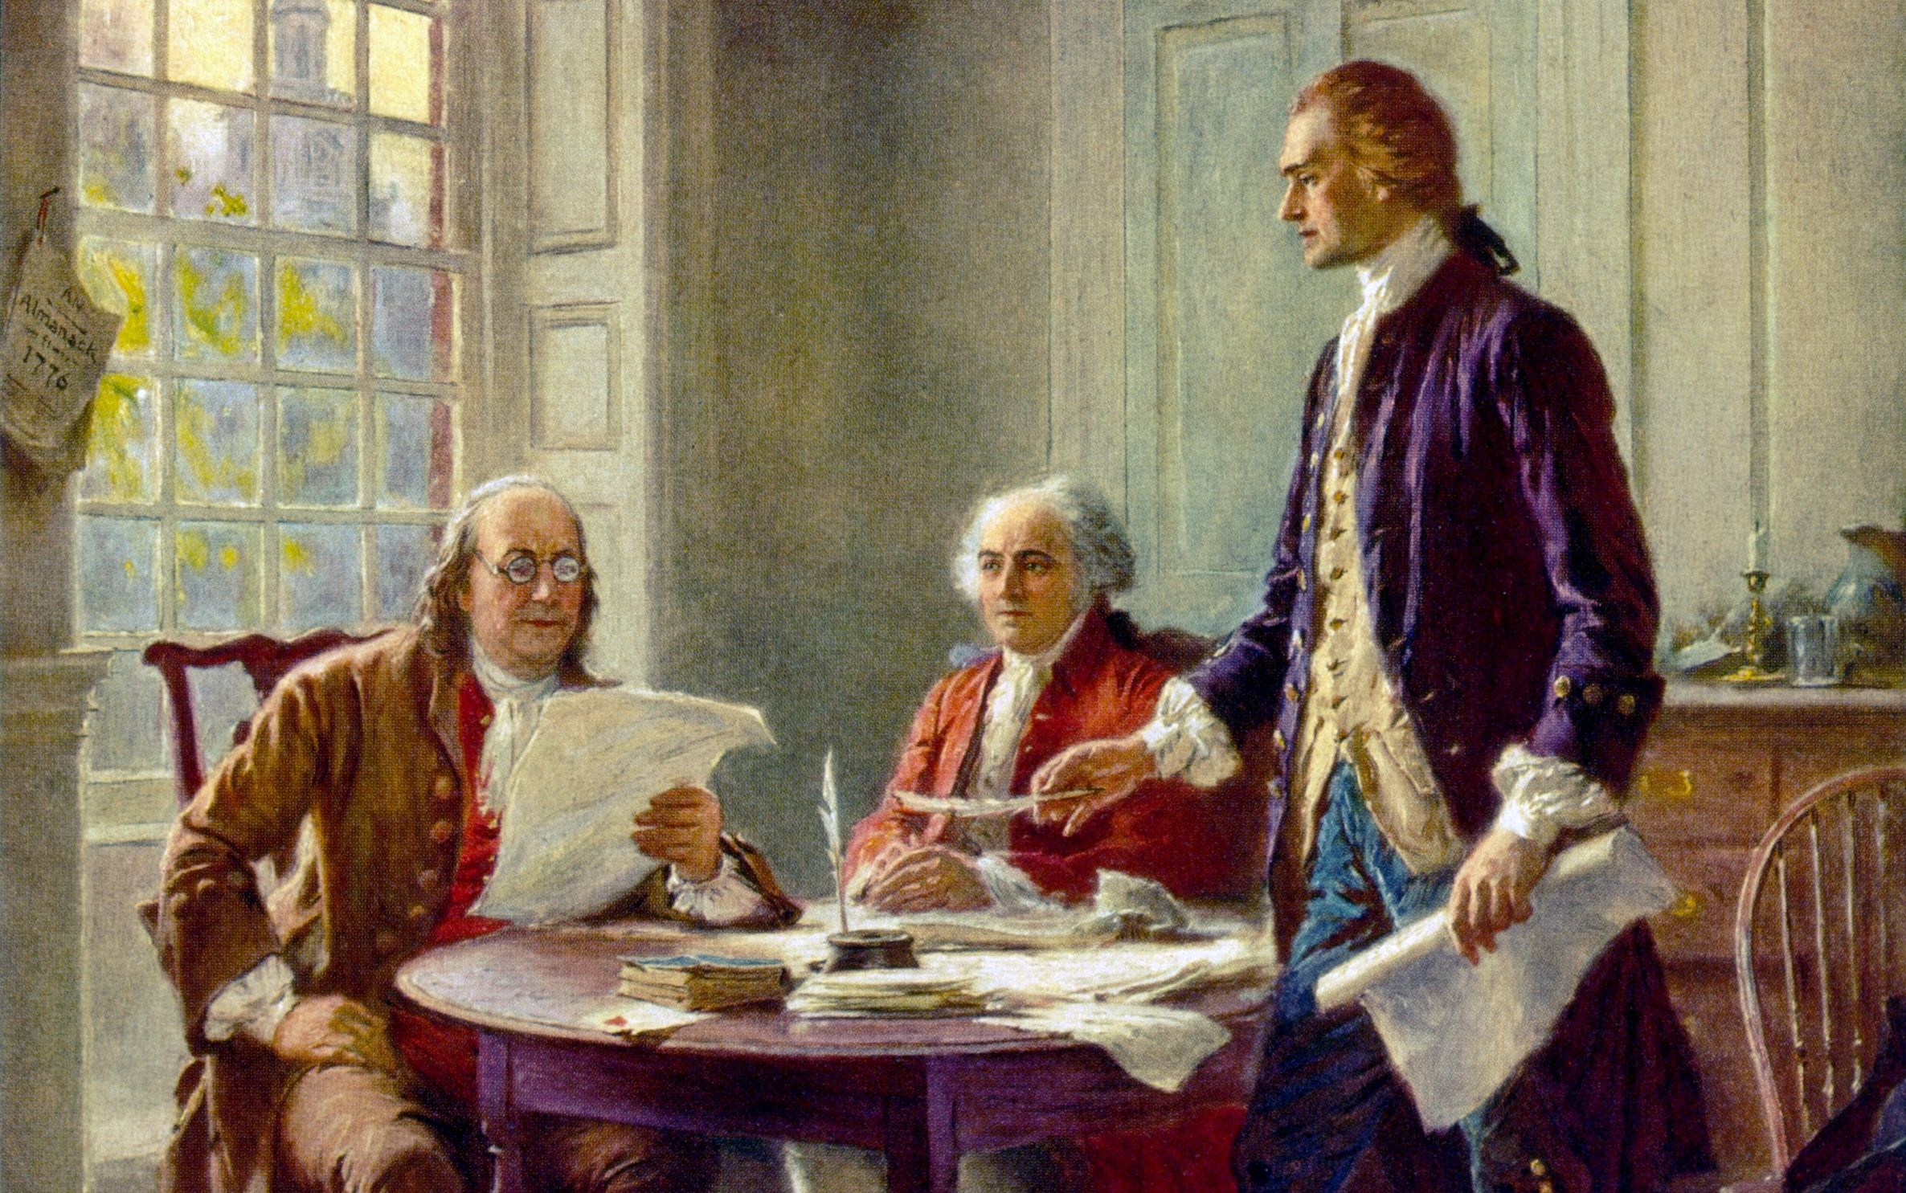
John Adams was chosen to be on the committee selected to draft a Declaration of Independence.

Slide 10
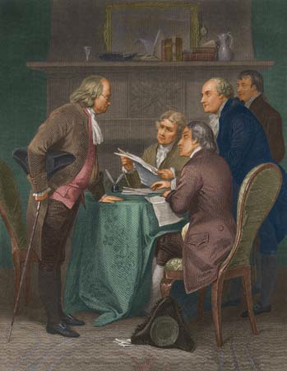
John Adams and Benjamin Franklin persuaded Thomas Jefferson to write the Declaration of Independence.

Slide 11
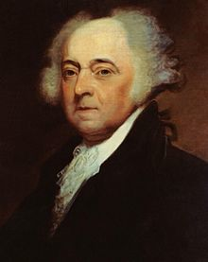
After serving his country during the war as a foreign minister (diplomat) who help negotiated alliances during the war and the Peace of Paris of 1783 Treaty at its end, Adams was abroad, serving as Minister to Great Britain at the time of the Constitutional Convention.

Slide 12
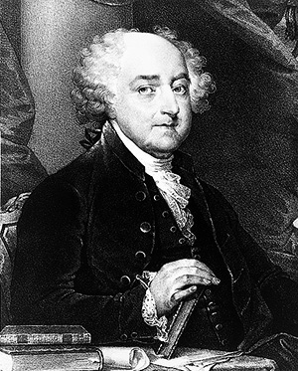
he was elected as the first Vice President of the United States, and he served with George Washington

Slide 13
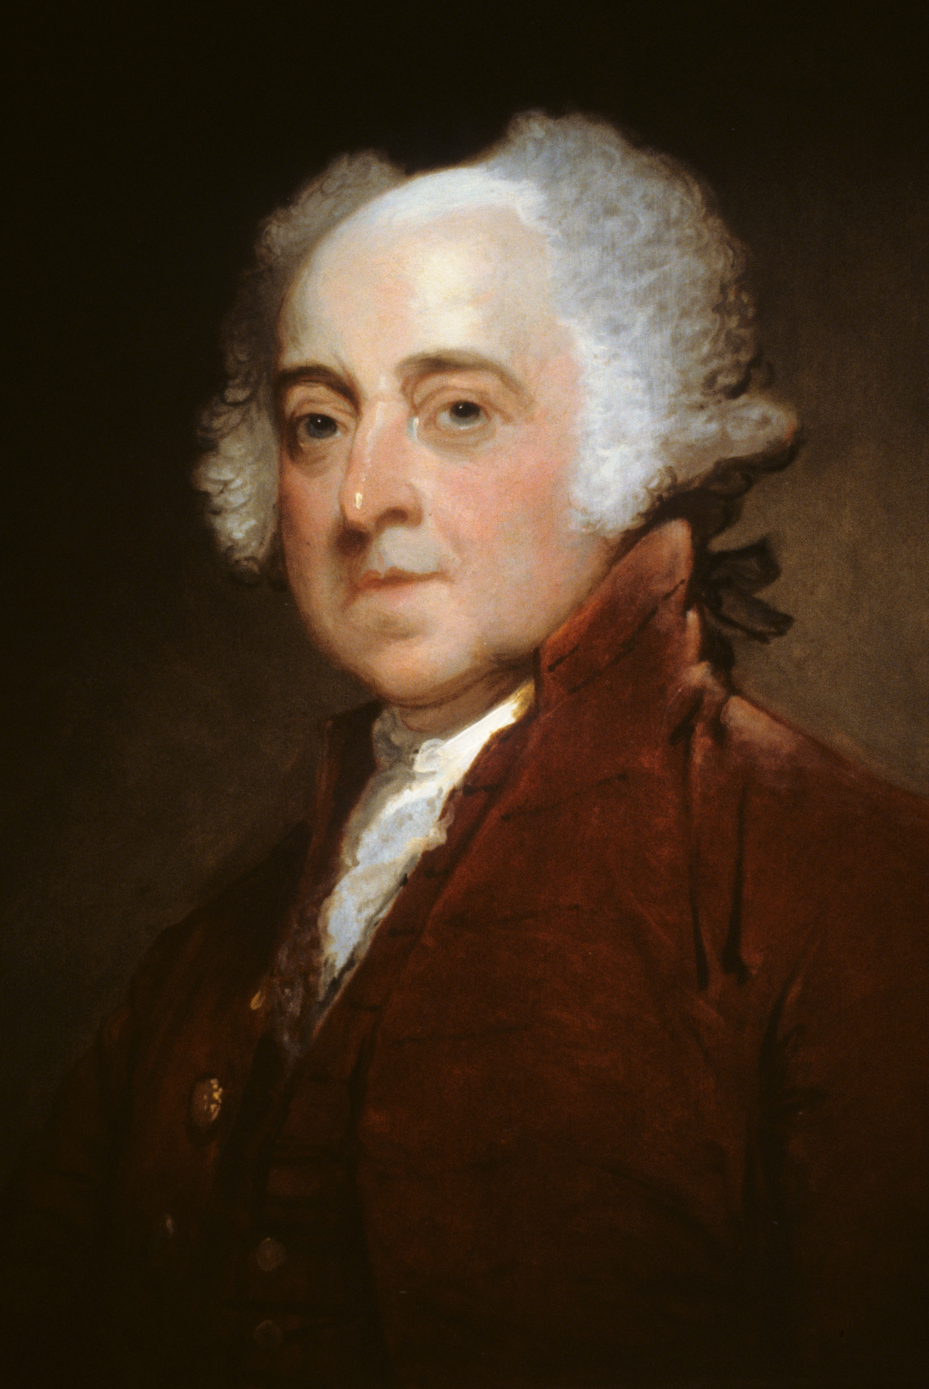
Later, he was elected as the second President of the United States.

Slide 14
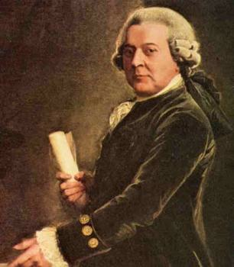
As an early leader of the Federalist Party, he advocated the establishment of a strong central government.

Slide 15
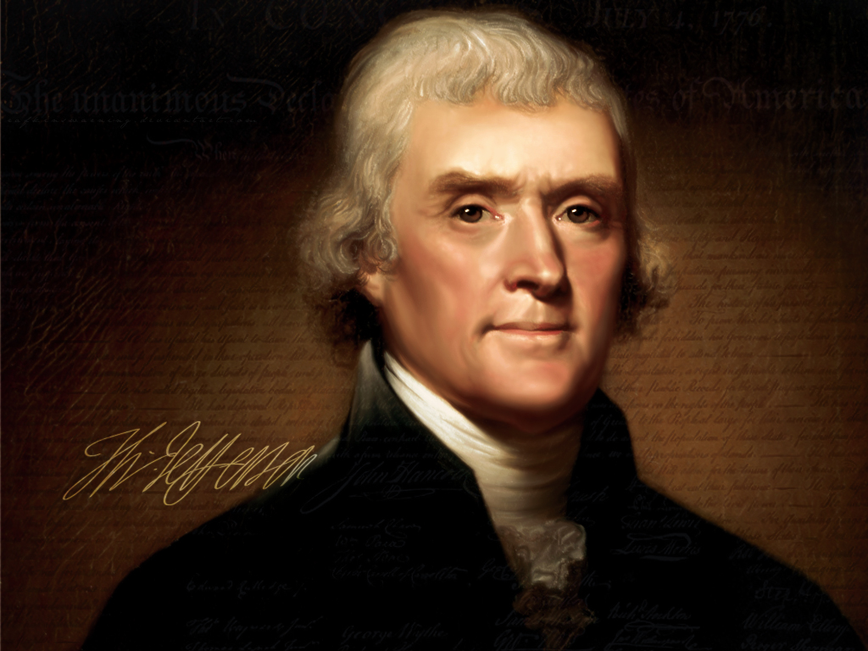
Thomas Jefferson, author of the Declaration of Independence,

Slide 16
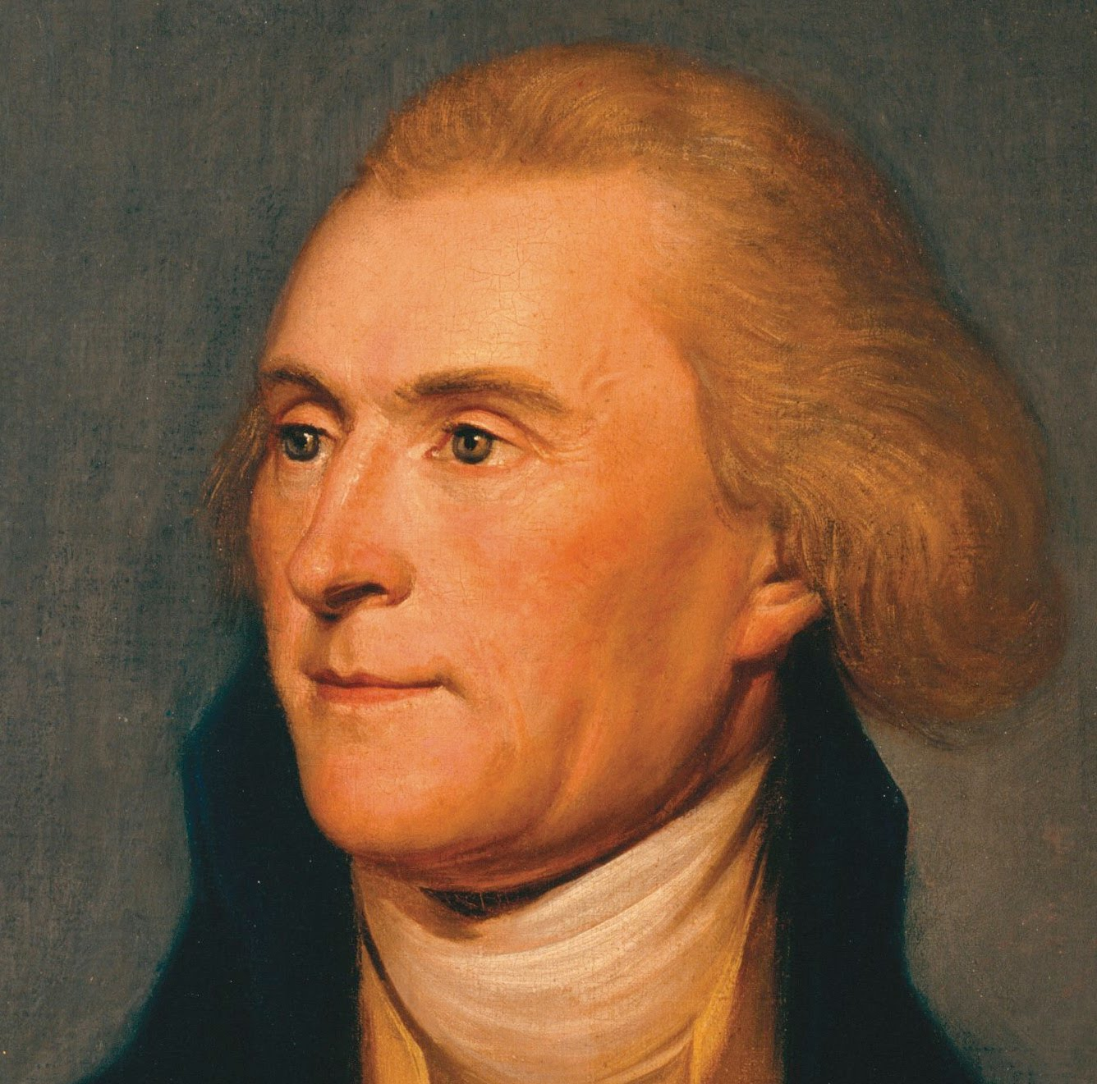
was Governor of Virginia during the American Revolution and abroad, serving as Minister to France at the time of the Constitutional Convention.

Slide 17
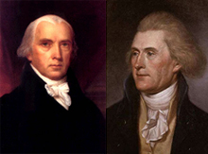
His neighbor and friend, James Madison had studied this history of governments and discussed much with Jefferson prior to coming to Philadelphia for the convention.

Slide 18
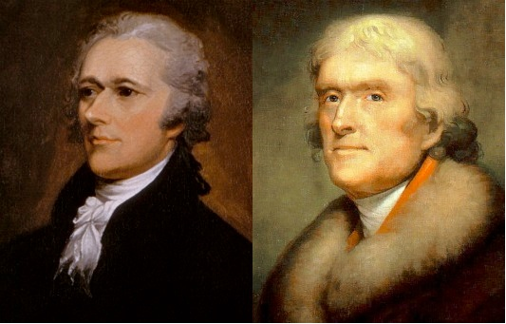
Washington named Jefferson his Secretary of State and therefore he served in Washington’s Cabinet until his resignation (over philosophical differences, with Hamilton and the Federalists, that eventually led to the formation of two political parties.)

Slide 19
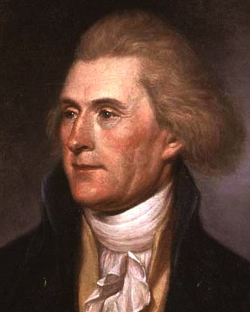
Jefferson became the leader of the Democratic-Republican Party

Slide 20
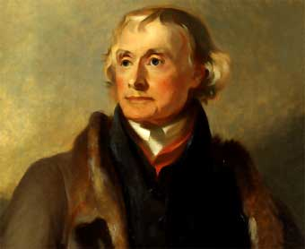
He became the third President of the United States and the first president from his political party.

Slide 21
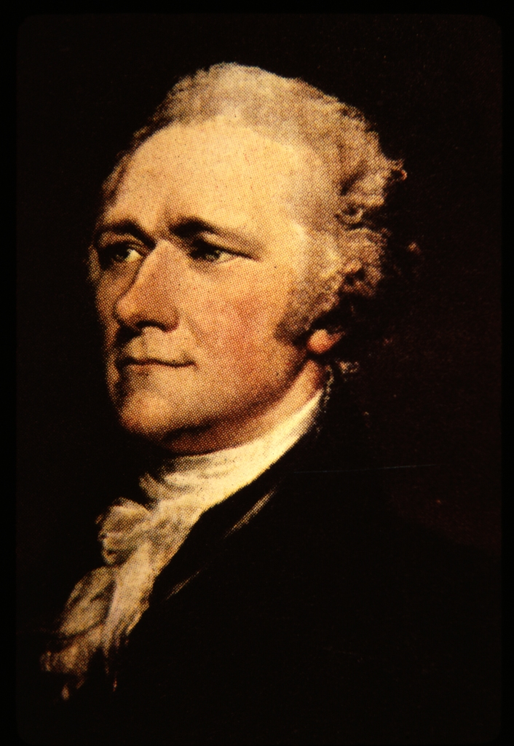
Alexander Hamilton had served with Washington during the war and was also a Founding Father (present at the Constitutional Convention in Philadelphia).

Slide 22
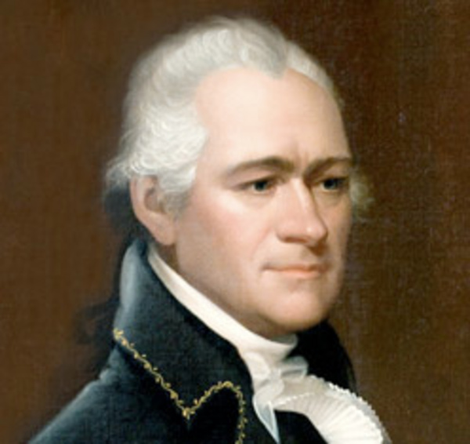
Washington named him Secretary of Treasury and served in Washington’s Cabinet,

Slide 23
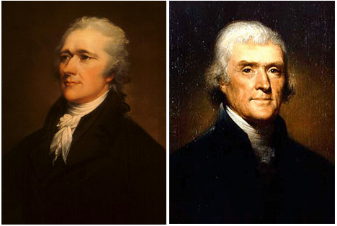
He disagreed with Jefferson on most issues

Slide 24
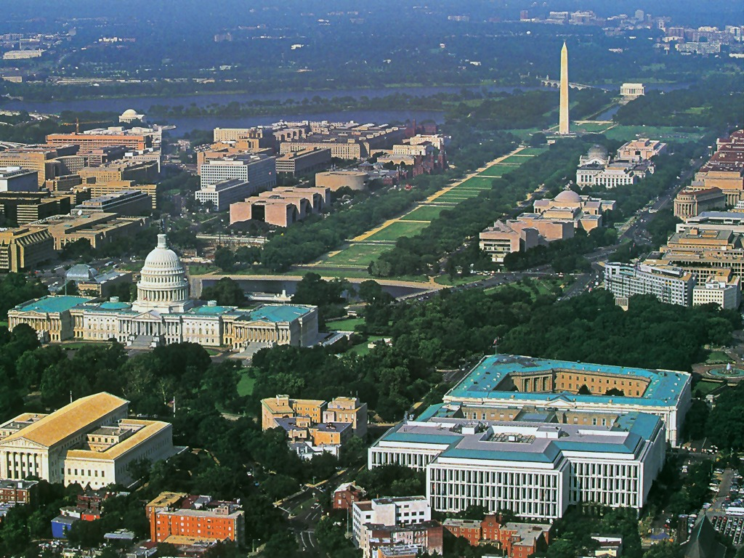
Hamilton proposed a series of laws that improved the financial standing of the new nation and the compromise to insure their passage also led to the present-day situation of the new capital (Washington, DC) between Maryland and Virginia

Slide 25
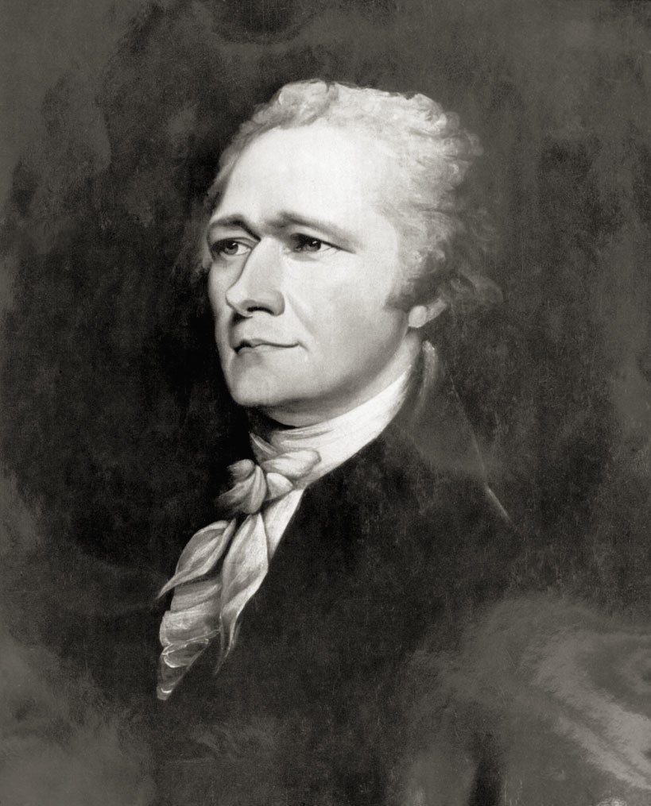
He was the leader of the Federalist Party

Slide 26
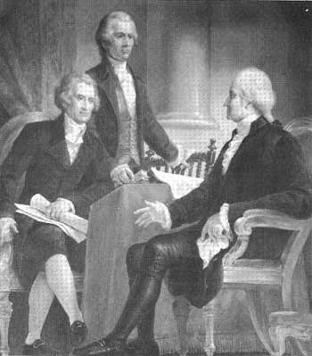
was a close adviser to President Washington, despite the fact that Washington strongly advised against having political parties.

Slide 27
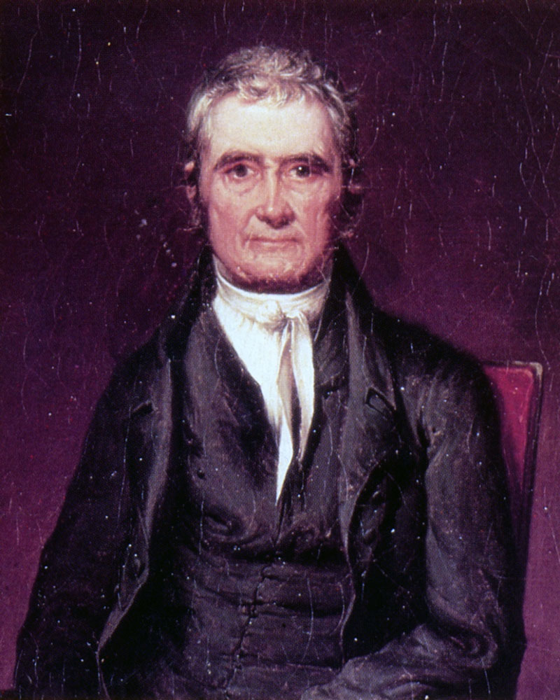
John Marshall was appointed as the Chief Justice of the Supreme Court by President Adams.

Slide 28
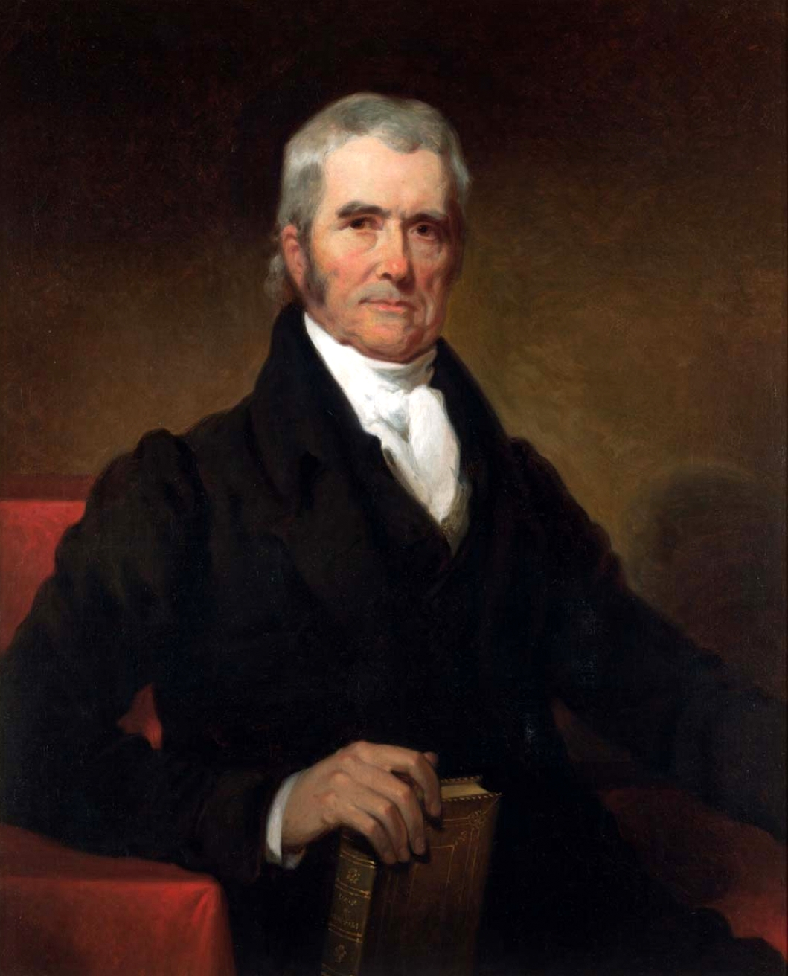
Marshall strengthened the role of the Supreme Court in the federal government by asserting the right of the Supreme Court to review the laws and determine if they are constitutional.

Slide 29
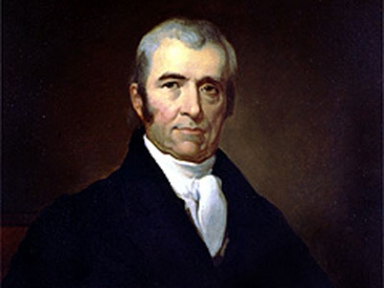
He was a Federalist, so he wanted to strengthen the federal government.

Slide 30
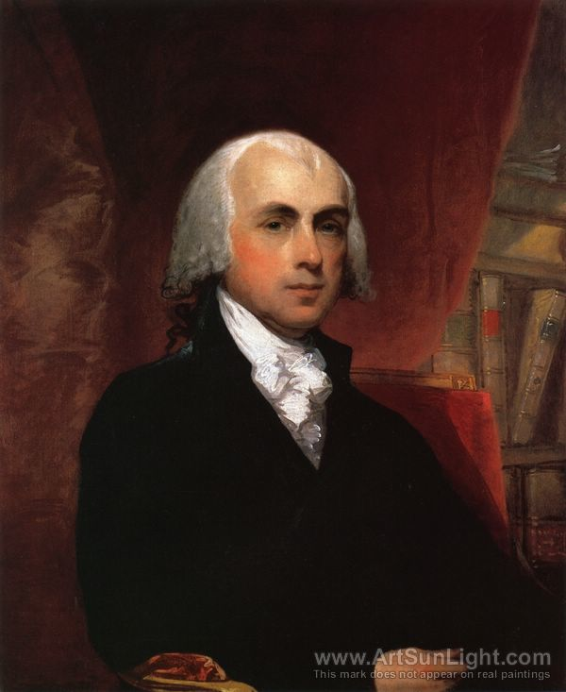
James Madison was the major author of the Constitution.

Slide 31
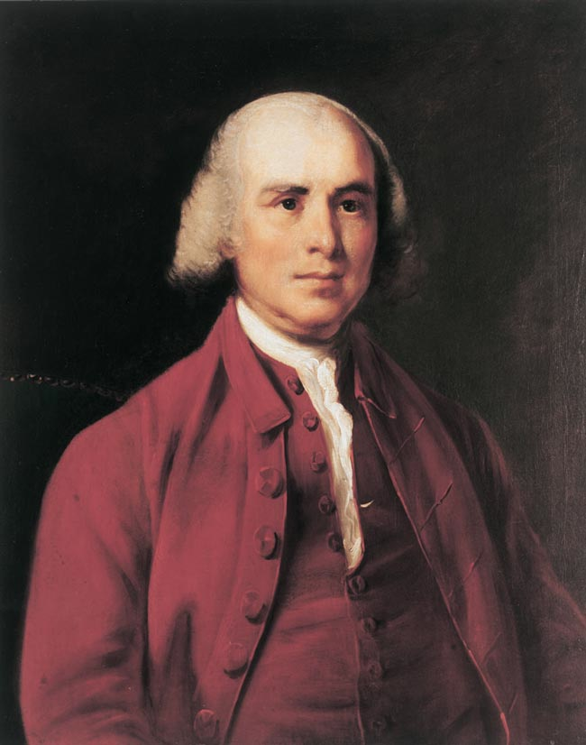
He served in the first US Congress and wrote the amendments that became the Bill of Rights.

Slide 32
Madison was also a leader in the Democratic-Republican Party and was elected the fourth President of the United States.

