Slide 1
4-4.3 Compare daily and seasonal changes in weather conditions (including wind speed and direction, precipitation, and temperature) and patterns.

Slide 2
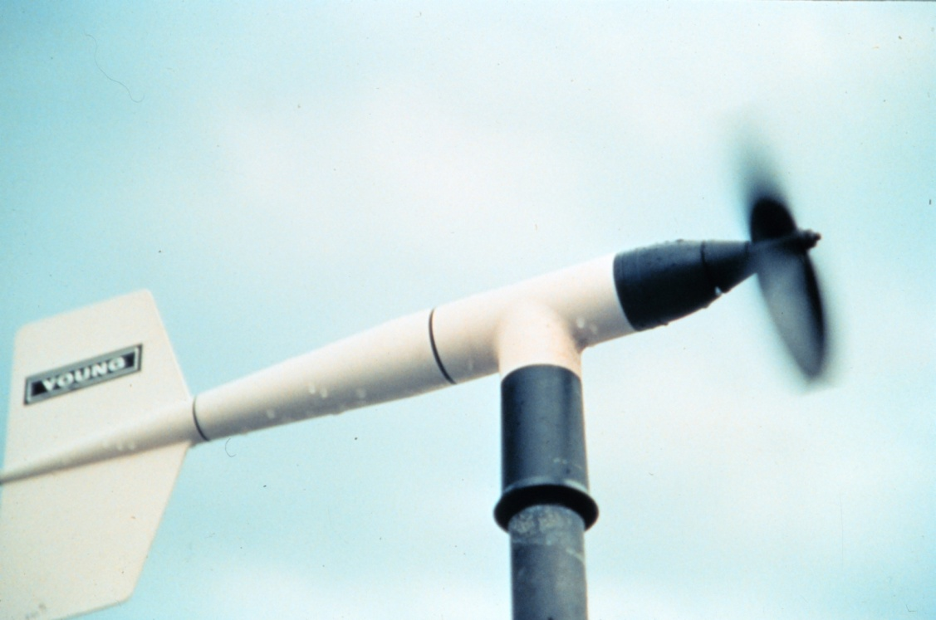
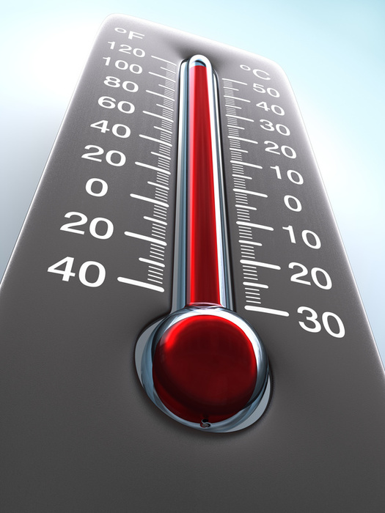
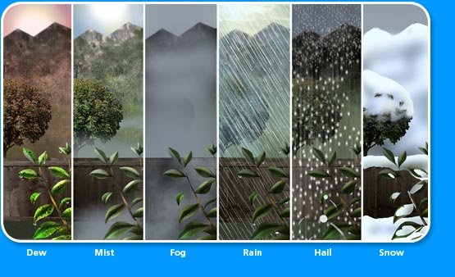
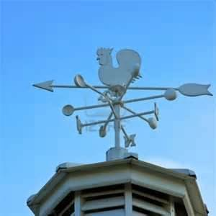
daily changes in weather result from changes in weather conditions, including temperature, wind speed and direction, and precipitation

Slide 3
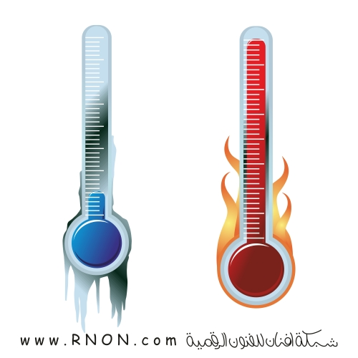
Temperature The condition of how hot or cold the air is at a given time

Slide 4
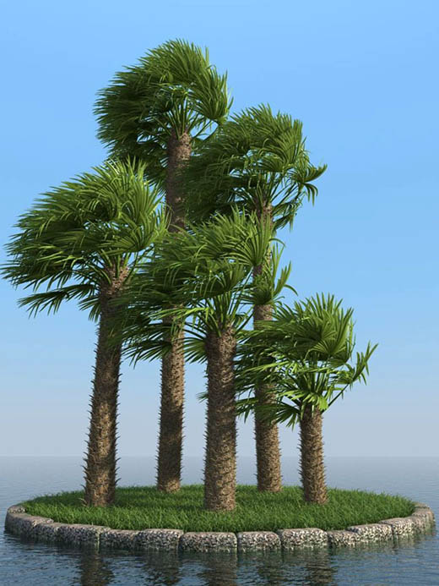
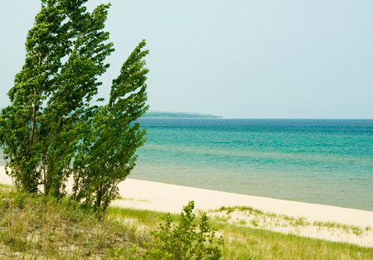
Wind speed The condition of how fast the wind is moving

Slide 5
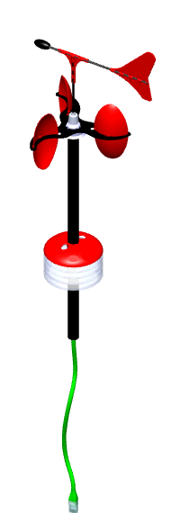
Wind direction The condition determined by where the wind is coming from

Slide 6
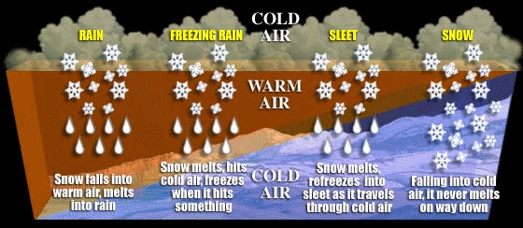
Precipitation The condition of the type of water falling to Earth from the clouds

Slide 7
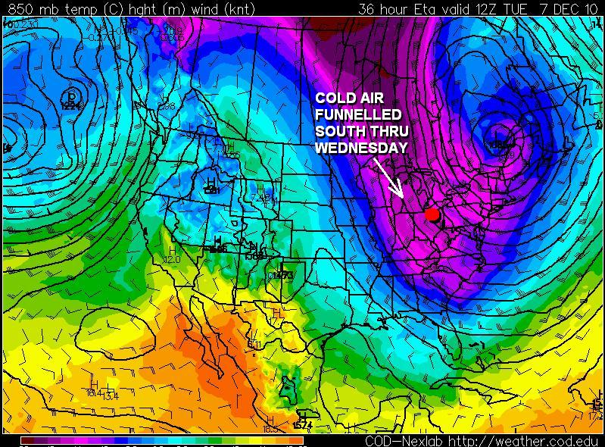
As the seasons of the year change, temperature changes may cause precipitation changes; winds blowing from the north may bring colder air than winds blowing from the south or west.

Slide 8
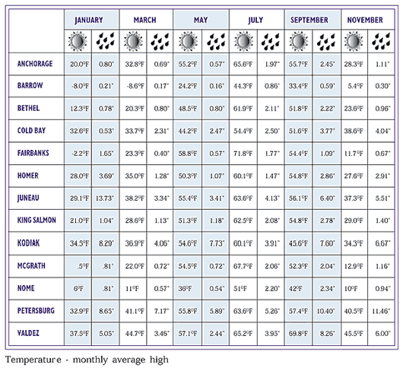
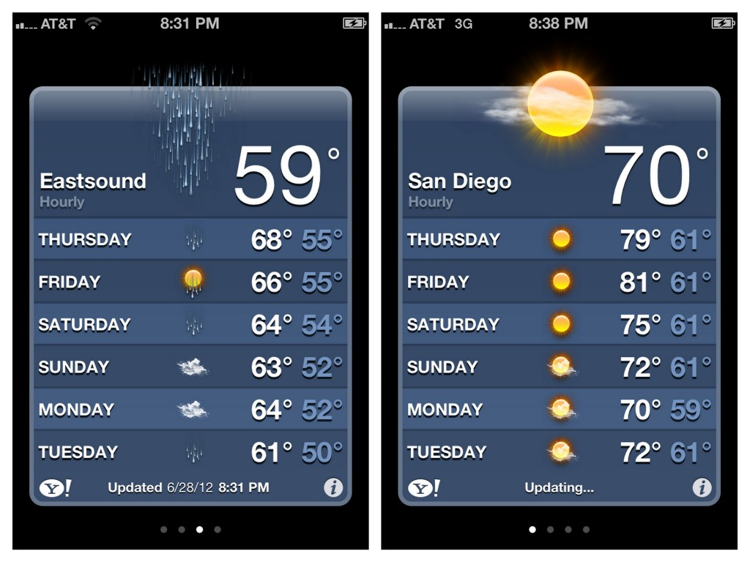
One day’s weather conditions can be compared to another in the same season, or compared to daily weather that occurs in different seasons.

Slide 9
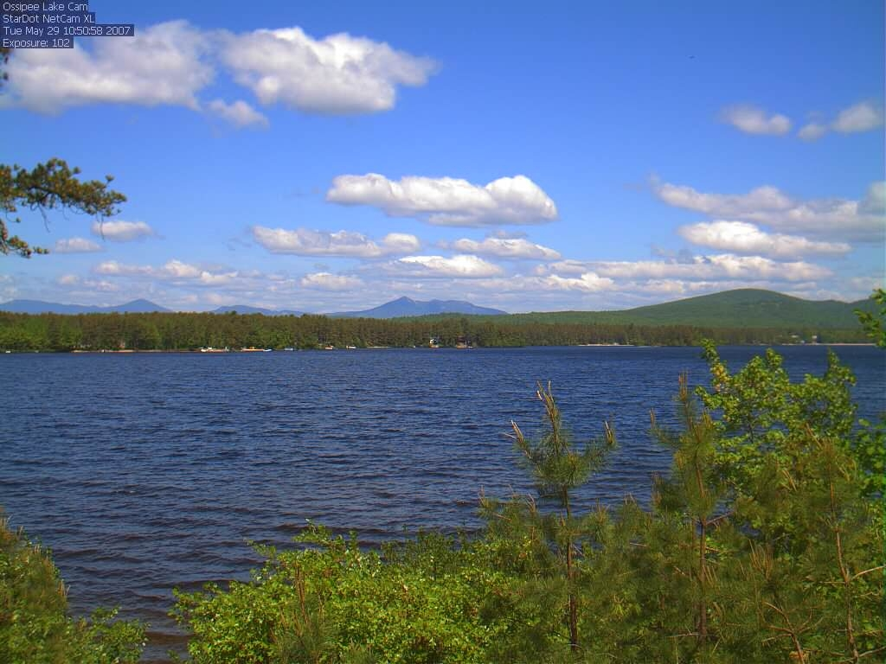
• Examples of weather conditions are fair weather,

Slide 10
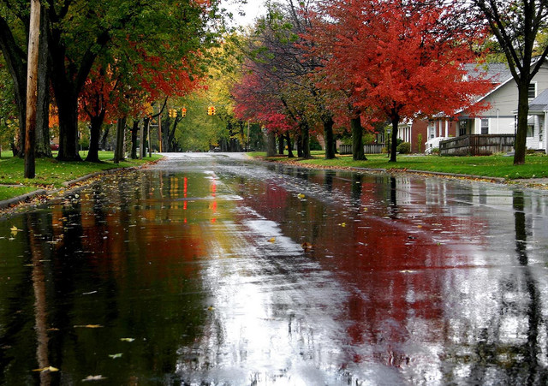
• Examples of weather conditions are showers or light rain,.

Slide 11
• Examples of weather conditions are clear skies with cold temperatures,

Slide 12
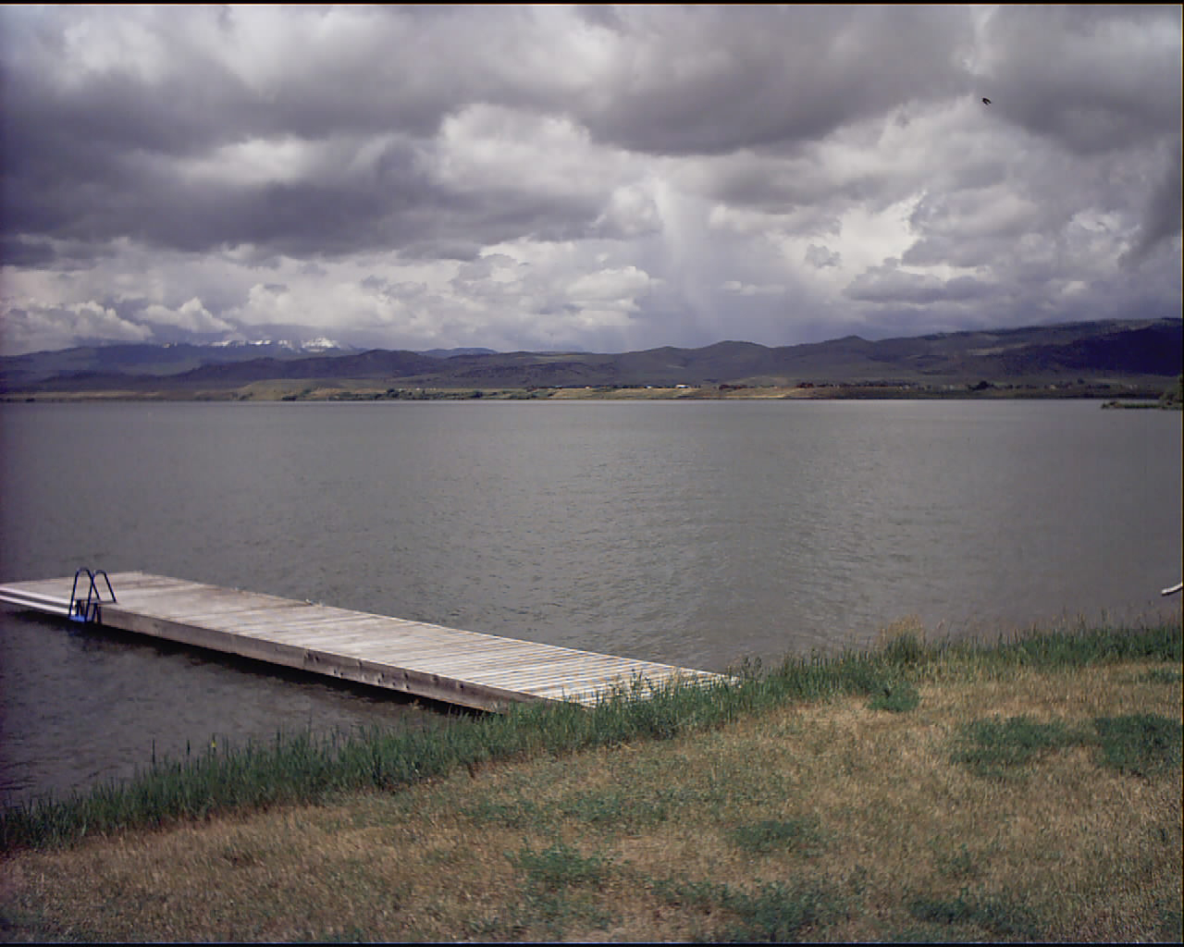
• Examples of weather conditions are days of clouds and precipitation,

Slide 13
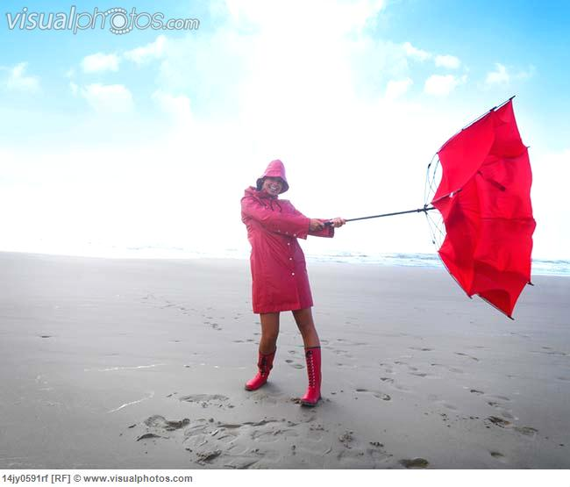
• Examples of weather conditions are windy fair days

Slide 14
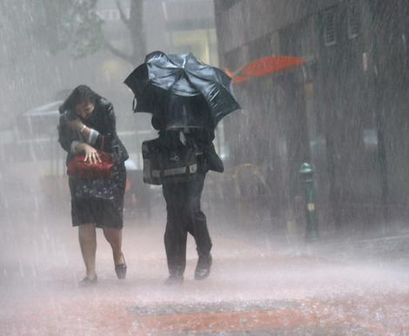
• Examples of weather conditions are windy stormy weather

Slide 15
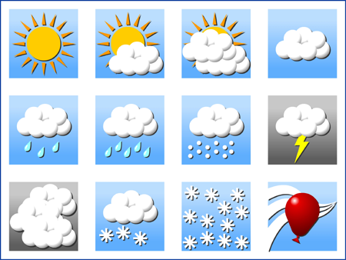
Weather patterns involve weather conditions that are repeated due to the season of the year.

Slide 16
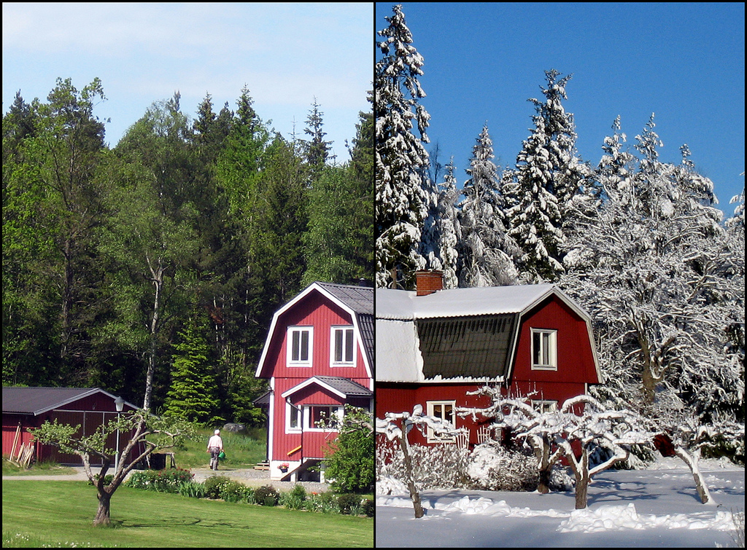
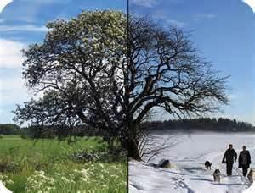
For example, summer temperatures are generally warmer than winter temperatures.

