Slide 1
4-3.4 and 4-3-.5
Revolutions and the seasons
Rotations and day and night

Slide 2
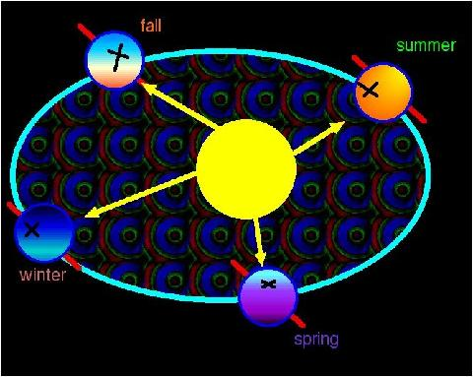
The earth has distinct seasons which result from the tilt of its axis and its revolution around the sun.

Slide 3
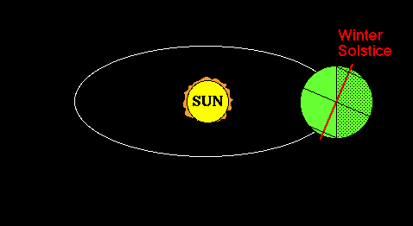
Earth revolves around the sun one time each year in about 365 ¼ days

Slide 4
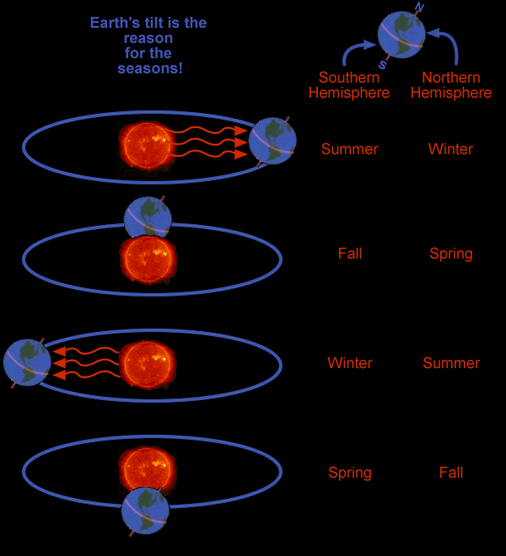
Earth has season because earth’s axis is tilted

Slide 5
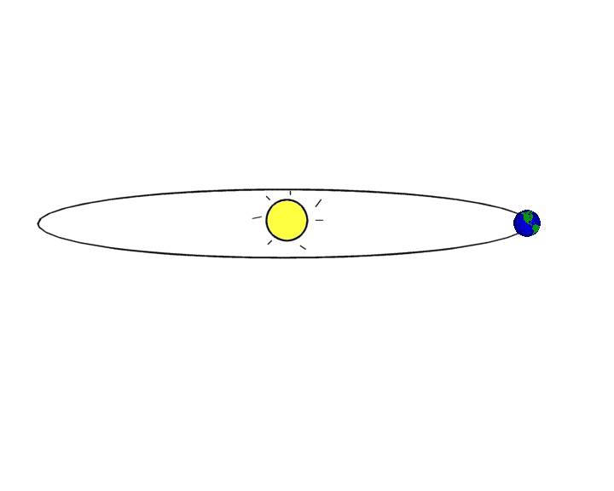
Because of the tilt, the number of daylight hours changes throughout the year
http://astro.unl.edu/naap/motion1/animations/seasons_ecliptic.swf

Slide 6
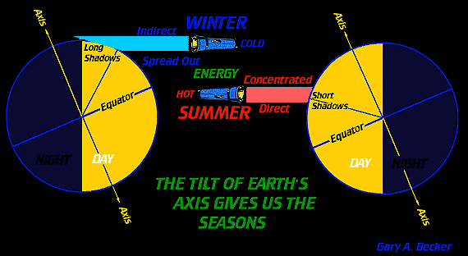
As earth revolves around the sun, different parts of the earth get more sunlight

Slide 7
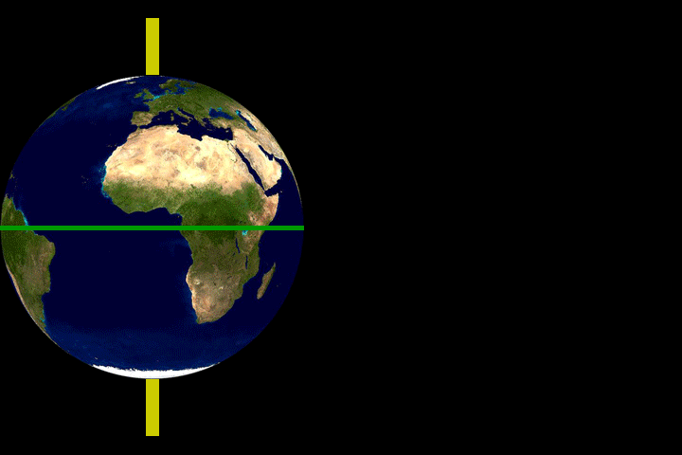
As earth revolves around the sun, different parts of the earth get more sunlight

Slide 8
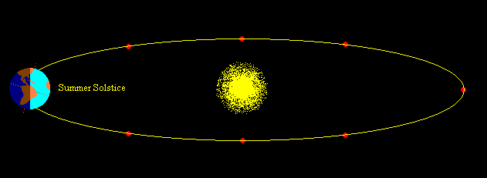
The tilt also causes the northern or the southern part of the earth to point toward the sun

Slide 9
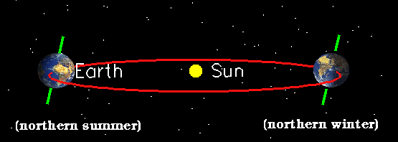
When the tilt is toward the sun, the season is summer; when the tilt is away from the sun, the season is winter

Slide 10
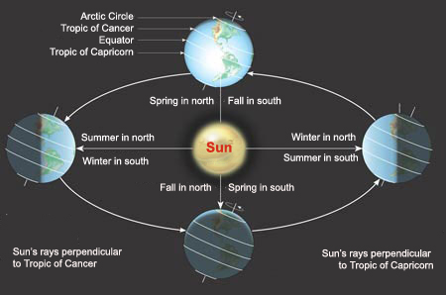
The two hemispheres have opposite seasons

Slide 11
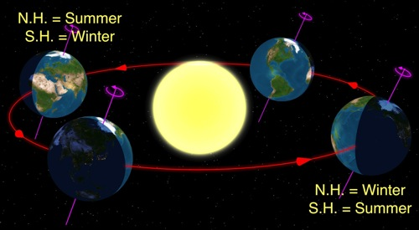
The seasons do not depend on the distance of earth from the sun

Slide 12
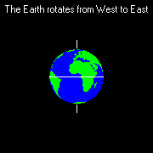
Earth rotates around an imaginary straight line called an axis that runs through the planet’s center

Slide 13
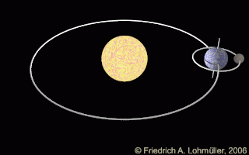
The movement of earth as it makes an orbit around the sun in one year is a revolution

Slide 14
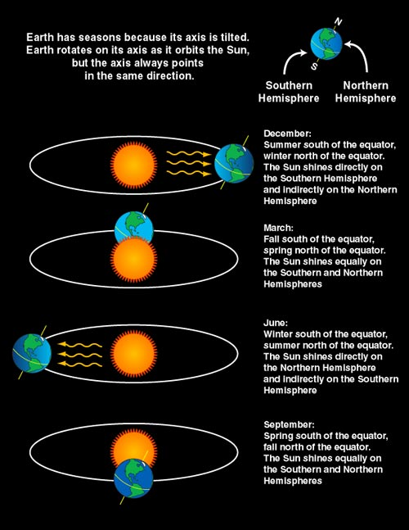
The effects on earth due to the change in the amount of sunlight caused by the tilt of the earth's axis cause our seasons

Slide 15
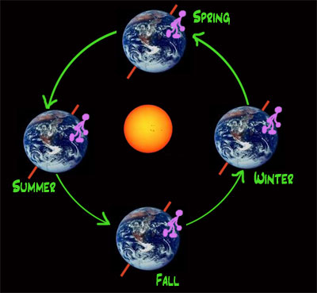
Summer occurs when part of earth is tilted most toward the sun

Slide 16
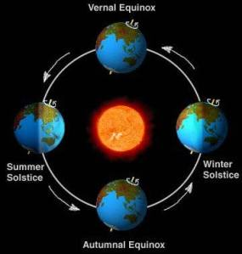
Autumn and spring occur when neither part of the earth is pointed directly toward or away from the sun

Slide 17
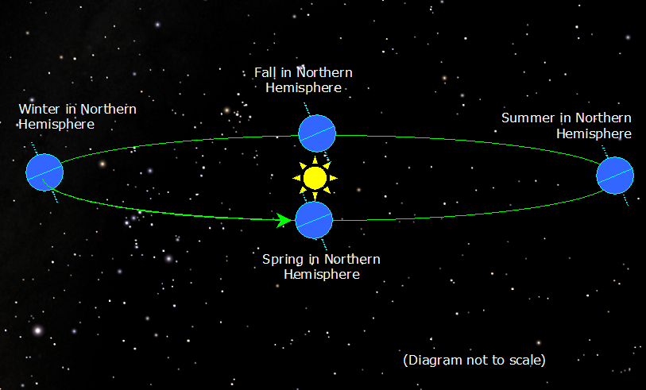
Winter occurs when part of earth is tilted away from the sun

Slide 18
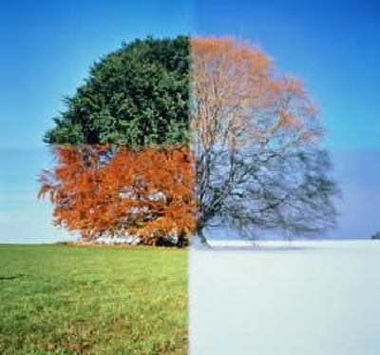
The sequence of the season during the year is summer, autumn, winter, spring

Slide 19
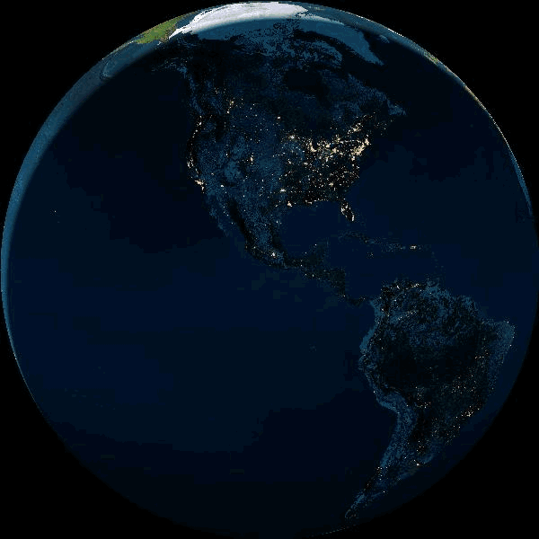
Earth rotates (spins) on its axis and completes one rotation in 24 hours.

Slide 20
Earth rotates from west to east, therefore, the Sun appears to rise in the east and set in the west.
http://www.ictgames.com/dayNight/index.html

Slide 21
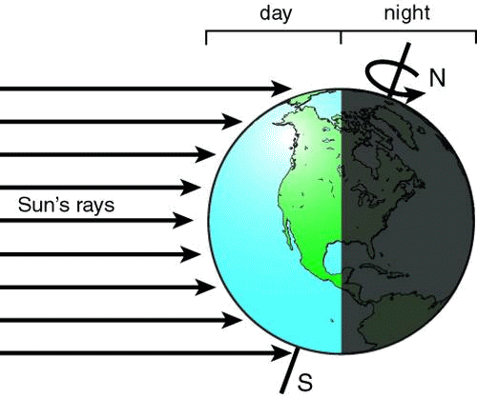
Because of this rotation, only the side of Earth facing the Sun is lit and therefore experiences day; the side of Earth not facing the Sun experiences night.

