Slide 1
4-3.2: Explain the significance of major ideas and philosophies of government reflected in the Declaration of Independence.

Slide 2
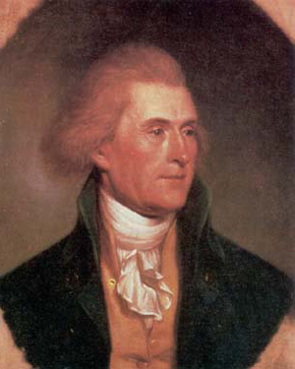
There are four major ideas that were reflected in the Declaration of Independence. Thomas Jefferson said them best:

Slide 3
“All men are created equal…”:

Slide 4
Although Jefferson did not recognize the rights of African Americans or women and all men were not treated equally, this phrase is the fundamental principle of American government.

Slide 5
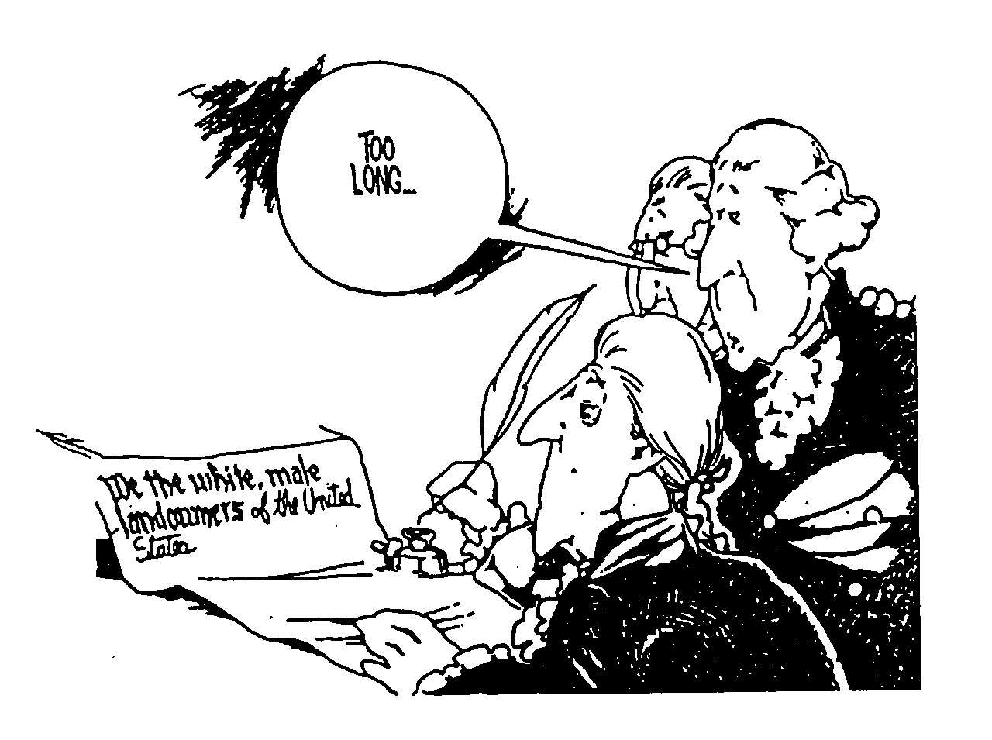

Slide 6
“… they are endowed by their creator with certain inalienable rights; that among these are life, liberty, and the pursuit of happiness”:

Slide 7
Rights are not given to men by their government but are inherent and undeniable.

Slide 8
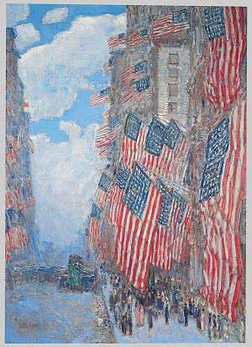
“to secure these rights, governments are instituted among men, deriving their just powers from the consent of the governed”:

Slide 9
The purpose of government is to protect the rights of the people

Slide 10
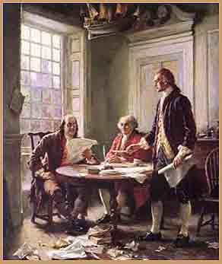
“whenever any form of governments becomes destructive of these ends, it is the right of the people to alter or to abolish it”

Slide 11
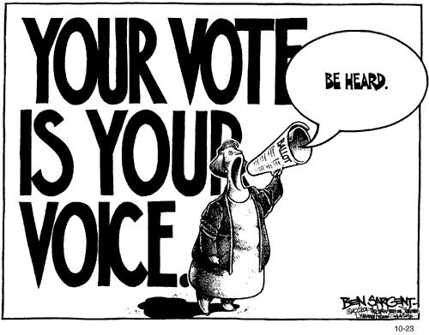
If the government does not protect the rights of the people, it is the right of the people to change their government.

Slide 12
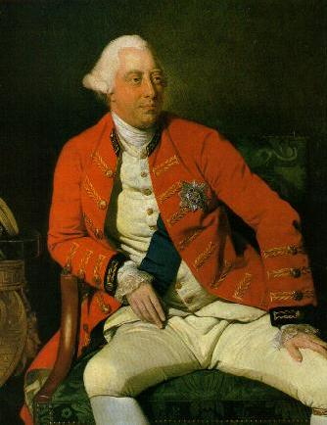
The Declaration of Independence also includes a list of grievances against King George III,

Slide 13
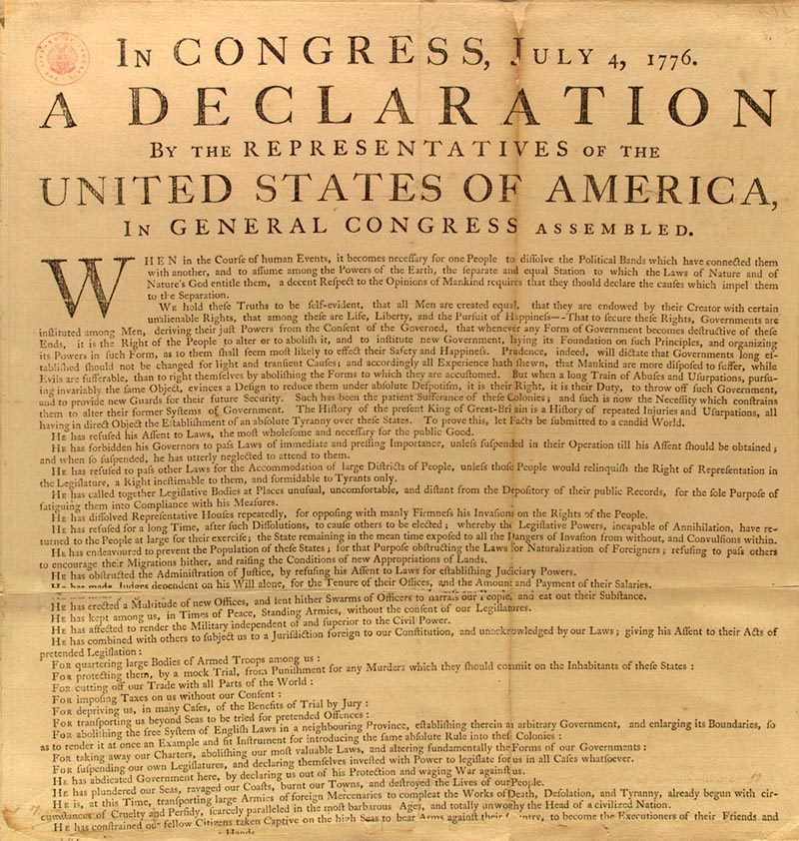
they were there to persuade/ prove (to skeptical colonists and the world) that the rights of the people had been violated,

Slide 14
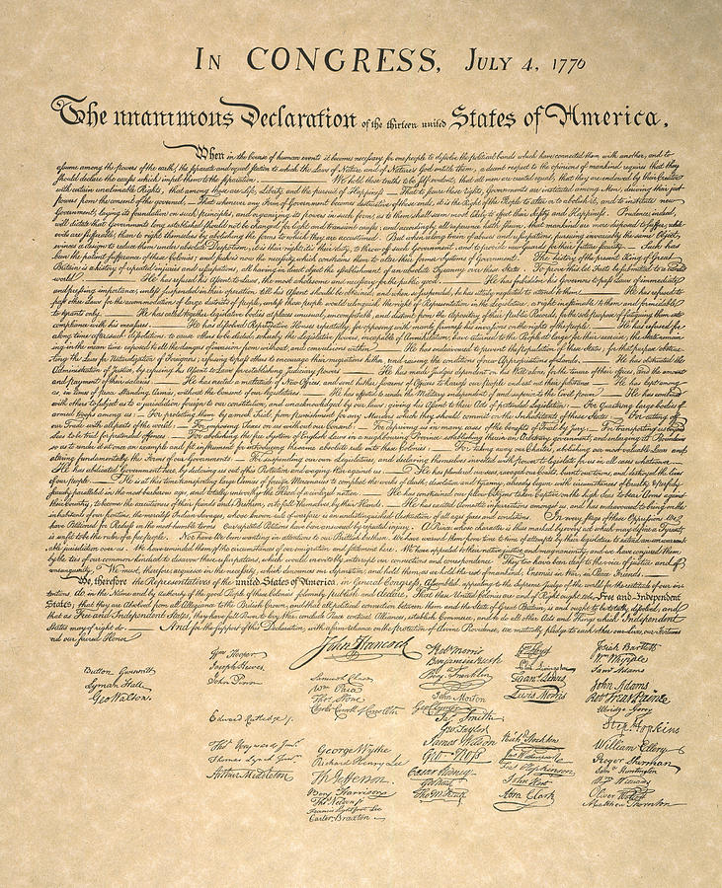
therefore the people had the right to abolish their old government and form a new one.

Slide 15
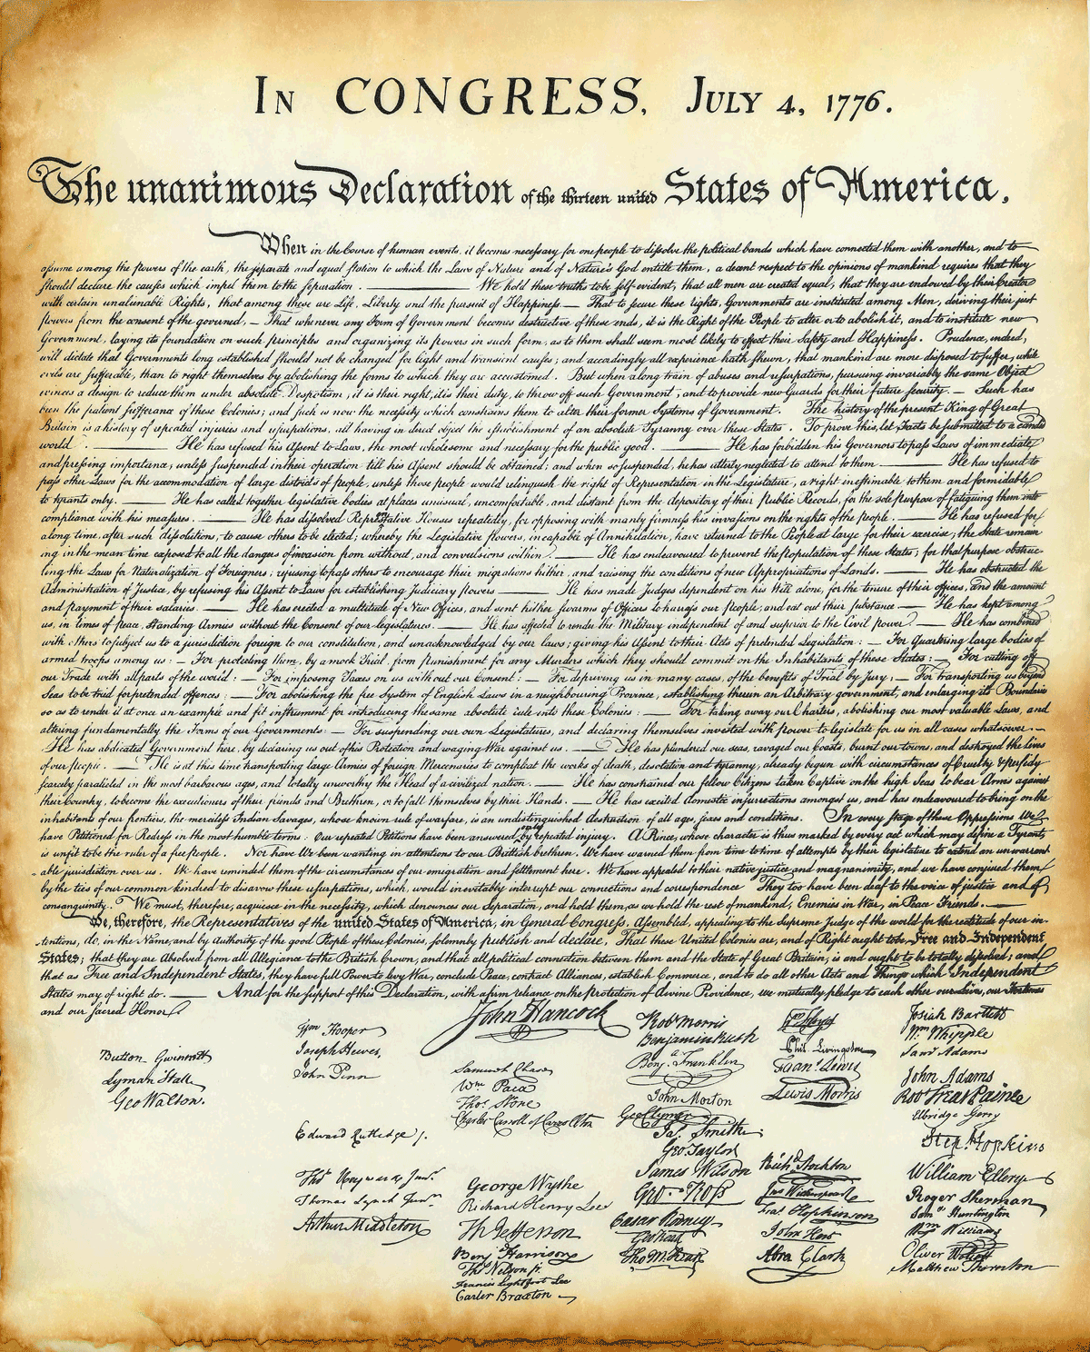
The Declaration concludes with a formal statement declaring the colonists’ independence from England.

Slide 16
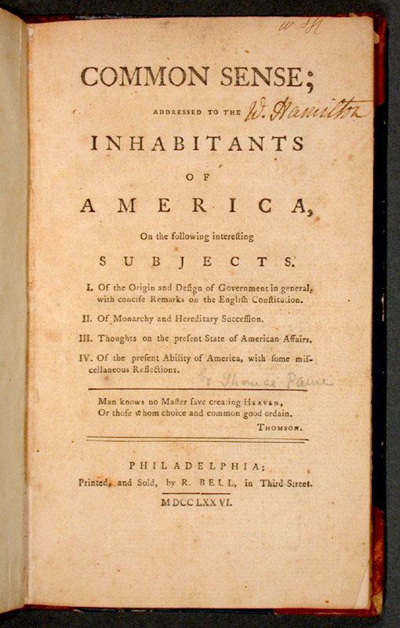
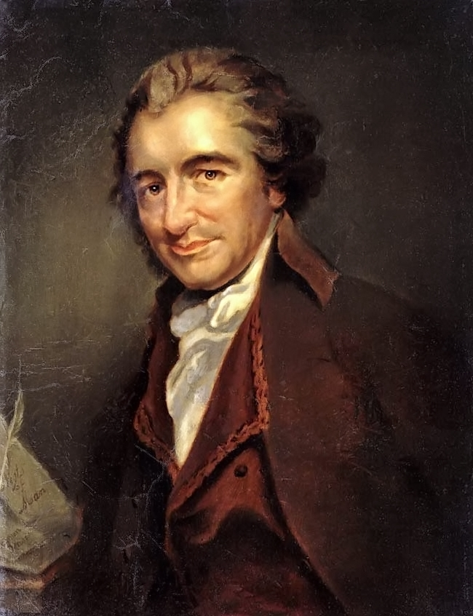
Thomas Paine wrote a persuasive pamphlet supporting independence called Common Sense to further the cause.

