Slide 1
Revolutionary War
4-3.1: Explain the major political and economic factors leading to the American Revolution,
including the French and Indian War, the Stamp Act, the Tea Act, and Intolerable Acts as well as
American resistance to these acts through boycotts, petitions, and congresses.

Slide 2
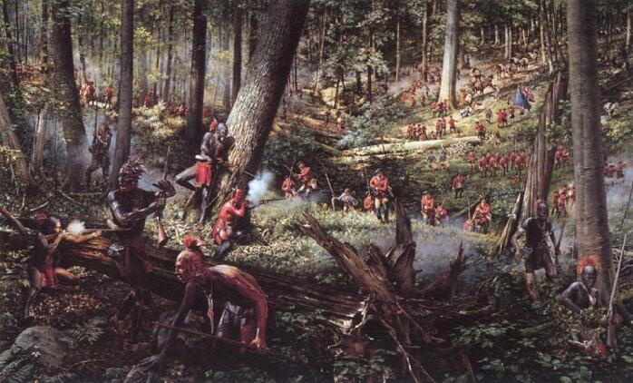
Political factors and economic factors that ultimately led to the American Revolution started with the French and Indian War

Slide 3
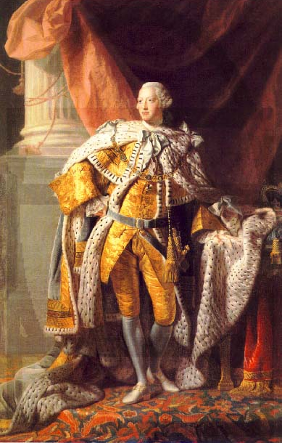
King George III ruled Great Britain

Slide 4
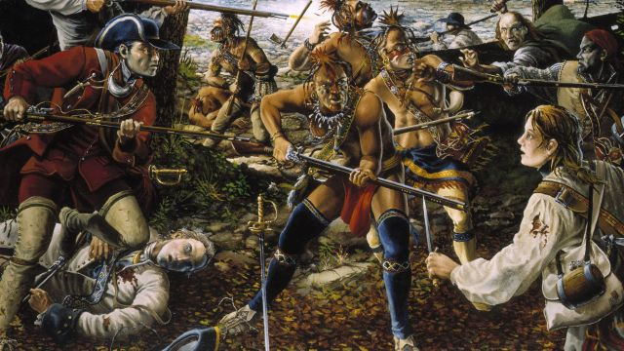
The French and Indian War was fought between France and England over lands in the Ohio River Valley, which both the French and English claimed.

Slide 5
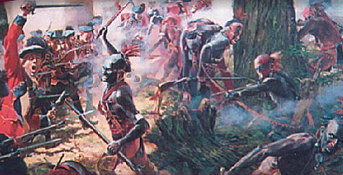
The British won the war and gained control of these lands but amassed a large debt as a result of the war.

Slide 6
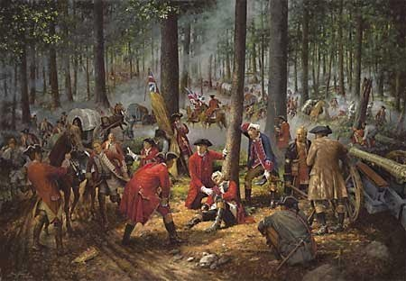
The British Parliament determined that this debt should be paid by the American colonists, whose lands the British had been defending.

Slide 7
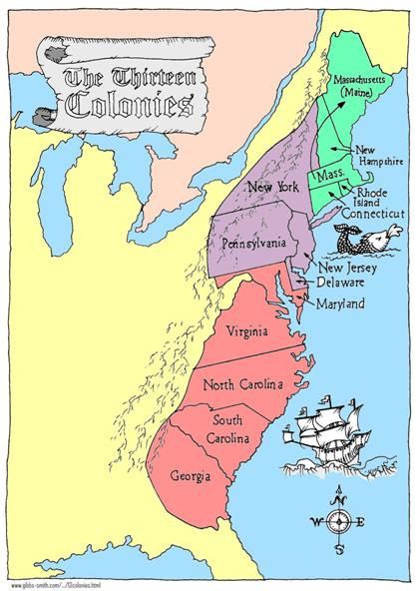
This was a change in the British government’s colonial policy. Before the French and Indian War, the British government ignored what was happening in the colonies and let them govern and tax themselves.

Slide 8
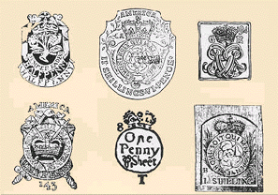
After the French and Indian War, the British Parliament began to pass a series of laws that changed the relationship between the colonial assemblies and the Parliament.

Slide 9
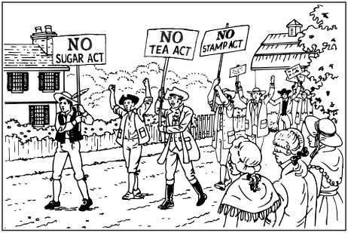
Colonists believed it was the right of their colonial assemblies to impose taxes, not the right of the King or of Parliament, and they resisted this changed policy through protests and boycotts of British goods.

Slide 10
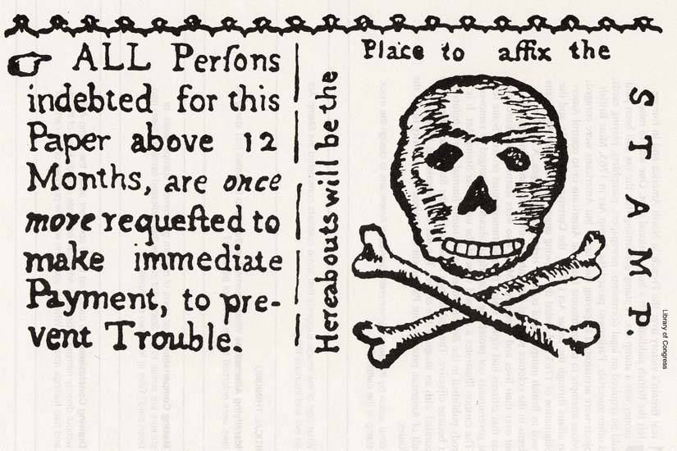
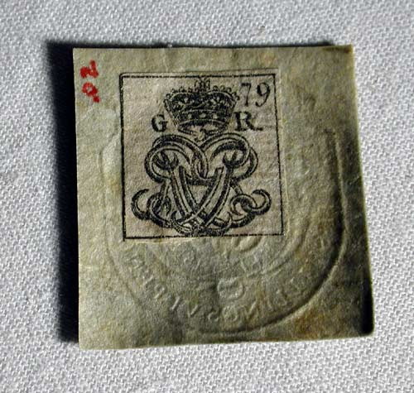
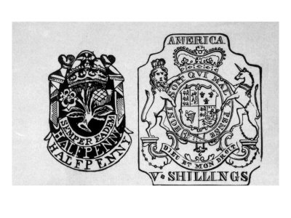
One of the British taxes, the Stamp Act, placed a tax on all papers, such as legal documents and newspapers.

Slide 11
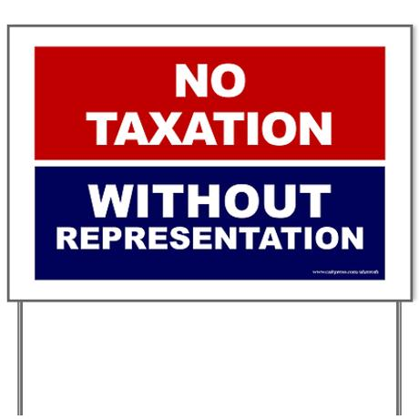
The colonists would pay this directly (taxes before this were indirect duties on imports included in the retail price of the goods and were invisible to the colonial consumer), and protested with the cry, “No taxation without representation.”

Slide 12
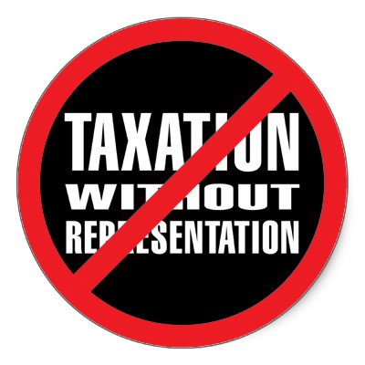
Colonists did not have a representative in Parliament and therefore had no voice in Parliament.

Slide 13
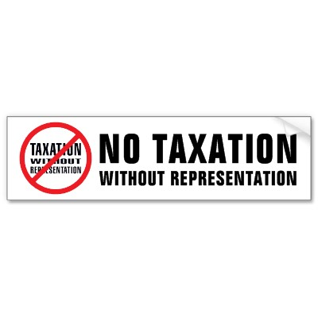
They did not actually want representation in the distant Parliament because they knew they would be outvoted.

Slide 14
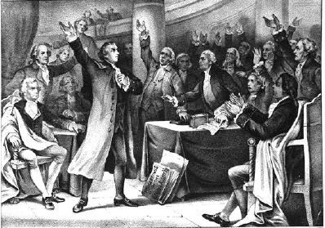
Colonists organized a Stamp Act Congress, which sent a petition to the King, and declared a boycott on British goods that led to the repeal of the Stamp Act.

Slide 15
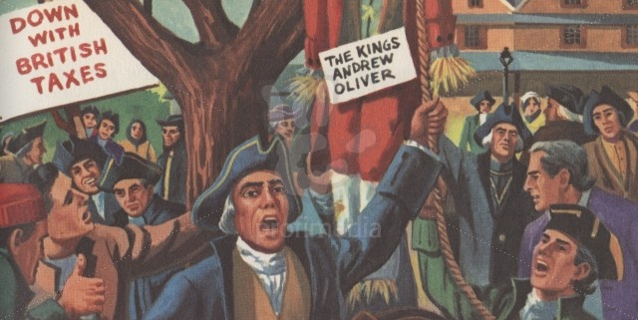
They also organized the Sons and Daughters of Liberty in order to protest British taxes.

Slide 16
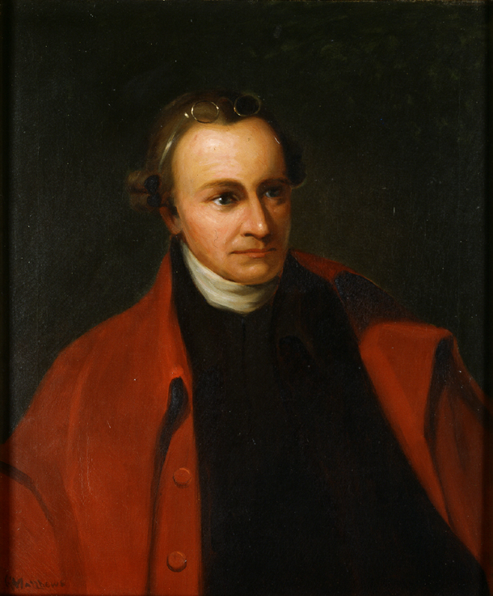
Patrick Henry was a member of the Virginia’s colonial assembly who wrote a strong protest to the Stamp Act that asserted the rights of the colonists.

Slide 17
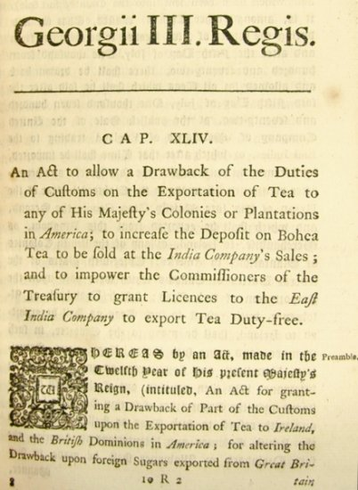
The Tea Act was not a tax. This act gave the British East India Company exclusive rights (a monopoly) to sell tea in the colonies, because the East India Tea Company had financial problems and Parliament wanted to help the company avoid bankruptcy.

Slide 18
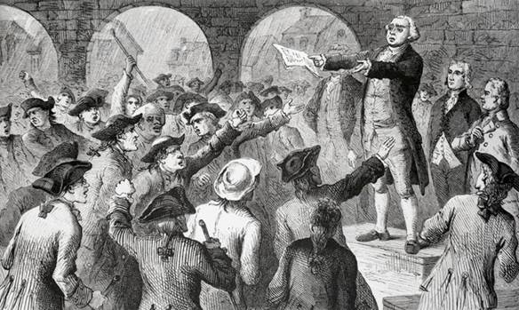
The Sons of Liberty feared the availability of cheap tea would threaten the effectiveness of a tea boycott.

Slide 19
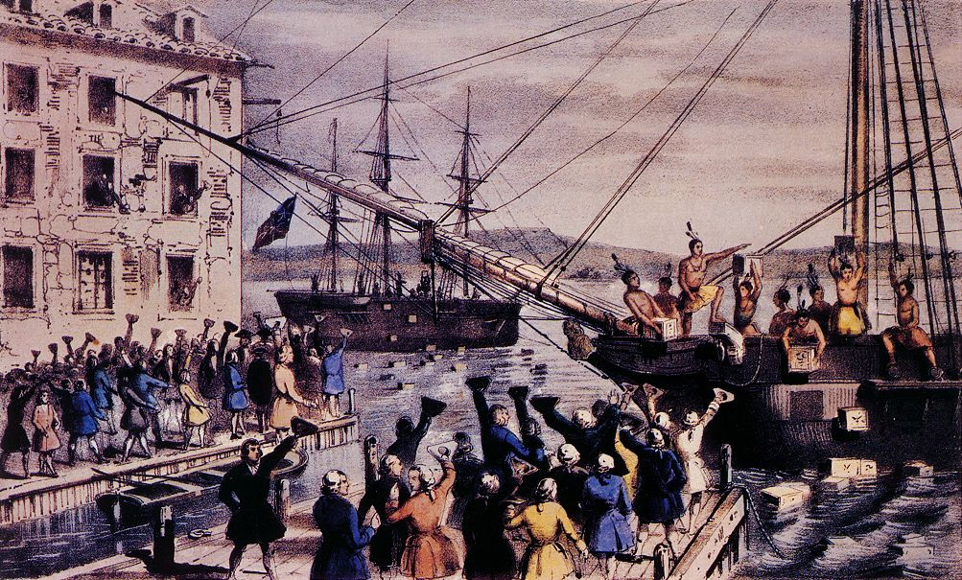
In Boston, they boarded the British ship and threw the tea overboard

Slide 20
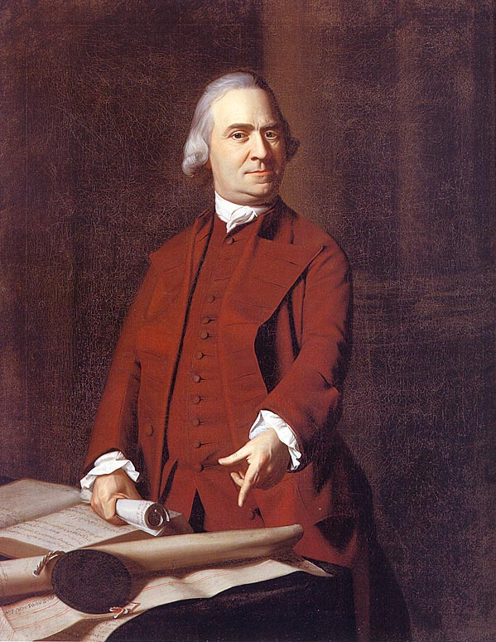
John Adams was a Massachusetts leader and a member of the Sons of Liberty. He was a strong advocate of independence and was on the committee charged with writing the Declaration of Independence.

Slide 21
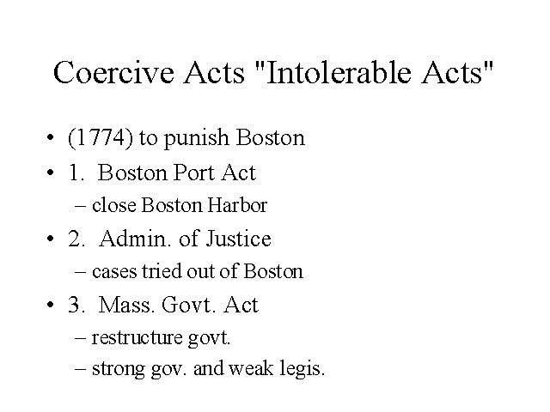
These actions, known as the Boston Tea Party, led Parliament to pass the Coercive Acts, renamed by the colonists, the Intolerable Acts for their punitive nature.

Slide 22
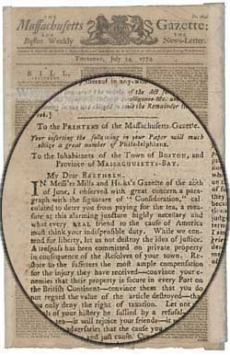
The British named these acts the Coercive Acts because they were designed to coerce, or force, the colonists to pay for the dumped tea and recognized the right of the Parliament to make tax laws for the colonies.

Slide 23
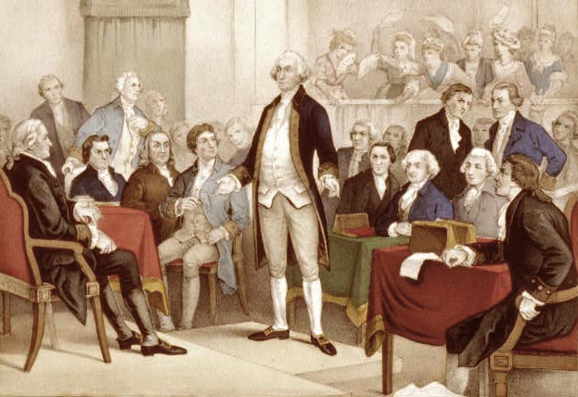
Colonists initially formed Committees of Correspondence to communicate their situations to each other then sent delegates to a Continental Congress in order to address the problem of the Intolerable Acts.

Slide 24
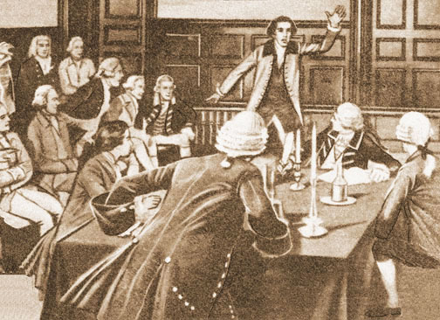
The First Continental Congress established a boycott on all trade with Great Britain and sent a petition to the King.

Slide 25
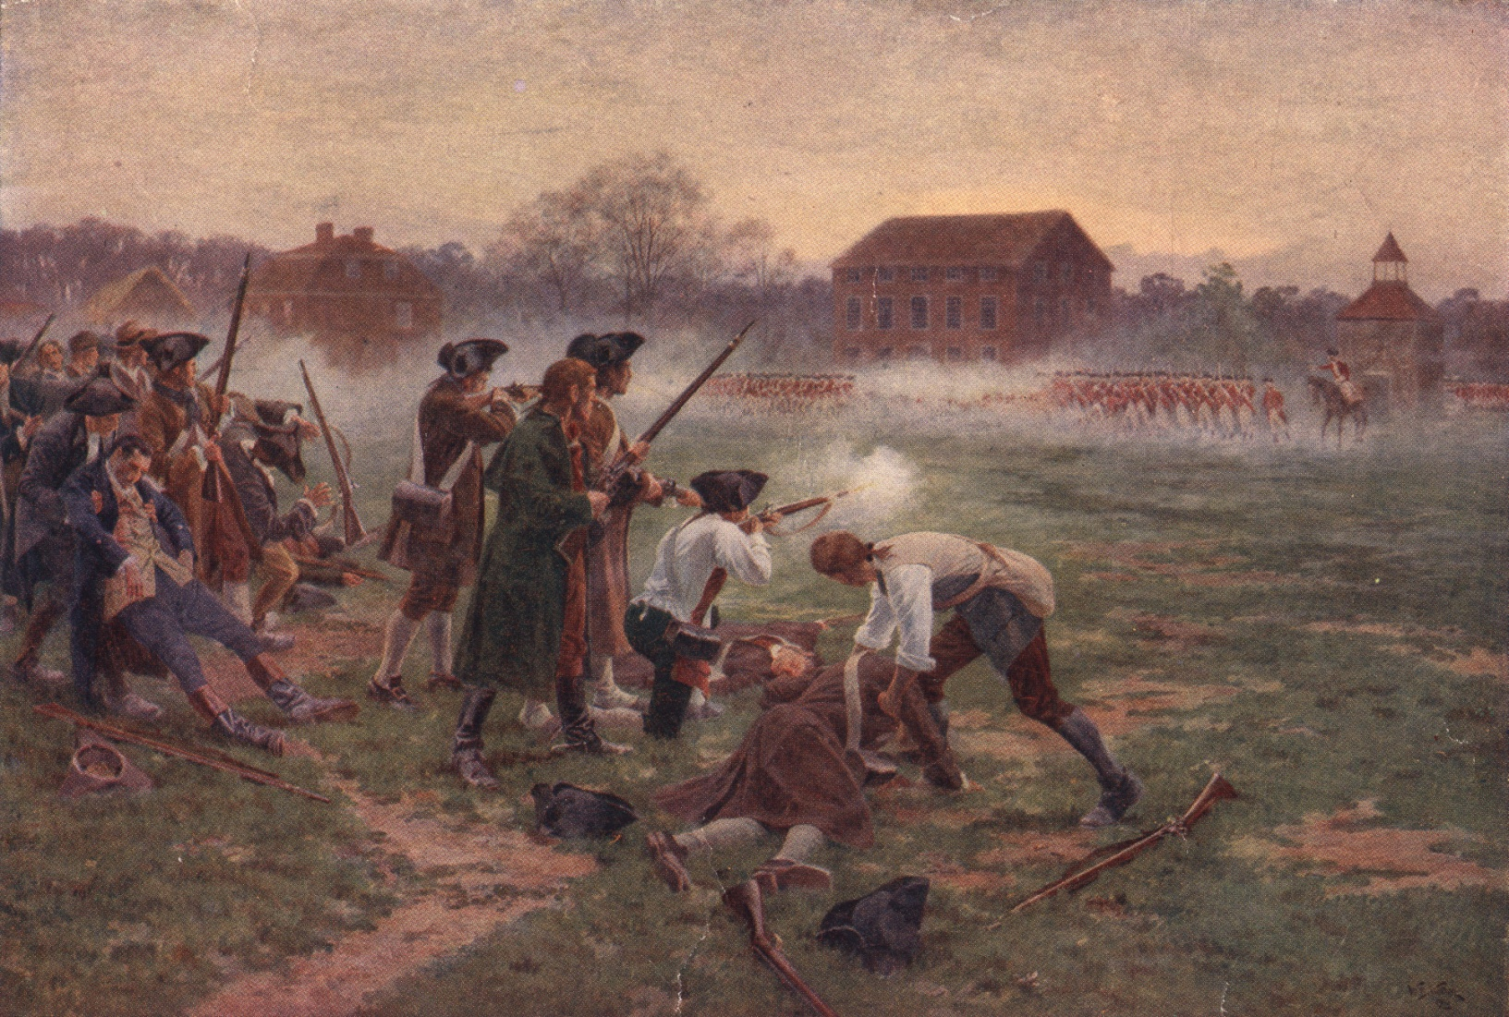
The Continental Congress also advised American colonists to arm themselves. This led to the battle of Lexington and Concord and the start of the Revolutionary War.

