Slide 1
4-2.4: Summarize the relationship among the Native Americans, Europeans, and Africans, including the French and Indian War, the slave revolts, and the conduct of trade.

Slide 2
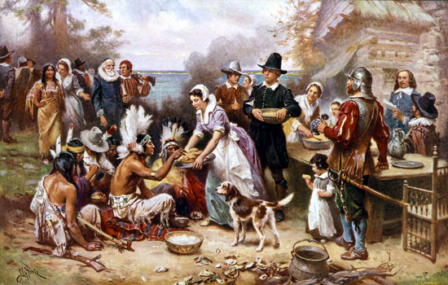
At first, Native Americans helped the colonists in Virginia and Plymouth to survive the first years and taught them to plant crops that would grow in the New World such as tobacco and corn.

Slide 3
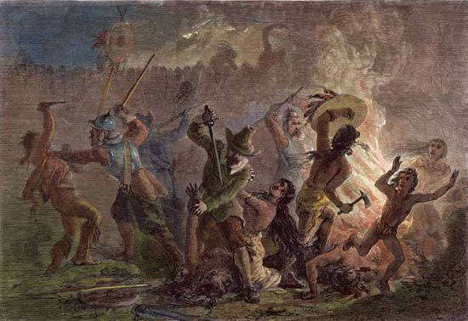
As more settlers came to the New World for land, the Native Americans resisted the new settlers.

Slide 4
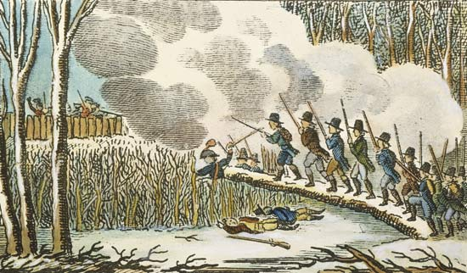
Many wars were fought between the colonists and the Native Americans.

Slide 5
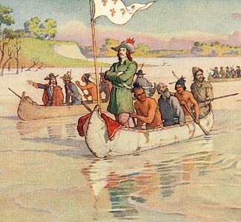
With Robert La Salle’s claim, the French moved into the Ohio River Valley to claim this land for France.

Slide 6
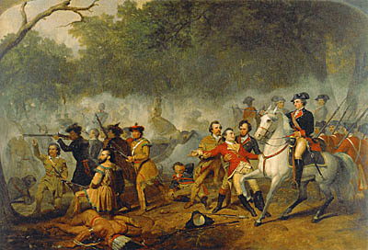
The English colonists and their mother country went to war with the French and their colonists, to protect their claims.

Slide 7
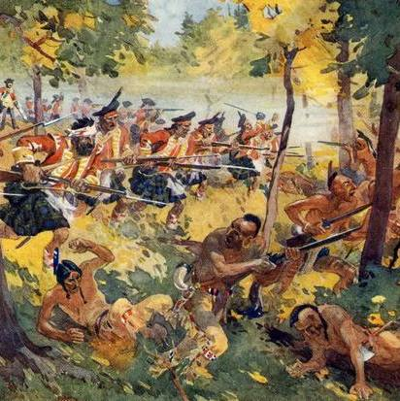
Many Native American tribes fought on the side of the French against the colonists and the British, giving the series of four wars spanning over seventy-four years and fought on three different continents.

Slide 8
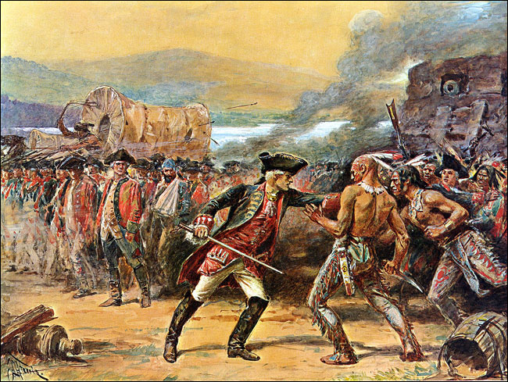
The last war in this sequence produced their American name- The French and Indian War(s). [In Europe this final conflict was called the Seven Years War because of the length of time it was fought.]

Slide 9
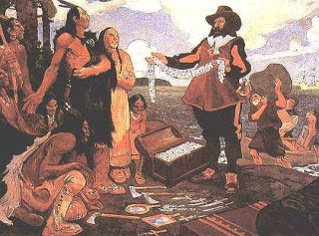
The French established good working relationships with the natives because of their fur trading.

Slide 10
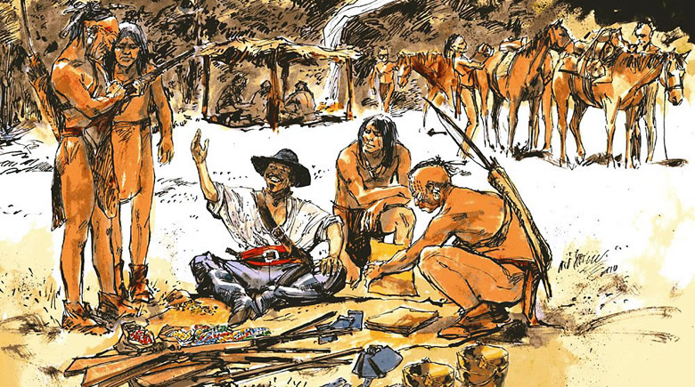
Because few French settlers came to the New World and the ones who came did not take much land for families or settlement, the French did not antagonize the Native Americans as the American colonists did.

Slide 11
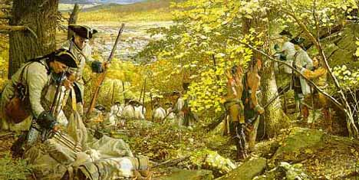
Most of the Native American groups allied with the French hoped that a French victory would limit the expansion of the English colonies to the Appalachian Mountains.

Slide 12
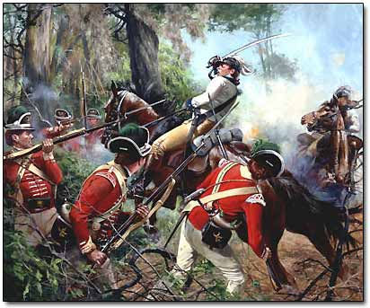
With the aid of alliances with the Iroquois Confederation, the Catawba and the Cherokee, the British won the French and Indian War

Slide 13
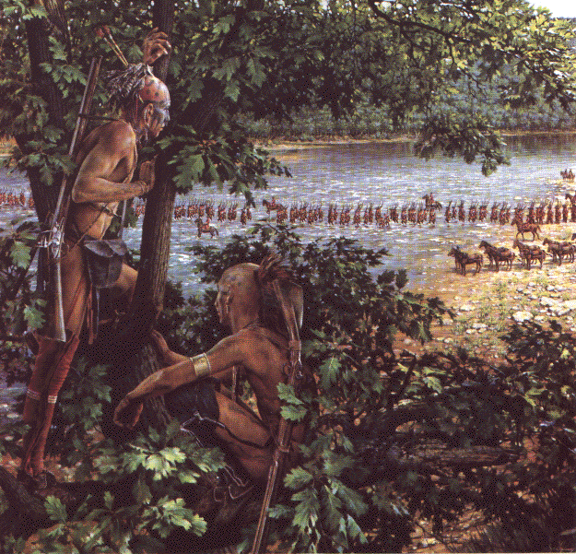
This forced the French to cede control of their North American land claims and many Native Americans lost their longstanding trading partners/military allies and thus found their ways of life greatly disrupted.

Slide 14
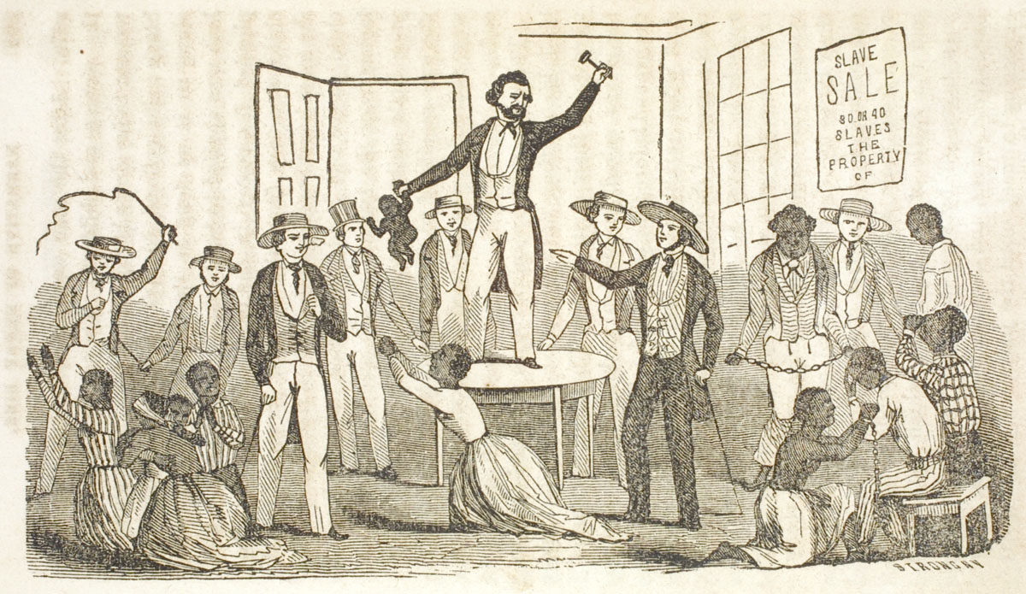
Plantation owners considered slaves to be their property and they were often sold without warning.

Slide 15
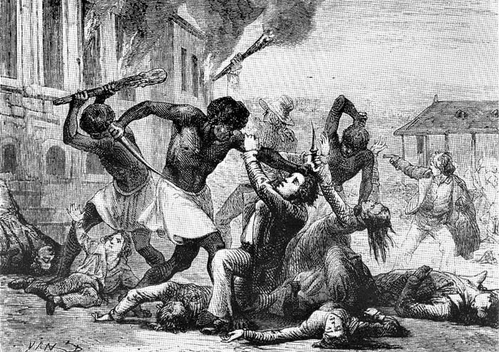
Slaves wanted to acquire their freedom from plantation owners. Some enslaved Africans rebelled against the poor living conditions and abusive treatment of some slave owners.

Slide 16
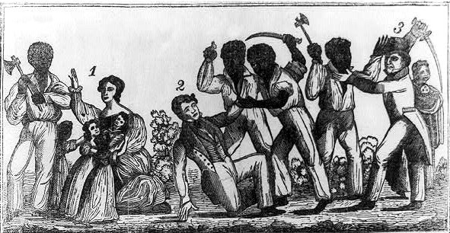
However, slave revolts like South Carolina’s Stono Rebellion (the largest in the colonial period in mainland British colonies), were largely unsuccessful.

Slide 17
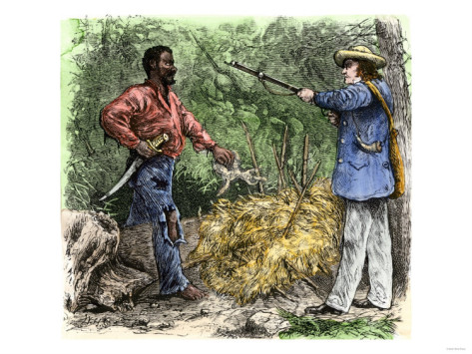
Some were discovered before the revolt could be carried out; others were quickly and brutally put down

Slide 18
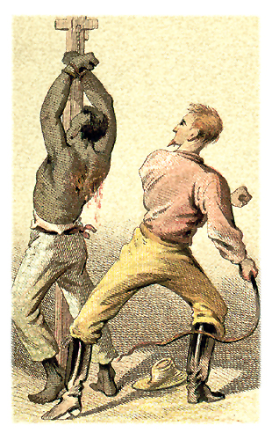
The result was harsher regulation and control of the slave population and the introduction of slave codes.

Slide 19
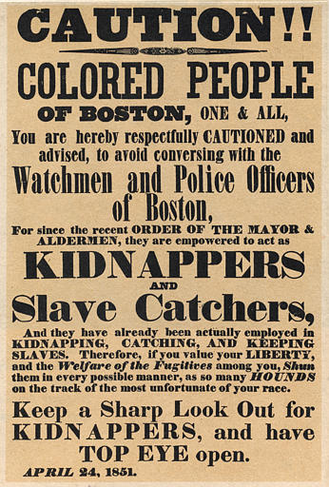
Slave codes were used to regulate and monitor the behavior of slaves in the colonies. The codes included rules such as limited education, purchases, and ability to sell goods.

Slide 20
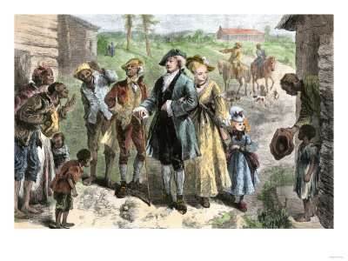
Slaves were also not allowed to travel without their master’s permission

Slide 21
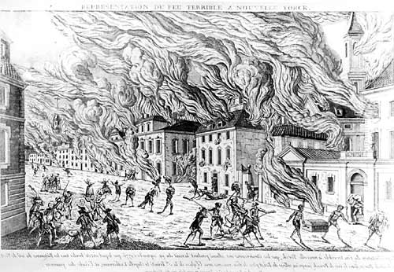
Such revolts also made the slave owners and the white population more fearful of the enslaved African population because the enslaved population already outnumbered the free population.

Slide 22
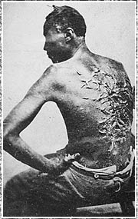
In order to maintain an oppressive system, some Southerners used violence and intimidation.

Slide 23
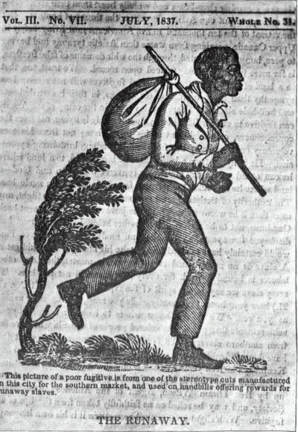
Although slaves continued to resist their captivity through work slowdowns, feigned illnesses, breaking tools, and running away, few were successful in escaping the bonds of slavery. Some slaves did escape the bonds of slavery by heading north

Slide 24
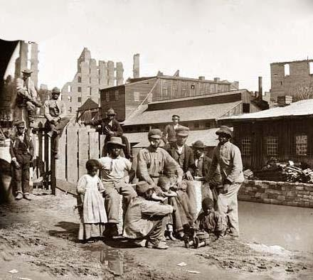
Still some in the north were able to work to purchase their freedom and the freedom of other slaves. These free Africans were able to find work as artisans or apprentices in the New England colonies.

